Slide 1
Let’s go shopping!
Выполнила:
Кушина Э.С.
учитель английского языка
МБОУ СОШ № 13
г.Волжский Волгоградская область

Slide 2




Мое настроение

Slide 3
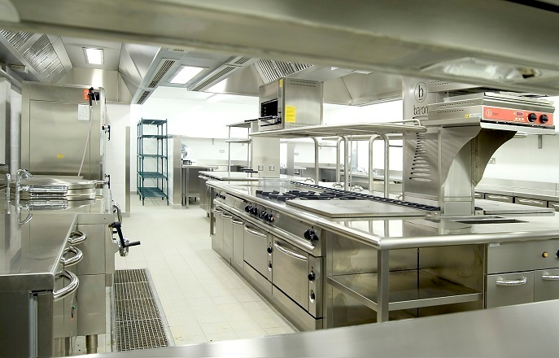

Hello, I’m Mr. Cook!

Slide 4


Фонетическая зарядка:
[p] – porridge, please, potato
[w] – would, would you like
[dз]- sandwich, porridge
[h] –have, honey, here, here you are
[i:] – sweet, meat, please

Slide 5
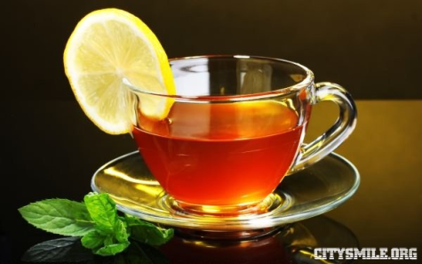
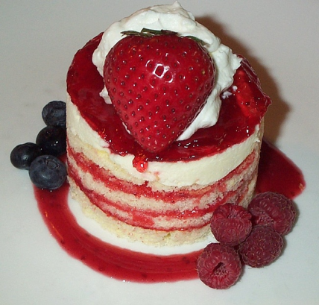
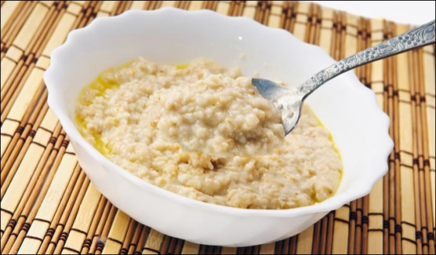
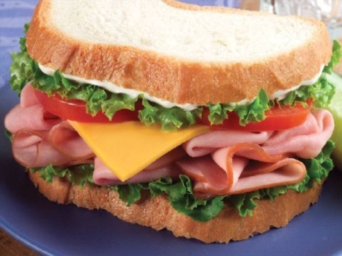

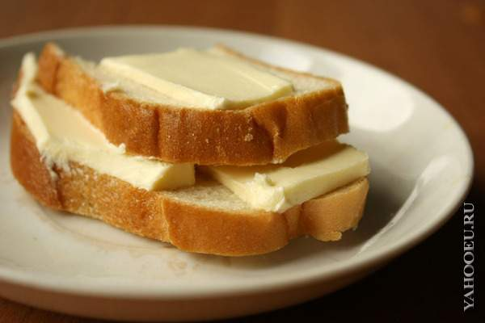


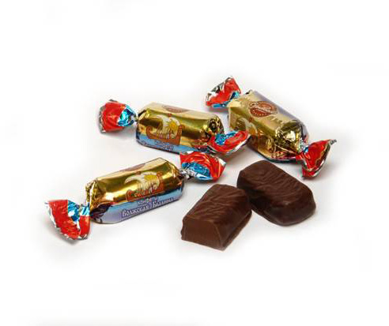
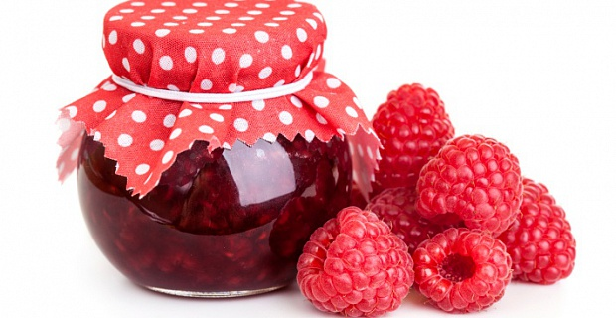
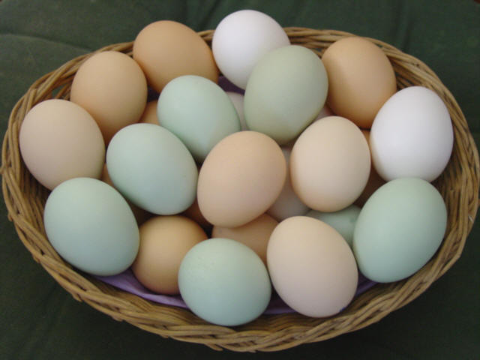

I like… for breakfast

Slide 6
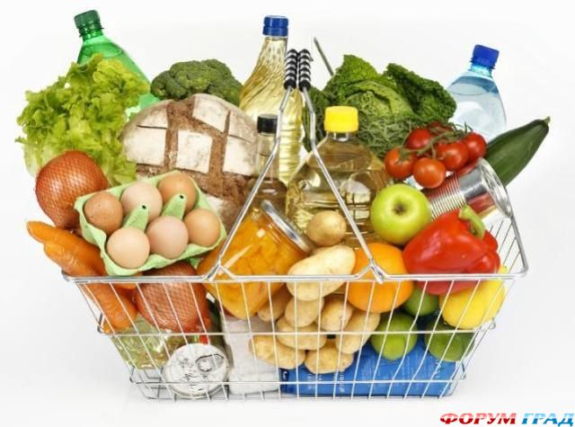
Let’s go shopping!

Slide 7

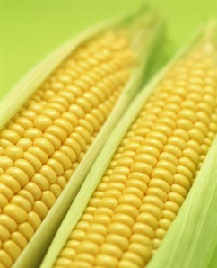

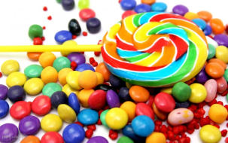
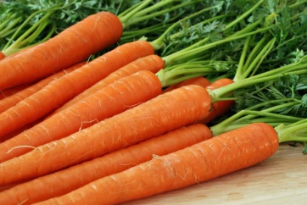
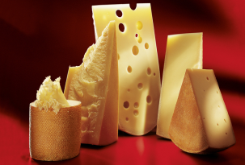


List of food
C | O | F | F | E | E | C
O | M | I | L | K | H | A
R | P | E | N | A | E | R
N | G | H | A | T | N | R
S | W | E | E | T | S | O
C | H | E | E | S | E | T
B | U | T | T | E | R | A

Slide 8
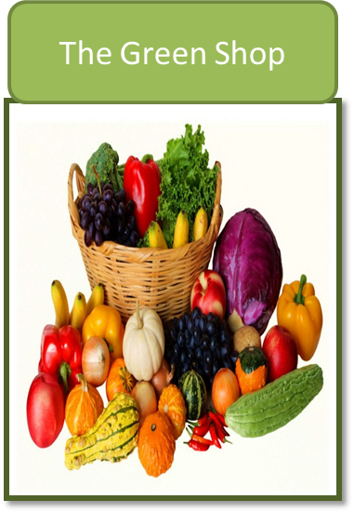
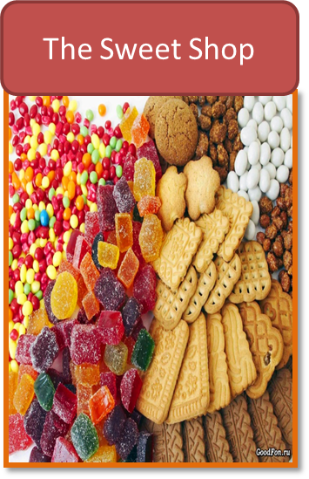
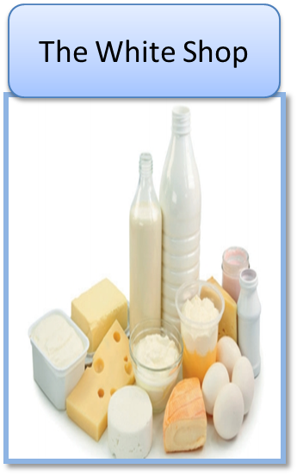
Shops
tomatoes
sweets
milk
apples
tea
eggs
bananas
cake
butter
cabbage
coffee
cheese
lemons
honey
Ice - cream
oranges
jam
carrots

Slide 9


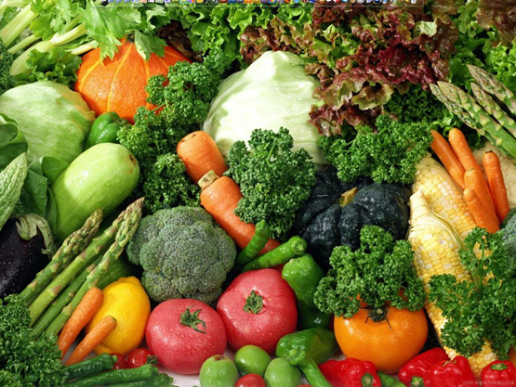
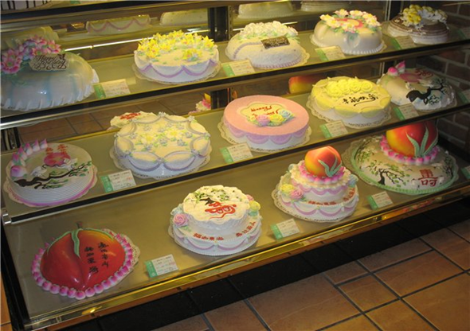

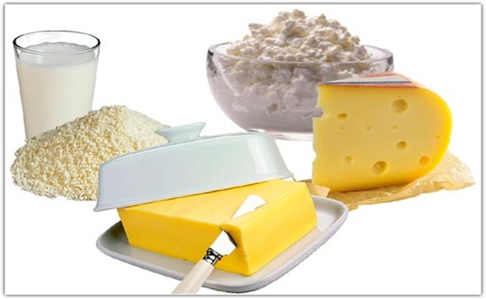
I can buy … in …

Slide 10
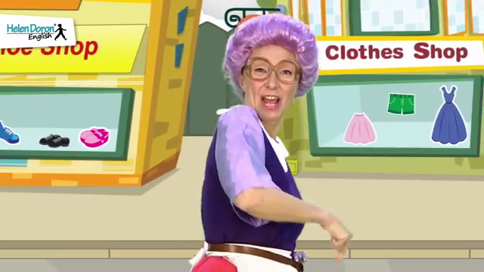

Slide 11
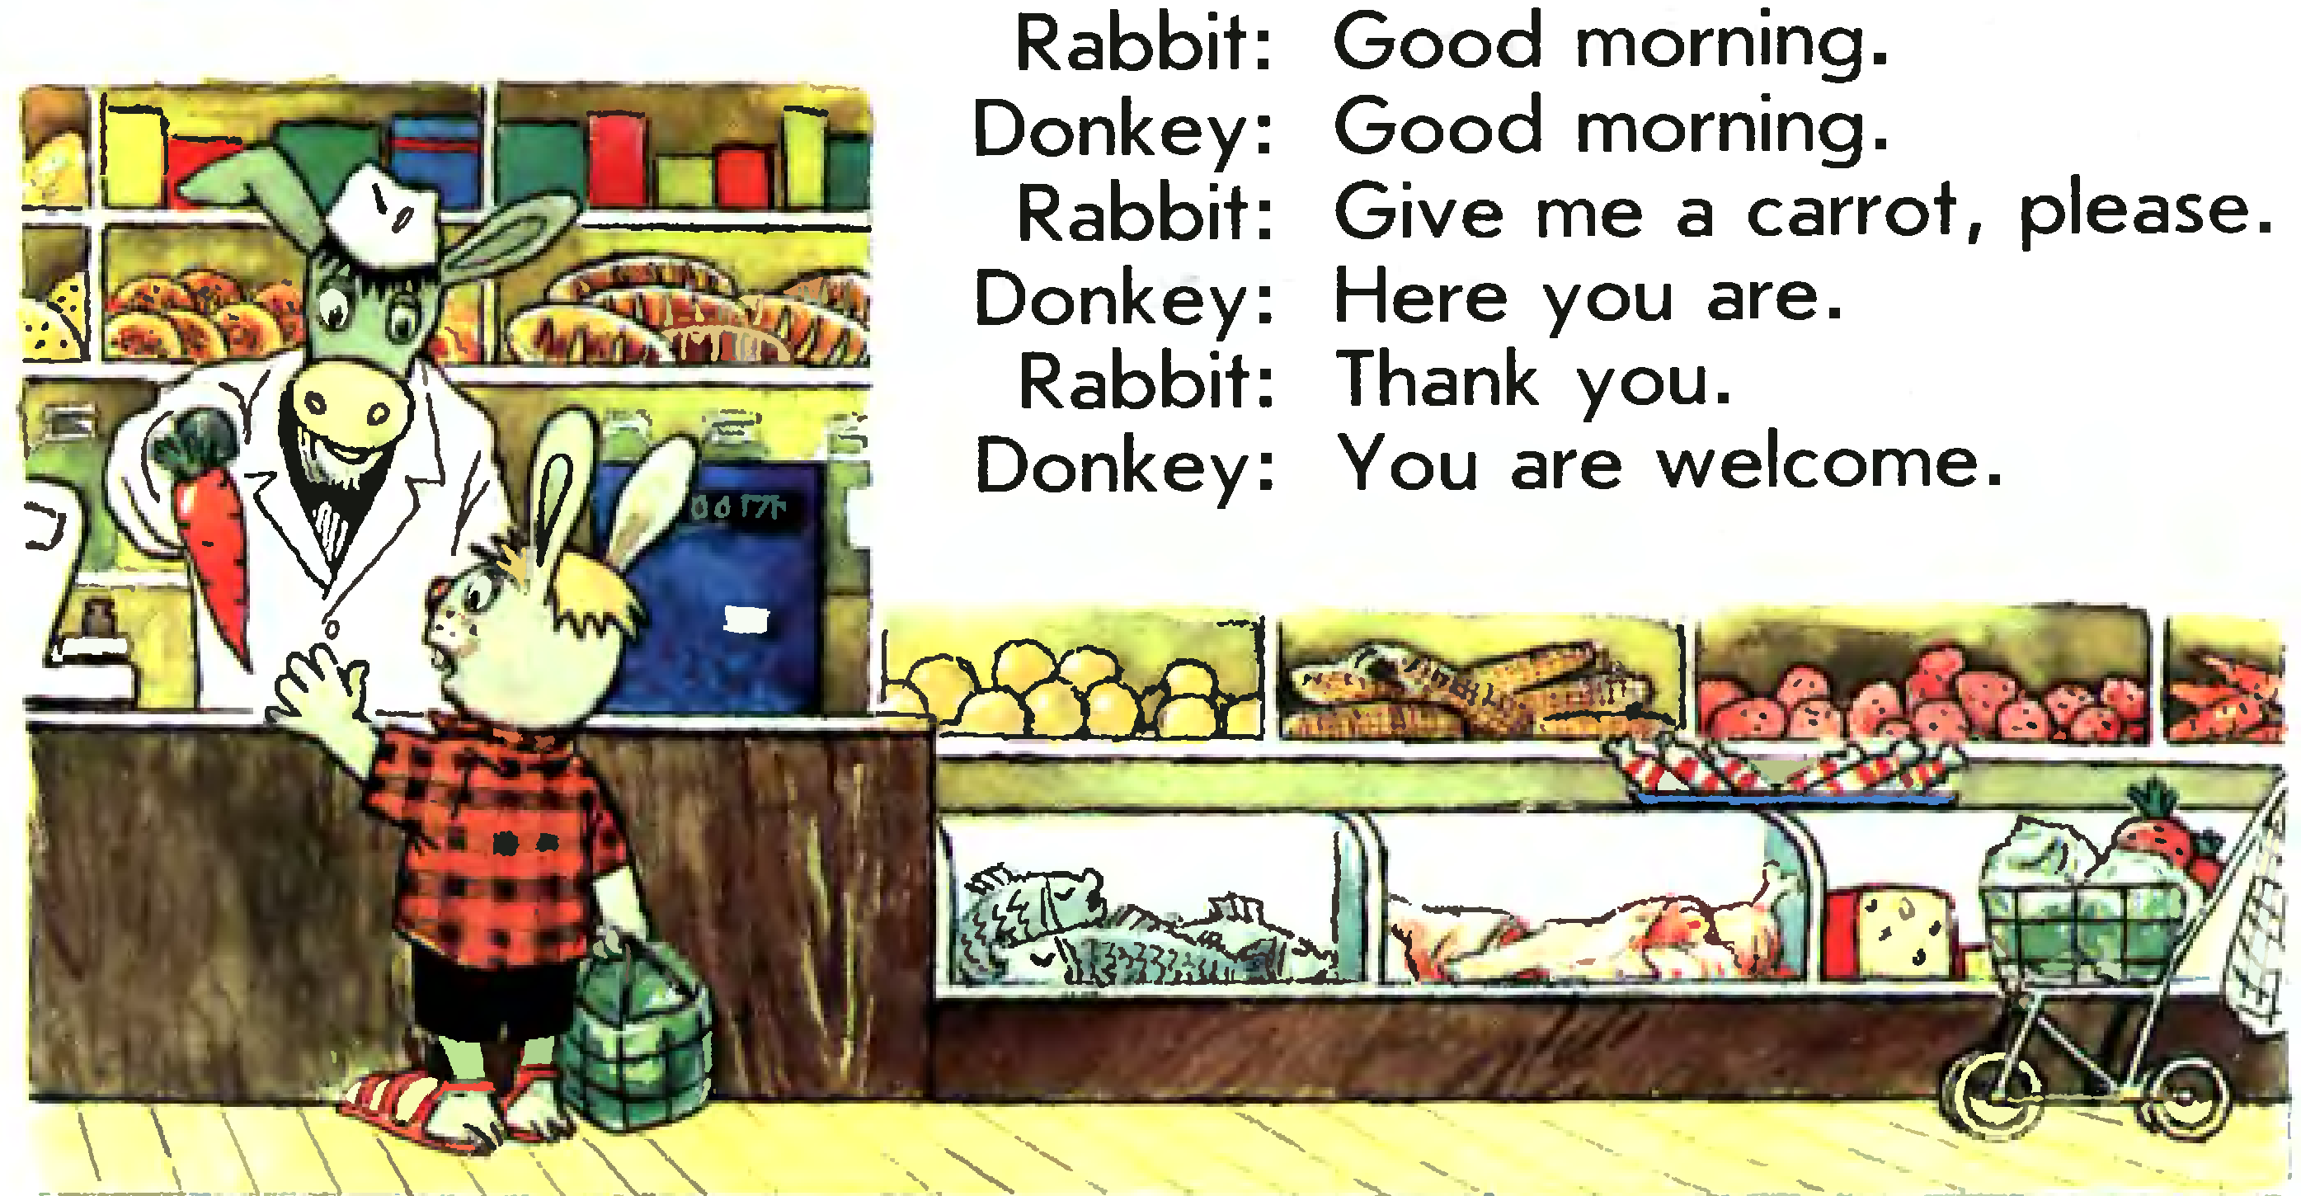


Slide 12

Make up a dialogue
Hello!
You are welcome!
Give me a carrot, please.
Good morning!
Here you are!
Thank you!

Slide 13
Make up a dialogue
- Give me a carrot, please
- You are welcome!
- Hello!
- Here you are!
- Good morning
- Thank you!

Slide 14
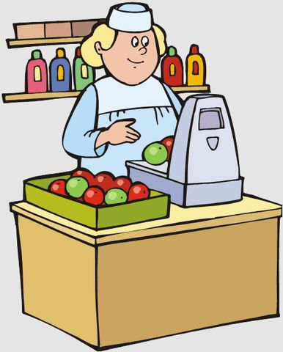
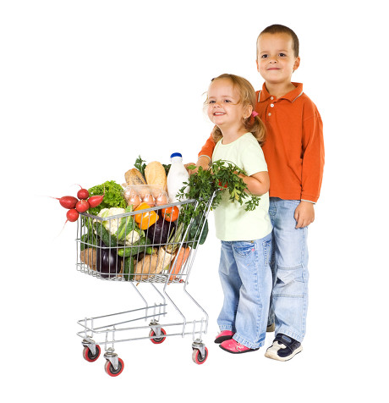
Hello!
Good morning!
Give me a carrot, please.
Here you are!
Thank you.
You are welcome!

Slide 15
Сегодня на уроке…
Я узнал….
Я вспомнил…
Легче всего мне было…
Для меня было особенно трудно…..
Самым интересным на уроке было….

Slide 16


