Slide 1
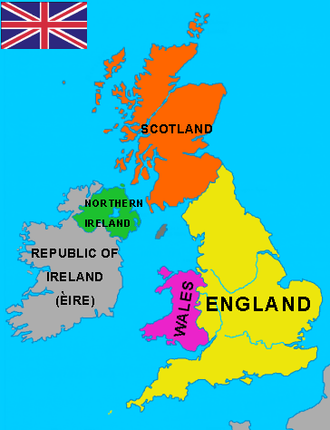

Slide 2
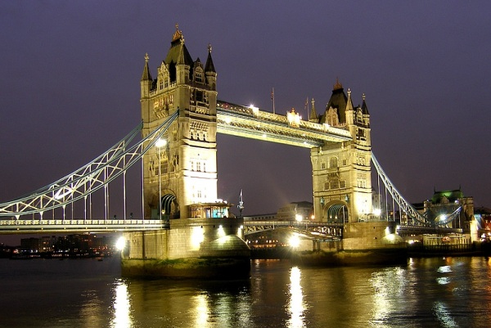
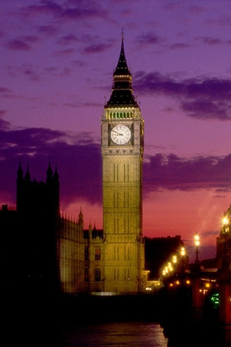
England

Slide 3
Capital London
Population 10 million
Area 129634
Nationality English
Official language English
Major cities London
Birmingham
Liverpool,
Manchester, Leeds
Location Europe
Borders Scotland, Wales

Slide 4
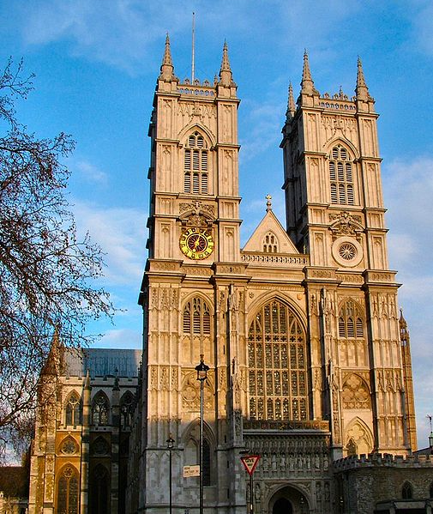
London’s Places of Interest
The Houses of Parliament
Westminster Abbey

Slide 5
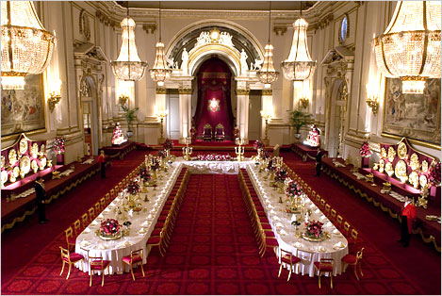
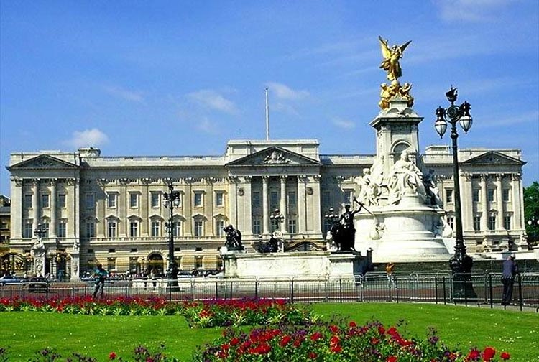
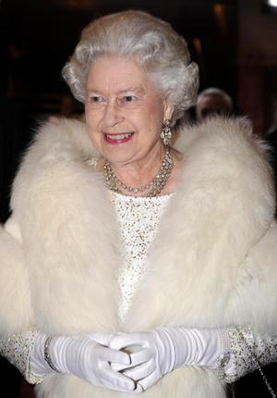
Buckingham Palace

Slide 6
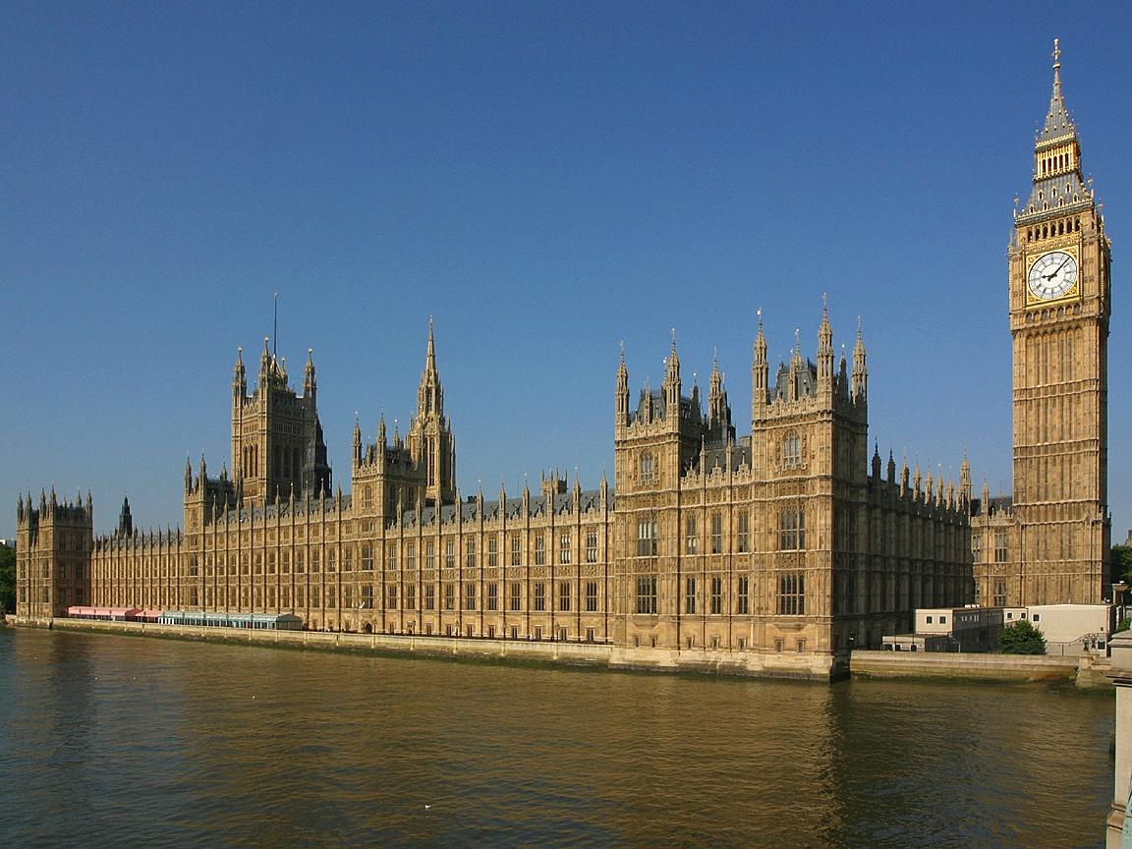
Houses of Parliament

Slide 7
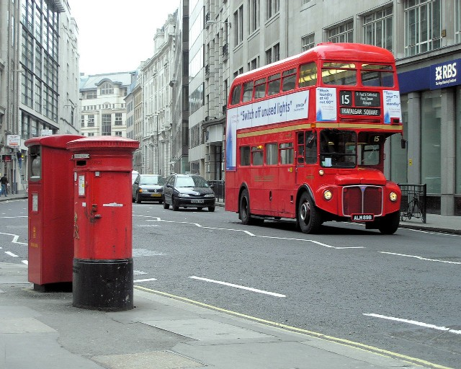
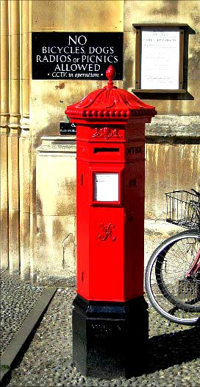
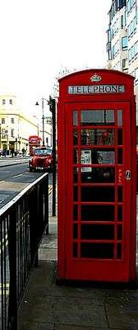
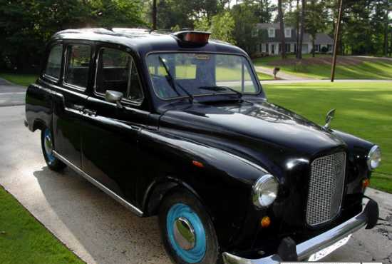
Double-decker bus
A Post box
A Telephone
box
Black cabs. London taxi

Slide 8
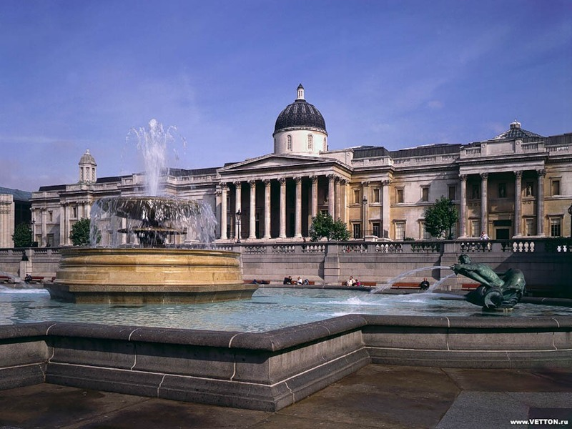
The national Gallery

Slide 9
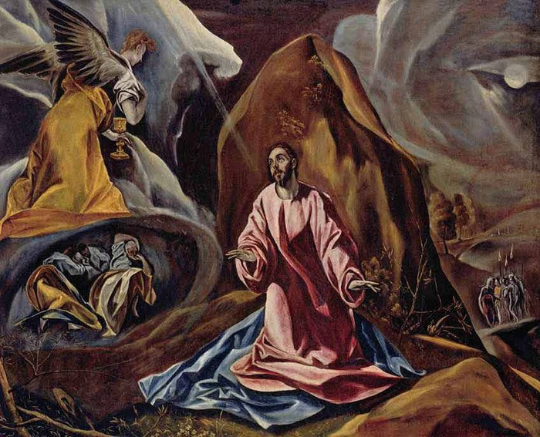
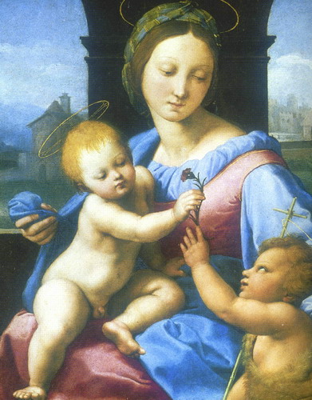
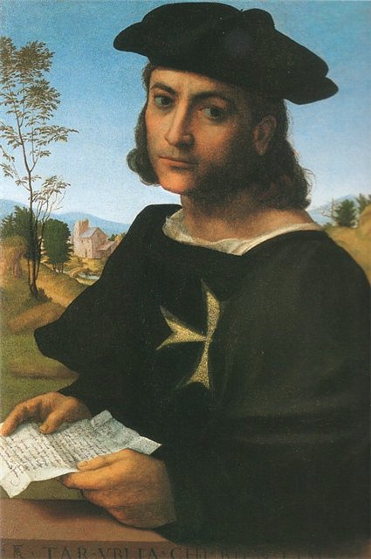
Pictures of the
National Gallery

Slide 10
The End

