Slide 1
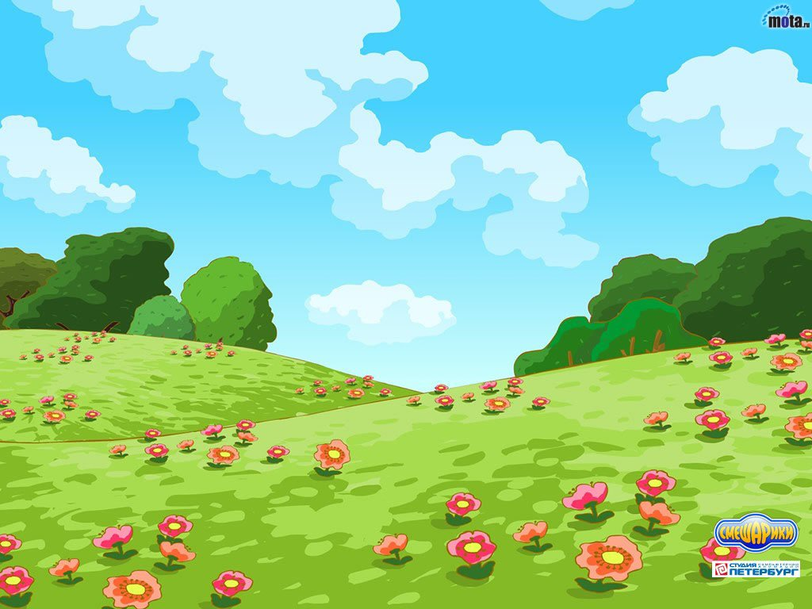
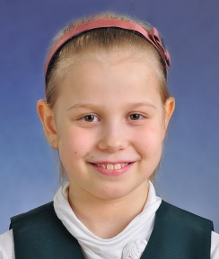
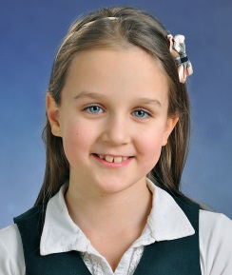
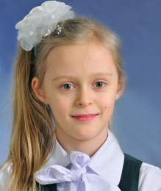
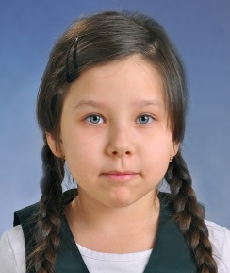
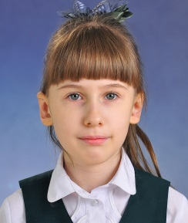
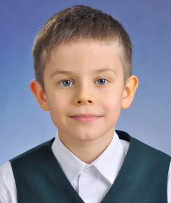
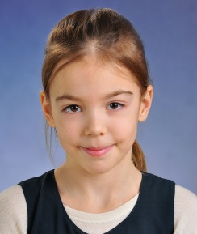
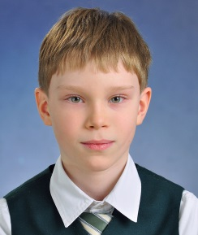
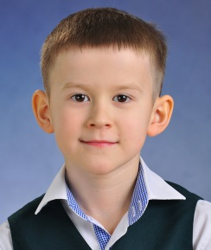
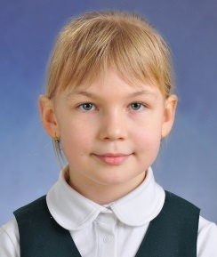
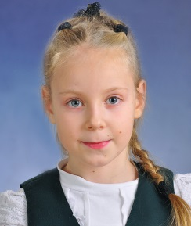
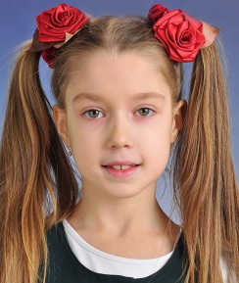
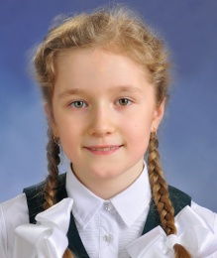

Slide 2
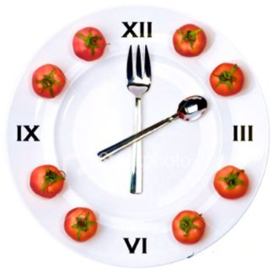
DAILY LIFE

Slide 3
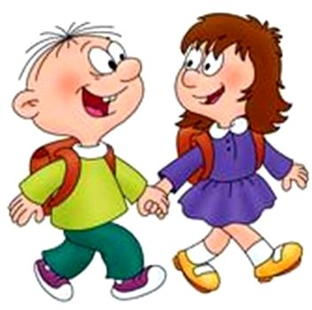
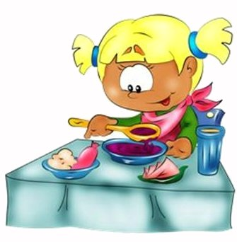
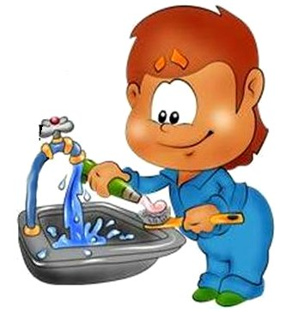
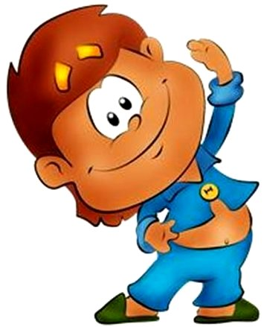
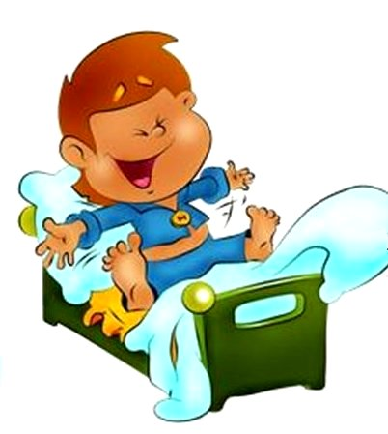
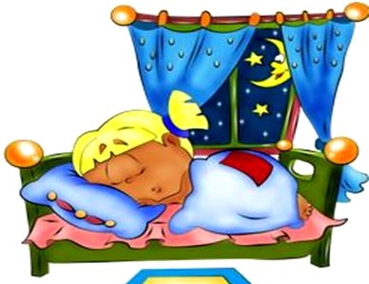
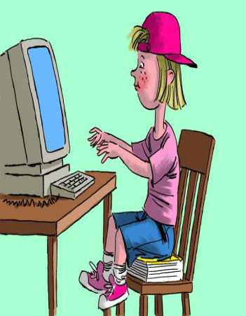
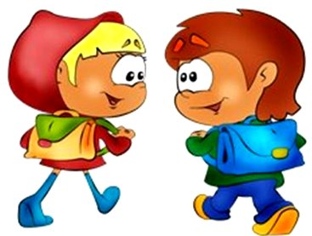
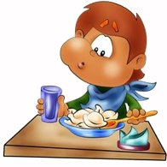
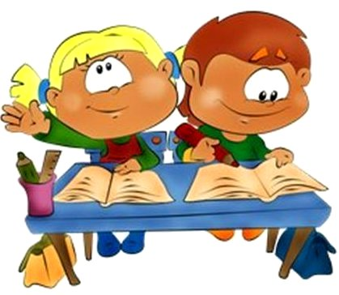
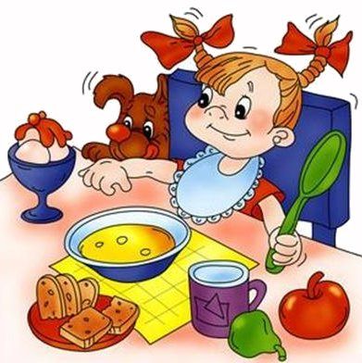
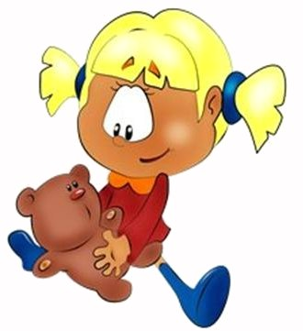
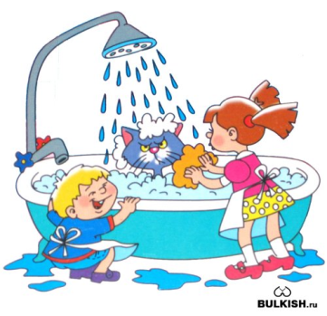

Slide 4
When do you usually get up?
get up

Slide 5
Do you do your morning exercises every day?
do morning exercises

Slide 6
What do you do in the bathroom?
wash a face, hands and ears

Slide 7
Do you always clean your teeth in the morning?
clean teeth

Slide 8
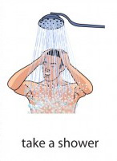
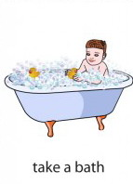
How often do you take a shower?
take a shower

Slide 9
What time do you usually have breakfast?
have breakfast

Slide 10
Do you usually go to school
at 8 or at 9 o´clock in the morning?
go to school

Slide 11
How many lessons do you usually have at school?
have many lessons at school

Slide 12
When do you come home
from school?
come home from school

Slide 13
Where do you usually have dinner?
have dinner

Slide 14
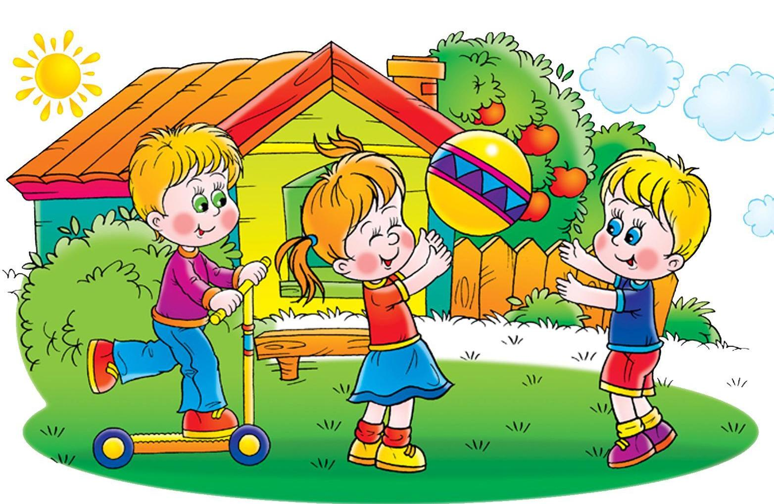
Whom do you go for a walk with?
go for a walk

Slide 15
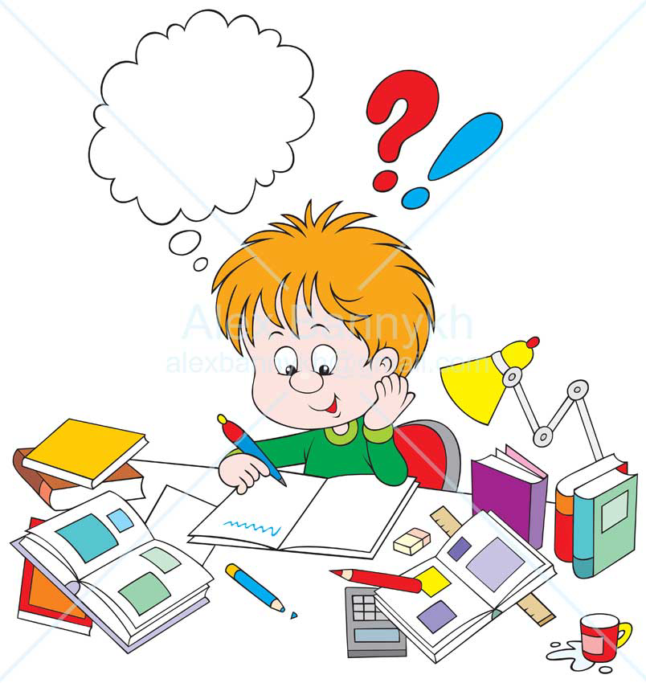
When do you do your homework?
do homework

Slide 16
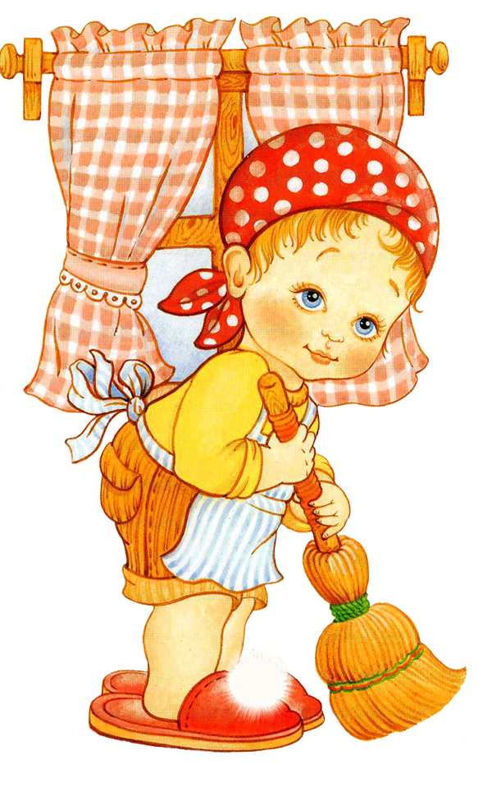
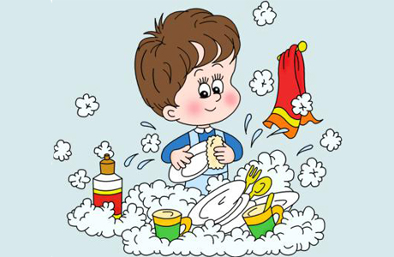
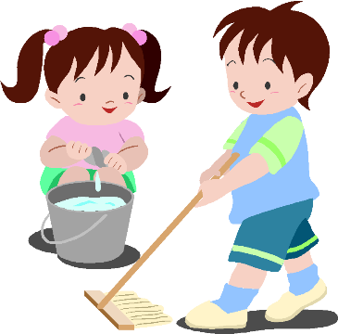
What do you do to help your mother about the house?
Sweep the floor, wash the dishes, water the flowers,
dust the furniture

Slide 17
Who has supper at 7 o´clock in the evening?
have supper

Slide 18
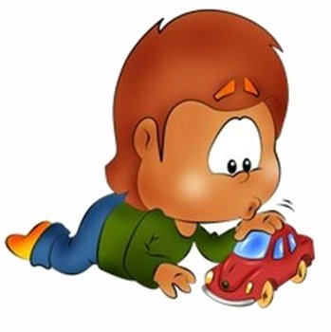
What do you usually do in the evening?
play with toys,
read books, watch TV,
play computer games

Slide 19
Do you go to bed early or late?
go to bed

Slide 20
Morning
Af
t
ernoon
Evening

Slide 21
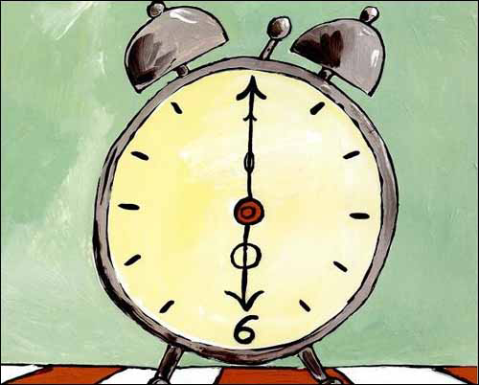
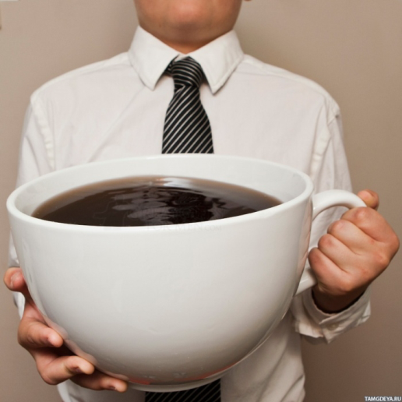
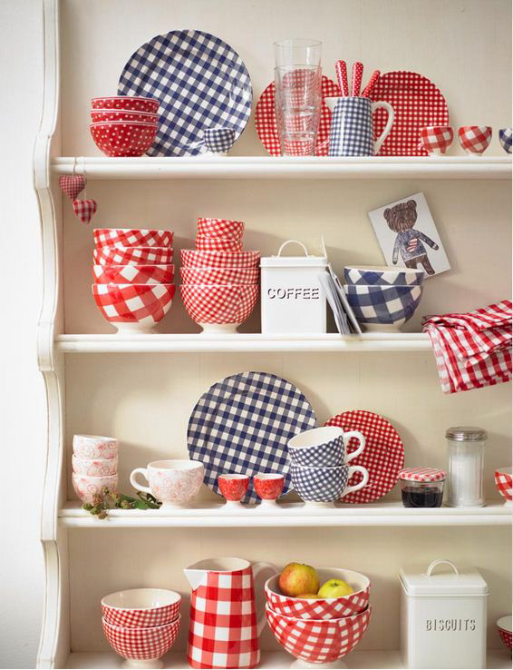
Bob _____ ___ at 6 o´clock,
He never ______ ___ late,
He always _____ ___ early,
He never _____ till 8.
He always _____ his coffee black,
He never _____ cream,
He rarely _____ a sleepless night,
He never _____ a dream.
He _____ his breakfast dishes
And _____ them on the shelf,
_____ around the kitchen
Humming to himself.

Slide 22
Bob gets up at 6 o´clock,
He never wakes up late,
He always gets up early,
He never sleeps till 8.
He always drinks his coffee black,
He never uses cream,
He rarely has a sleepless night,
He never has a dream.
He does his breakfast dishes
And puts them on the shelf,
Walks around the kitchen
Humming to himself.

Slide 23
KROSH
gets up late
has carrots for breakfast
cleans his teeth
eats carrots again
goes fishing
doesn’t usually have dinner
visits his friend Hedgehog or plays football or flies a kite
has a big meal for supper
plays games at 3 o’clock in the morning
goes to bed late

Slide 24
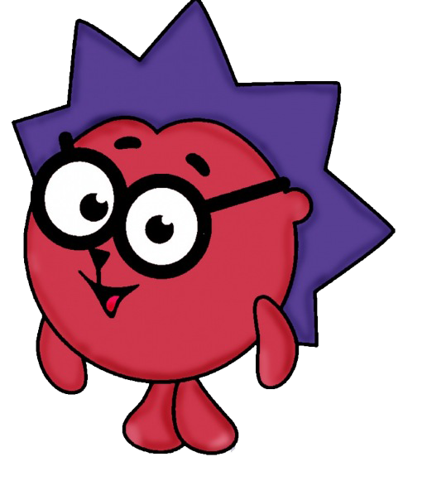
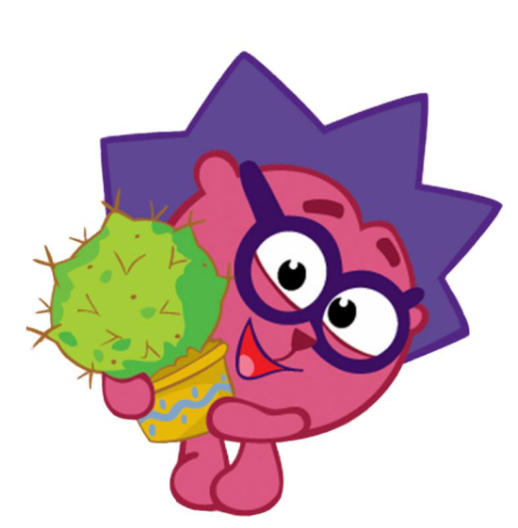
HEDGEHOG
gets up at 7 o’clock in the morning
washes his face
has breakfast
waters cactuses
goes for a walk with Krosh
has dinner
washes the dishes
cleans his house in the evening
has supper
reads a book
goes to bed early

Slide 25
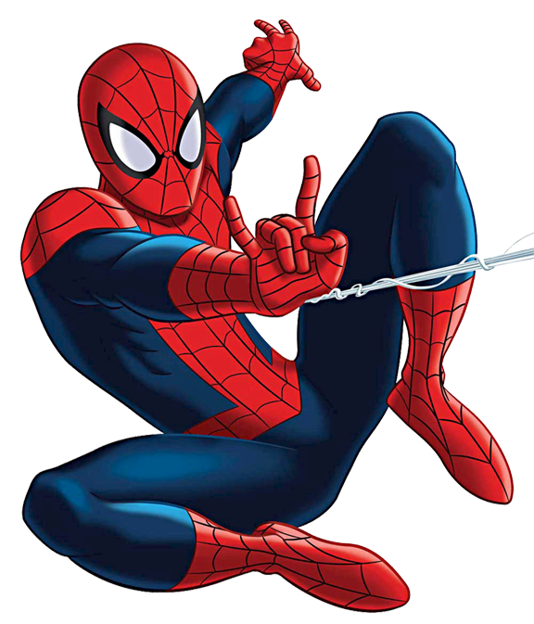
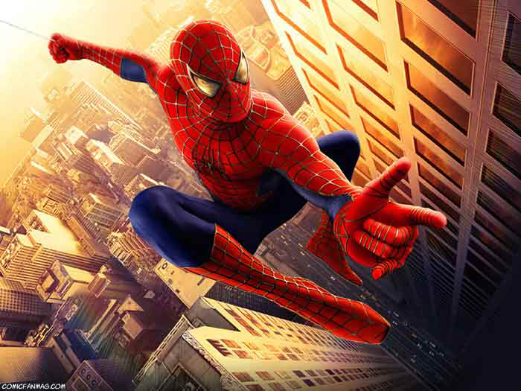
SPIDERMAN
gets up early
does his morning exercises
takes a shower
has breakfast
climbs houses
has dinner
solves puzzles
saves the world
has supper
goes to bed

Slide 26
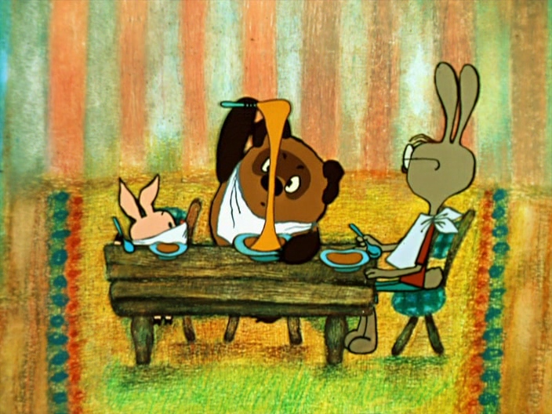
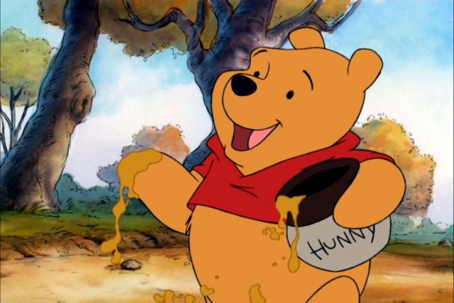
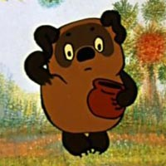
WINNIE-THE-POOH
gets up late
washes his face
sings songs
goes to see his friends in the morning
eats honey for breakfast and dinner
goes for walks with his friends
climbs trees to get honey
sings songs again
eats honey for supper
goes to bed

Slide 27
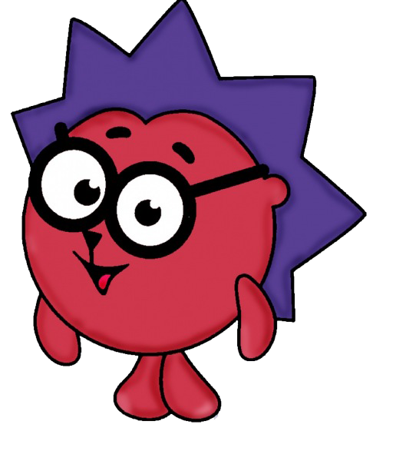
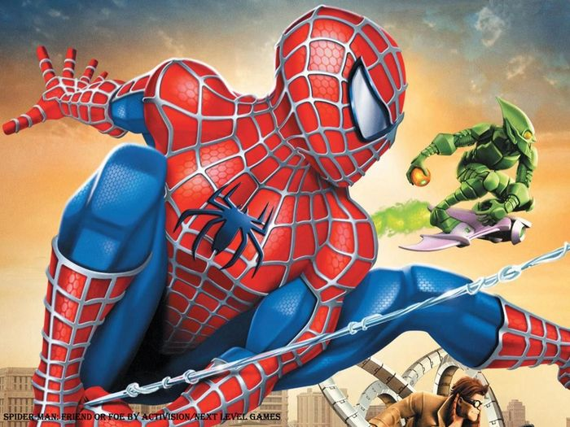
KROSH
HEDGEHOG
SPIDERMAN
WINNIE-THE-POOH

Slide 28
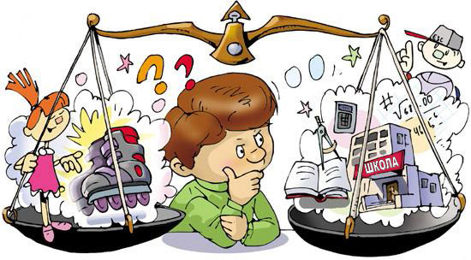
If you plan your day in the right way
You always know time to work
and time to play,
You can do a lot of things,
You feel healthy, cheerful and gay,
You are happy all the day!

Slide 29
Thank you for the lesson!

