Slide 1
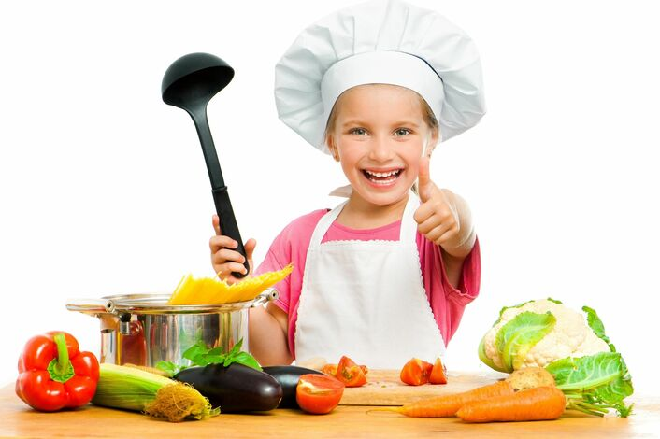
My favourite food
Выполнила учитель английского языка: Павелковская Н.С.
МБОУ Петрово-Дальневская СОШ
2019 г.

Slide 2
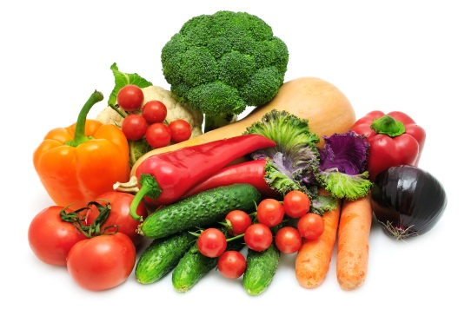
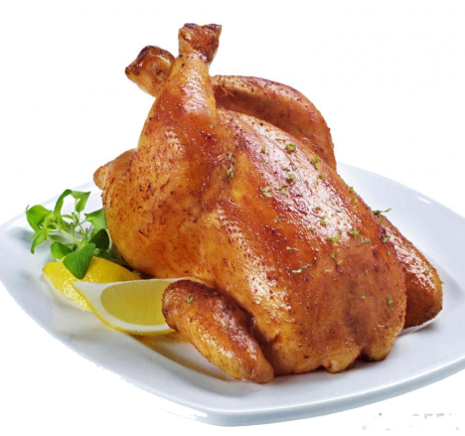
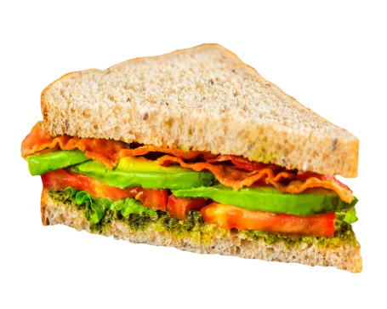
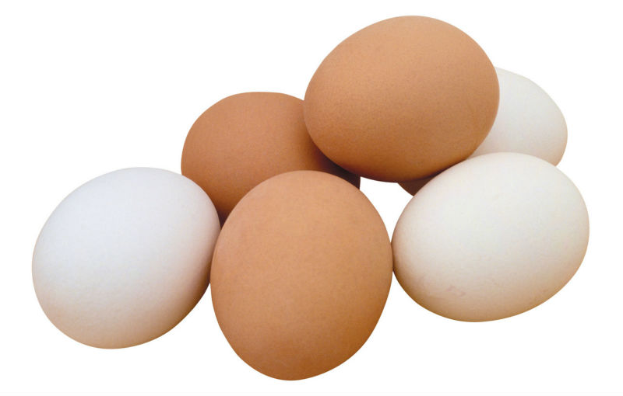
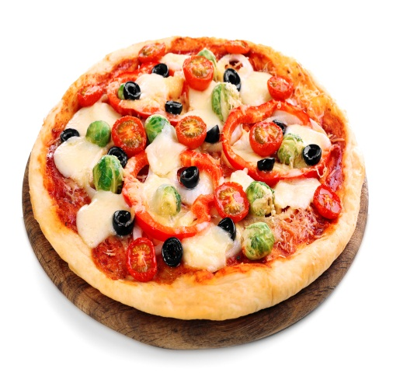
Food
vegetables
chicken
burger
sandwich
pizza
eggs

Slide 3
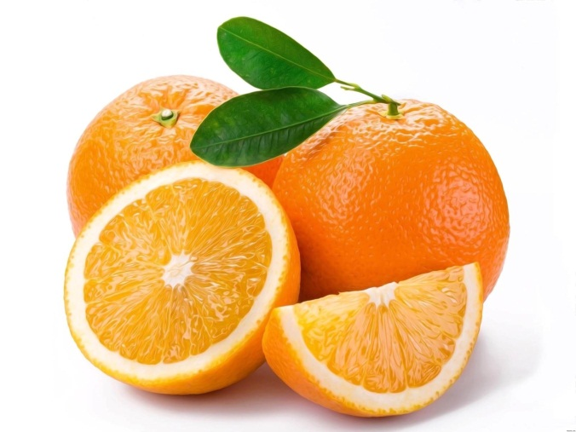
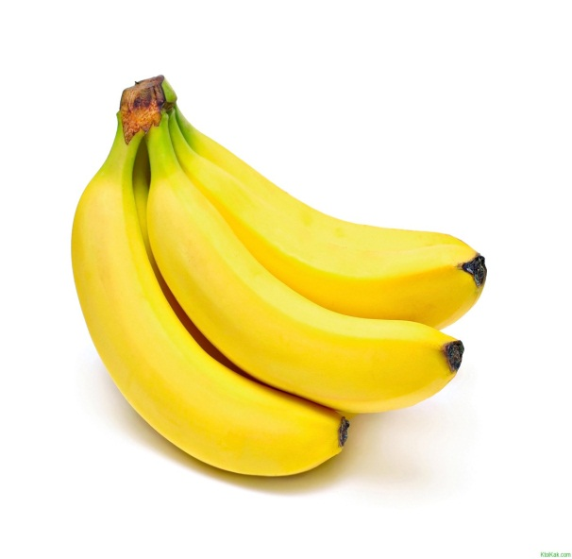
fruits
apples
oranges
bananas

Slide 4
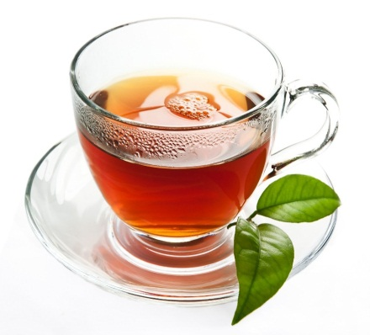
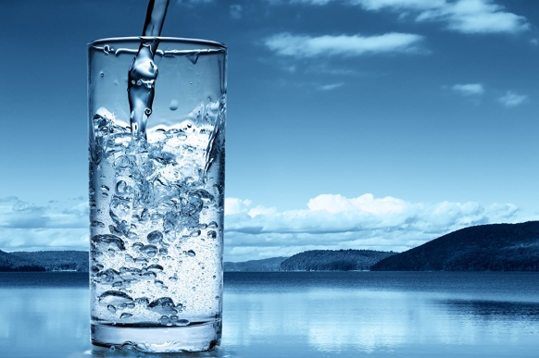
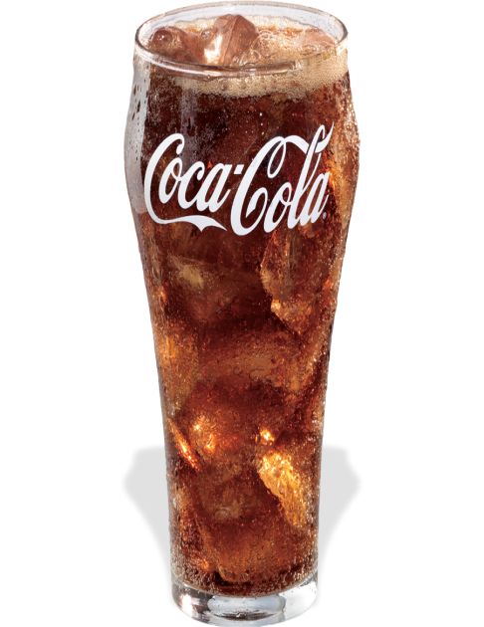
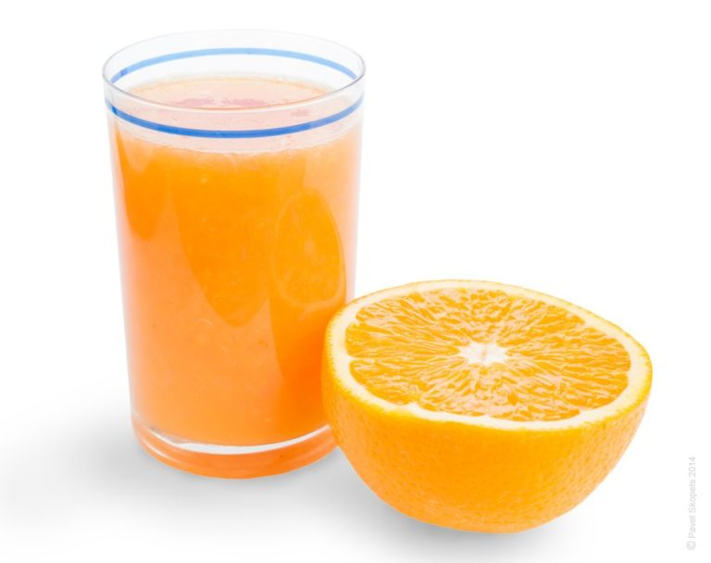
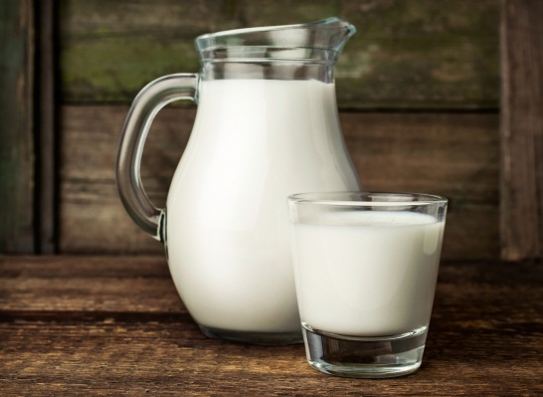
drinks
tea
water
lemonade
orange juice
milk
Coke

Slide 5
What is it?
It’s a ___________(breugr).
It’s an ____________(plpae).
It’s a _____________(asdnwchi).
It’s a______________(bannan).
It’s an_____________(raoeng).
It’s an _____________(geg).

Slide 6
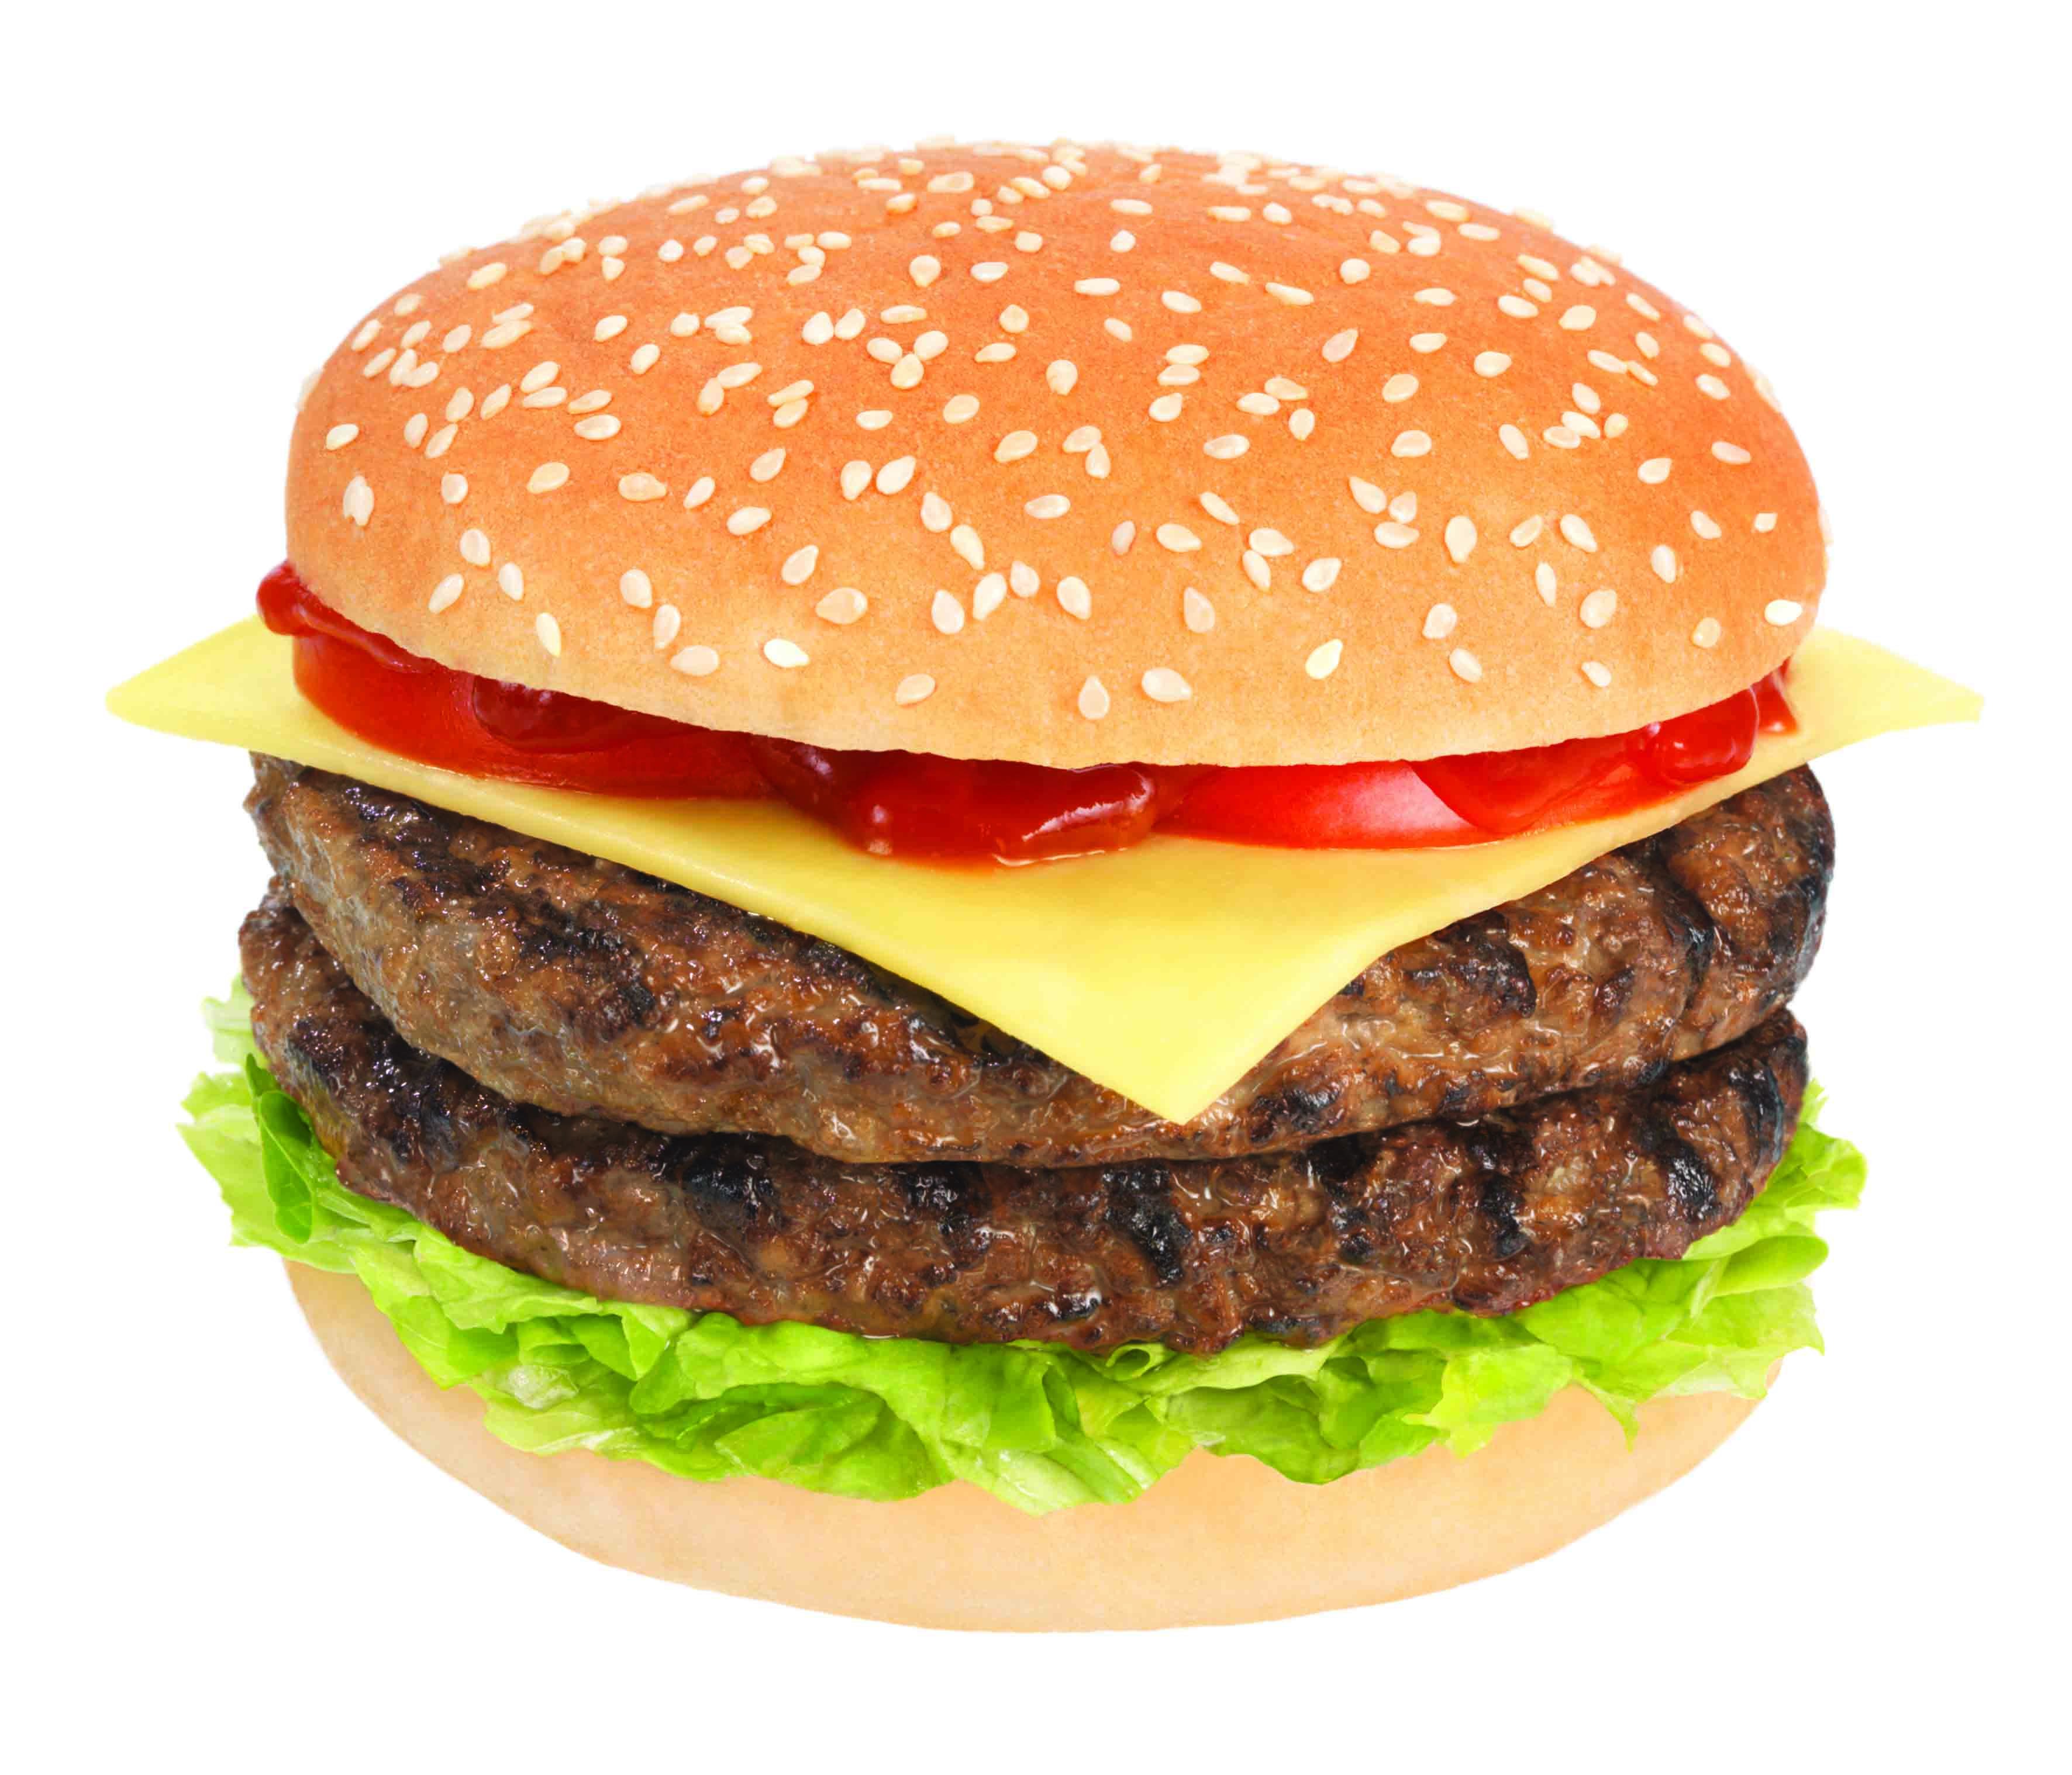
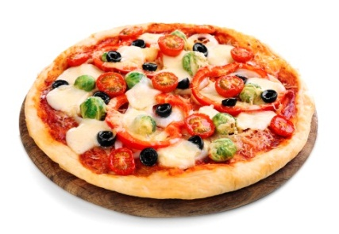
What’s your favorite food?
My favorite food is … .

Slide 7
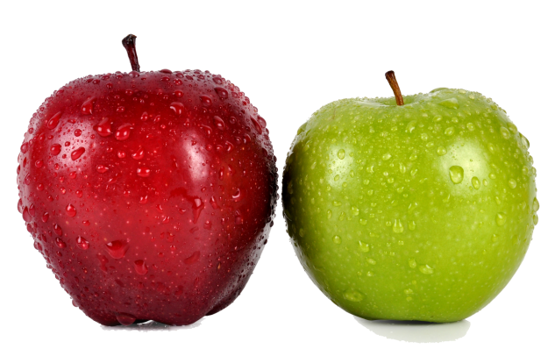
What’s your favorite fruit?
My favorite fruit is … .

Slide 8
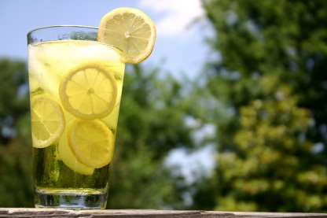
What’s your favorite drink?
My favorite drink is … .

Slide 9
Do you like … ?
-Yes, I do./No, I don’t.
1)
2)
3)
4)
-Yes, I do./No, I don’t.
-Yes, I do./No, I don’t.
-Yes, I do./No, I don’t.

Slide 10
Thank you for attention!

