Slide 1
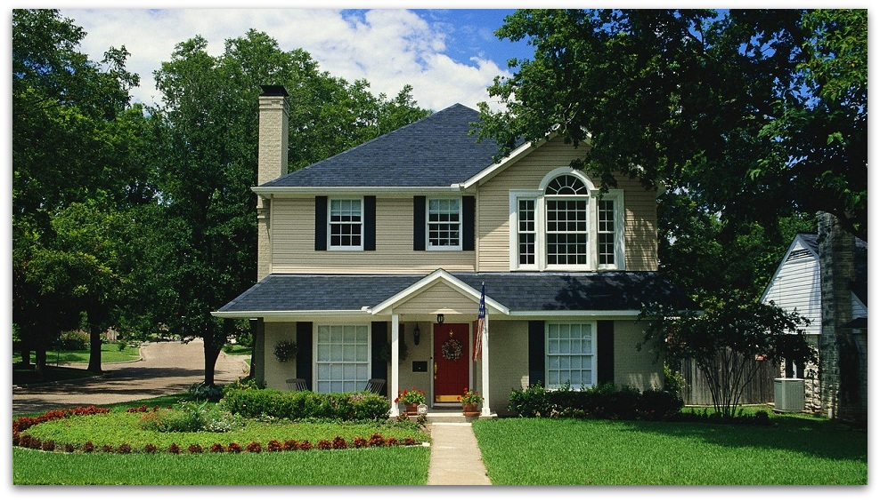
There is no place like home

Slide 2
My House
Let's go to my house.
Let's go today.
I'll show you all the rooms
Where we work and play.
Here is the kitchen
Where Mother cooks for me.
Here is the living room
Where I watch TV.
Here is the dining room.
We eat here every day.
And this room is my room
Where I sleep and play.

Slide 3
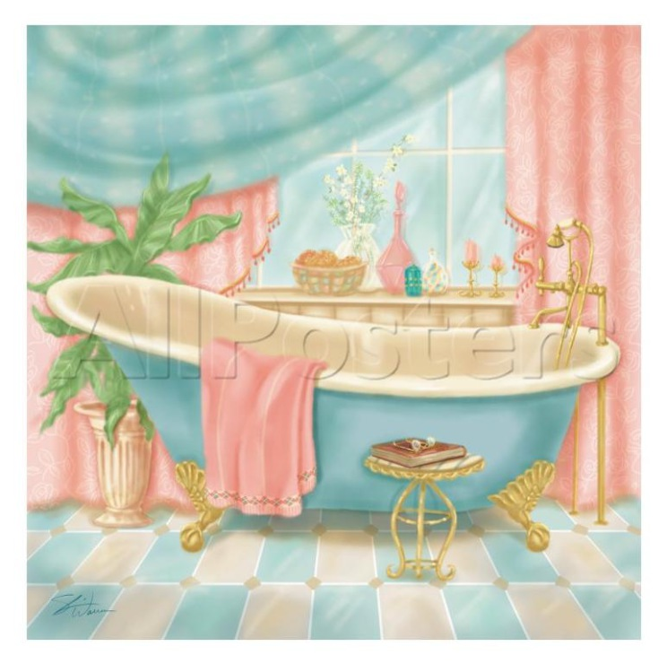
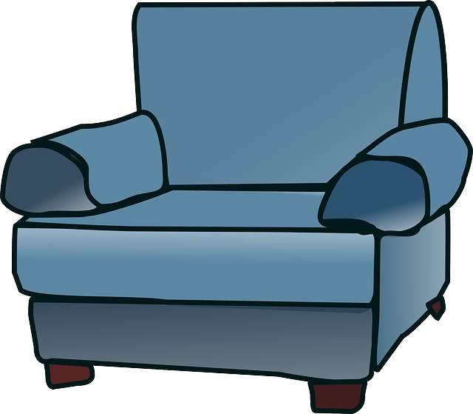
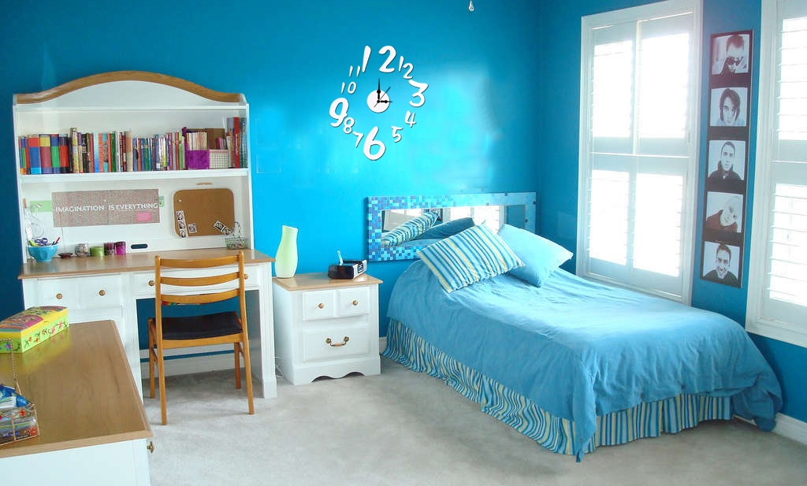
armchair
bathroom
bedroom

Slide 4
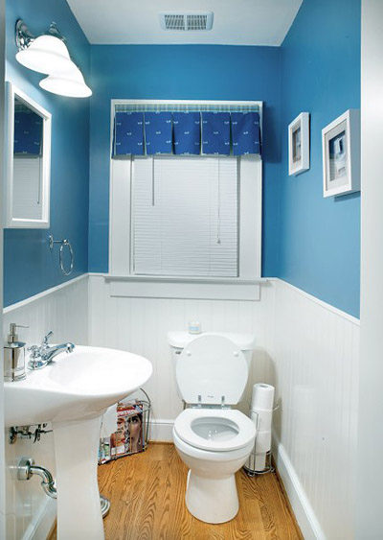
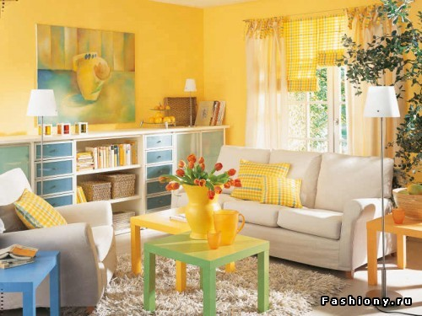
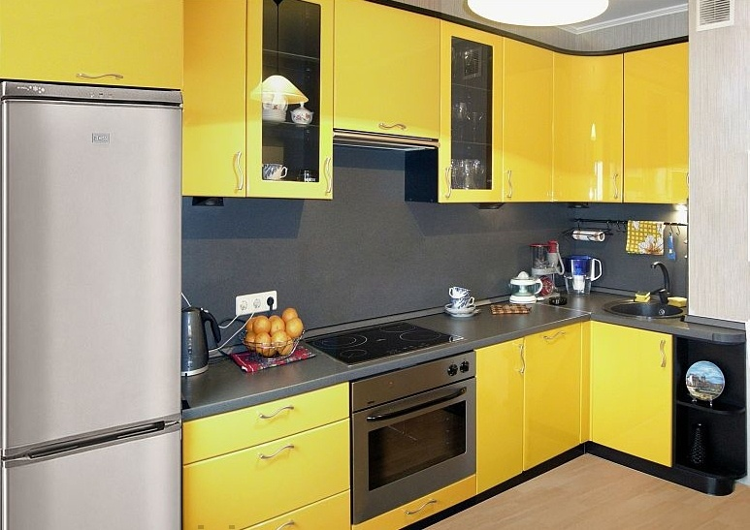
living room
living room
toilet
flat – квартира
house - дом
kitchen

Slide 5
What have you got in your house?
I have got …….. in my house.
(В моем доме есть...)
an armchair,
a chair, a sofa, a bedroom
a table,a bathroom,
a toilet, a living room, a kitchen

Slide 6
the ground floor – 1 этаж
the first floor – 2 этаж
the second floor – 3 этаж
Where do you live?
I live in the …….. .Я живу в(на)...

Slide 7
Repeat the words:
Ghosts - призраки
Downstairs – внизу
Upstairs - наверху
Other - другой

Slide 8
Now answer the questions. Choose the correct item:
1. What are the names of 2 ghosts?Как зовут призраков?
a)-Lizzy and Ziv; b)-Foxy and Rick;
2. Where do they live? Где они живут?
a)in a big new house; b) in a big old house;
3. Where does Lizzy like to play? Где Лиззи любит играть?
a)upstairs; b) downstairs;
4. What does Ziv like to do upstairs? Что Зиву нравится делать наверху?
a) jump; b) play

Slide 9
Homework
S/B p. 28 ex. 4 (b) читать, переводить
p. 29 записать в словарь и выуч.новые слова

