Slide 1
Тещина Лилия Васильевна
МКОУ Орловская СОШ им. И.Ф. Жужукина,
Учитель английского языка
Презентация
«Как хорошо я знаю …» (КВН)

Slide 2
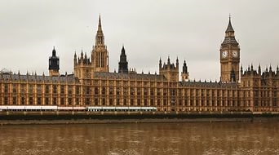
How well I know …

Slide 3
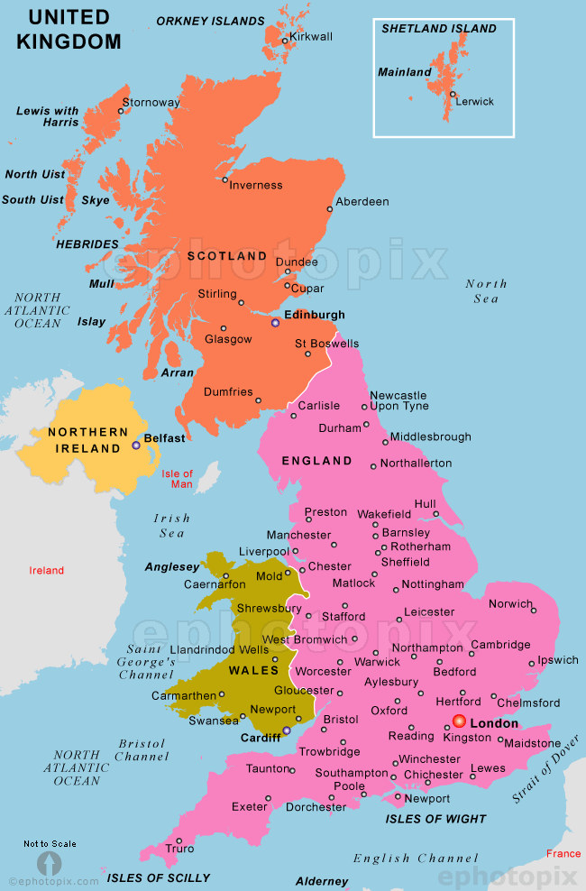
What is the full name of the country?
The United Kingdom
of Great Britain and
Northern Ireland.

Slide 4
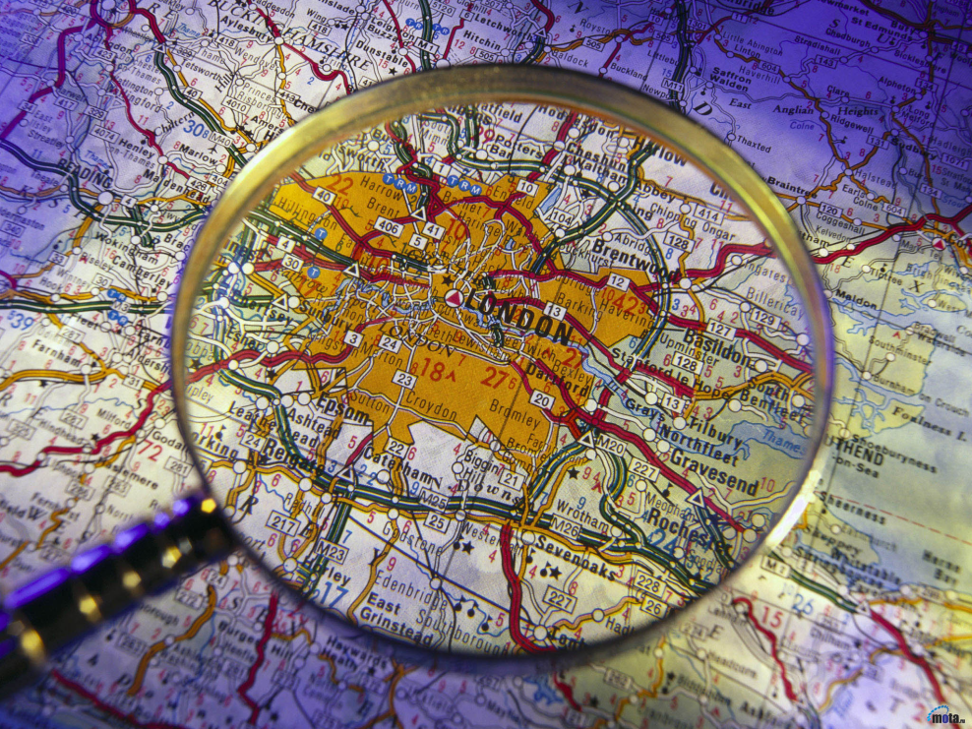
What’s the capital of the country?
London.
The Romans founded
it more than
2000years ago.

Slide 5
Match the countries with their capitals.
England.
Scotland.
Wales.
Northern
Ireland.
Cardiff.
Belfast.
London.
Edinburgh.

Slide 6
Match the countries with their emblems.
England.
Scotland.
Wales.
Northern
Ireland.
a)Thistle.
b)Red rose.
c)Clover.
d)Daffodil.

Slide 7
What’s the flag of the UK?
1.
2.
3.
4.
5.

Slide 8
What’s the name of the flag?
John Bull.
The Union Jack.
The Stars and Stripes.

Slide 9
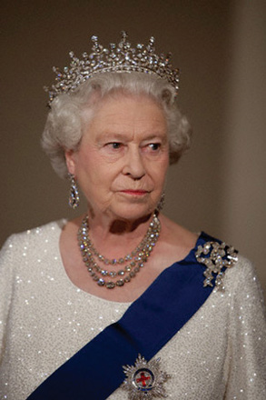
Who is the Queen of the UK?
Elizabeth the Second.
Eleanor the Second.
Elizabeth the First.

Slide 10
What’s traditional Christmas food?
Turkey and pudding.
Fish and chips
Cakes and fruit.

Slide 11
Puts the parts of the stories in the correct order.
a)Suddenly a huge creature jumped in front of us.
“Don’t be afraid, it’s an owl (сова)”, said a woman. She
said that her name was Mrs. Shade. She gave children
some treats.
b)It was Halloween night so my sisters and I decided to go trick or treating.
c)When we came home our mum was worried. “Where
were you?”, she shouted. We said that we were at
Mrs. Shade’s house. Mum was puzzled and said that Mrs.
Shade died ten years ago.
d)By the time we got the last house, it was late. The house looked
empty. Although we were scared, we went in.

Slide 12
Put the words in the correct order.
playing/football/John/now/is.
2. Sunday/saw/last/at/the Zoo/we/ tigers.
3. TV/watches/ the/in/Samantha/ evening.
John is playing football now.
2. We saw tigers at the Zoo last Sunday.
3.Samantha watches TV in the evening.

Slide 13
Circle the odd one out.
cold-wet- -foggy.
-paw-tail-feather.
bed-wardrobe- -fridge.
read-hunt-fish- .
leaf
lion
kitchen
hand

Slide 14
Correct mistakes.
Mary are having dinner at the moment.
I has come to school.
Alice don’t like playing chess.
John didn’t worked in the garden last week.
is
have
doesn’t
work

Slide 15
Complete the dialogue.
$ 45.
b) How can I help you?.
c) How much is it?.
d) What size are you?.
A: Good morning, madam. …
B: I’m looking for a skirt, please.
A: The skirts are here. …
B: I’m a 12. I like this one. …
A: It’s …
B: Thanks. I’ll take it.

Slide 16
Make up the dialogue.
Yes, there’s one quite near.
You’re welcome.
How can I get there?
Excuse me, is there a hospital near here?
Go down Bridge street and turn left into Green street. The hospital is next to the Swimming pool.
Thank you.

Slide 17
Translate the jokes.
- I’ve got five apples in my right hand,
and seven apples in my left hand.
What have I got?
- Very big hands.
- Waiter, what is this fly doing in my
soup?
- Learning to swim, sir.

