Slide 1
Тещина Лилия Васильевна
МКОУ Орловская СОШ им. И. Ф. Жужукина с. Орловка, Воронежская область учитель английского языка

Slide 2
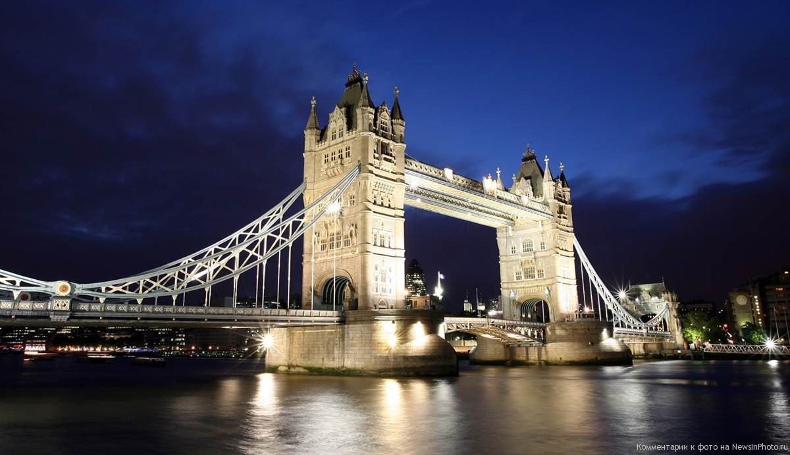
Sights of London.

Slide 3
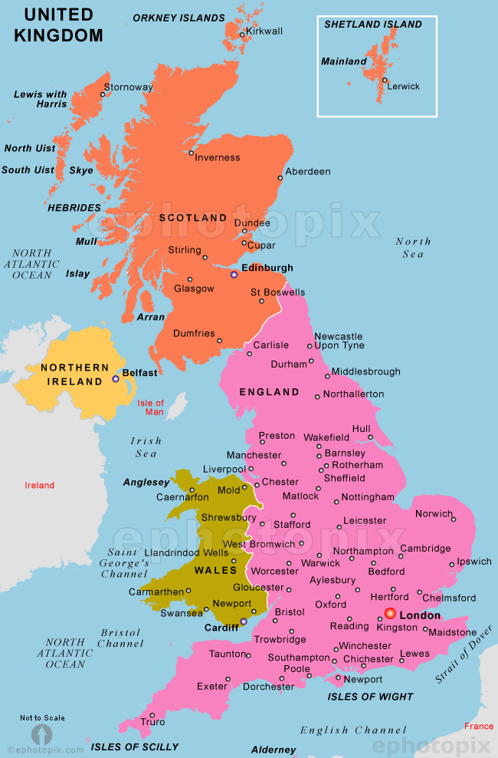
The full name of the country is
The United Kingdom of Great Britain and Northern Ireland
The sort name is the UK

Slide 4
The country consists of the Great Britain and Northern Ireland
The Great Britain contains
England, Scotland and Wales

Slide 5
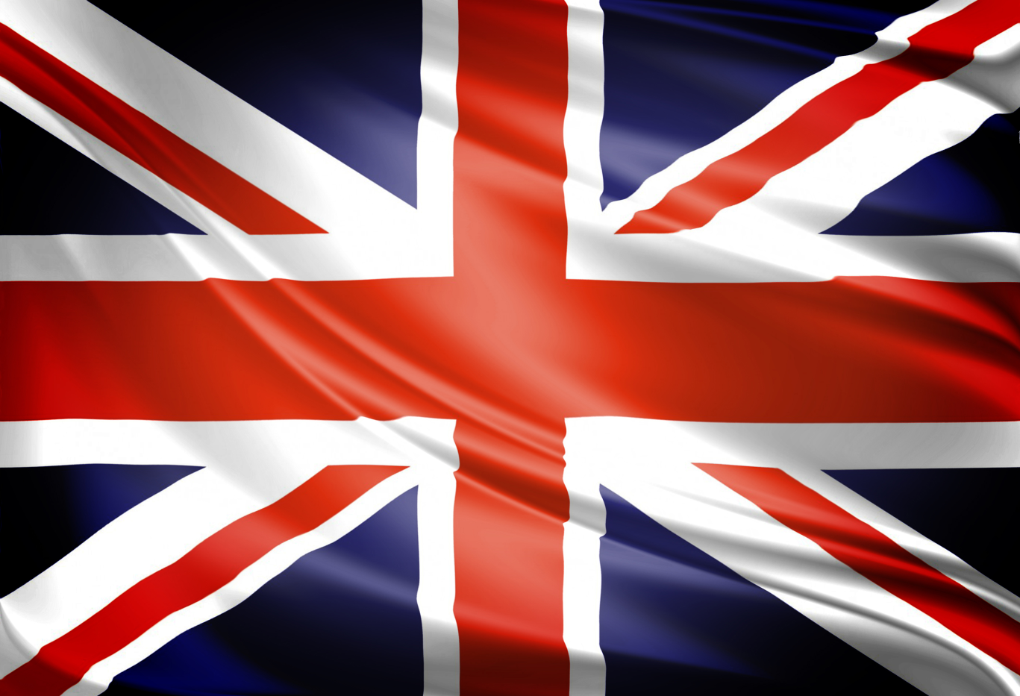
This is the flag of the country.
People name it the Union Jack because it’s made up of three flags: the crosses of St George, St Andrew and St Patrick representing England, Scotland and Northern Ireland.

Slide 6
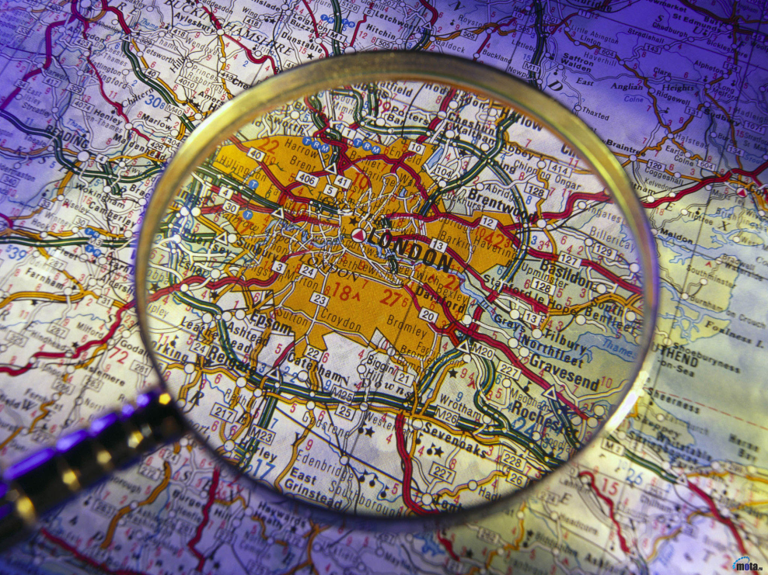
The capital of the country is London.
It’s situated in England.

Slide 7
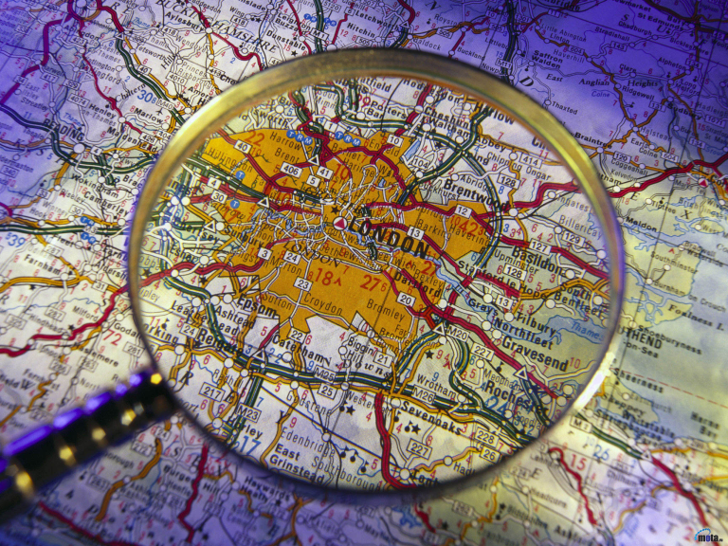
London
London was founded by the Romans more than 2000 years ago. They started it as a fortress. Later they transformed it into a town and called it Londinium. Different people came and destroy it. But Londoners restored their city again and again. Now it is a big and beautiful city.

Slide 8
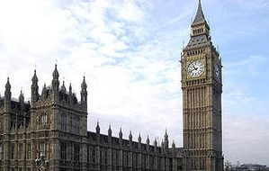
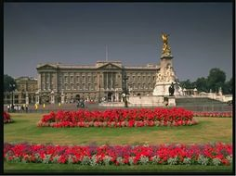
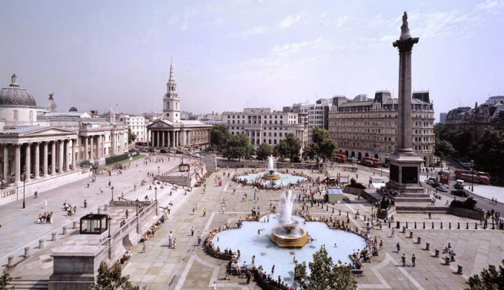
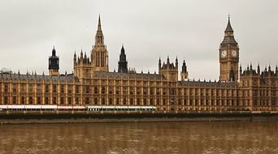
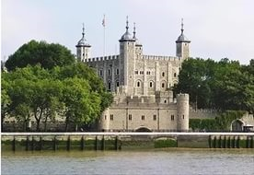
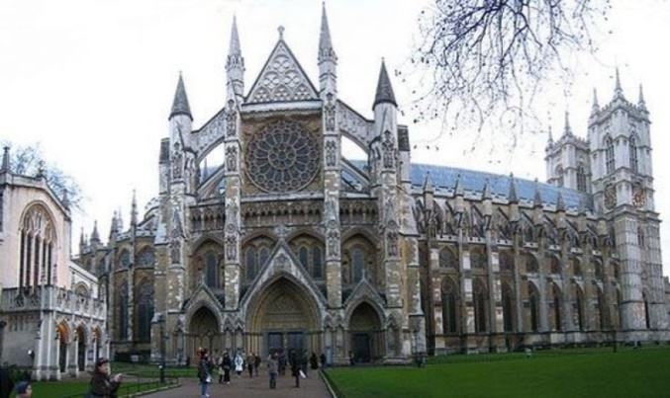
There’re a lot of interesting places which people can visit in London.

Slide 9
Big Ben
Big ben is the bell that strikes the hours inside the great clock of the houses of Parliament. Its name comes from the bell’s commissioner of works, Sir Benjamin Hall. The Tower is 98 metres high. The bell inside tower is 14 tons. The houer hand is 3 metres long and the minut hand is 4 metres long.

Slide 10
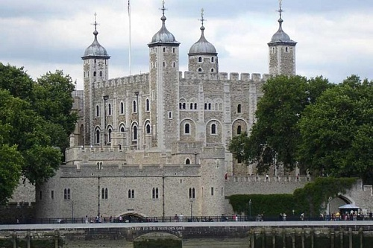
The Tower of London
The Tower of London was founded by Willliam the Conqueor in the 11th century and was used him as a fortress and a palace. Later it was made a prison. A lot of famous people were killed there. Now it’s a museum and the visitors sometimes hear strange sounds, ghost steps and see ghosts.
There live 12 black ravens and the legend says if they are disappear London will disappear too.

Slide 11
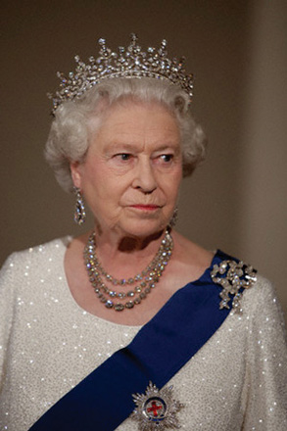
Buckingham Palace.
Buckingham Palace is the London residence of the British Queen Elizabeth II . But it was built for the Duke of Buckingham in the early 18th century. There’re 775 rooms in the palace. There’s a cinema, a swimming pool and a post office there .

Slide 12
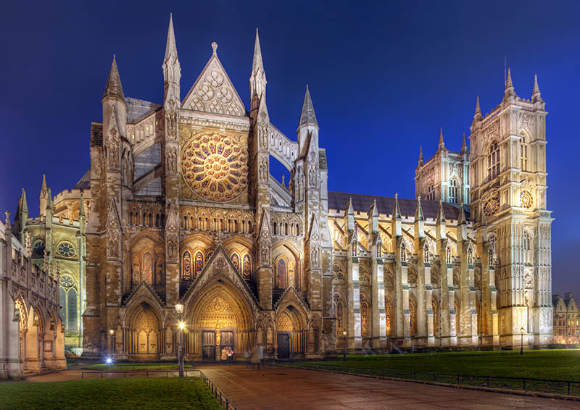
West minster Abbey
West minster Abbey is a church near the Houses of Parliament. The present building was started in 1245. Most British kings were crowned there.

Slide 13
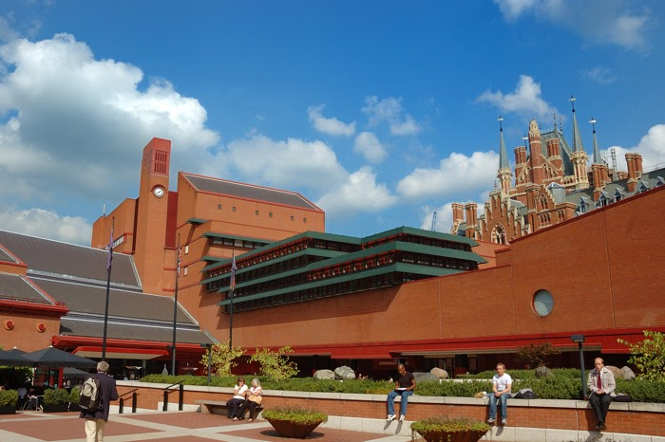
The British library
The British library is the largest public library in Britain. It has more than 10 million books. Books take 320 km of shelf space. It has copy of every book published in the country. It can take up 2 days to find a necessary book.

Slide 14

Trafalgar square with a stature of Admiral Nelson.
Horatio Nelson was an English admiral and the greatest warrior. He won the battle of Trafalgar and England became mistress of the seas. At Trafalgar the French killed him. His last words were “Thanks God I have done my duty”

Slide 15
What have you known about the country and its capital?

Slide 16
What’s the short name of the country?
a)The USA
b)The UK
c)The UB

Slide 17
What’s the capital of the country?
a)London
b)Washington
c)Moscow

Slide 18
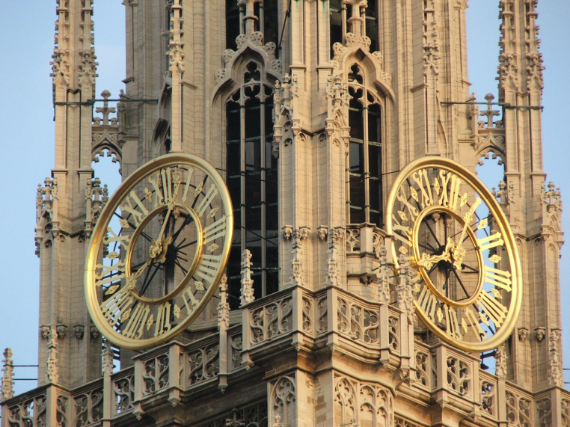
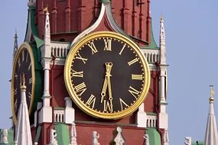
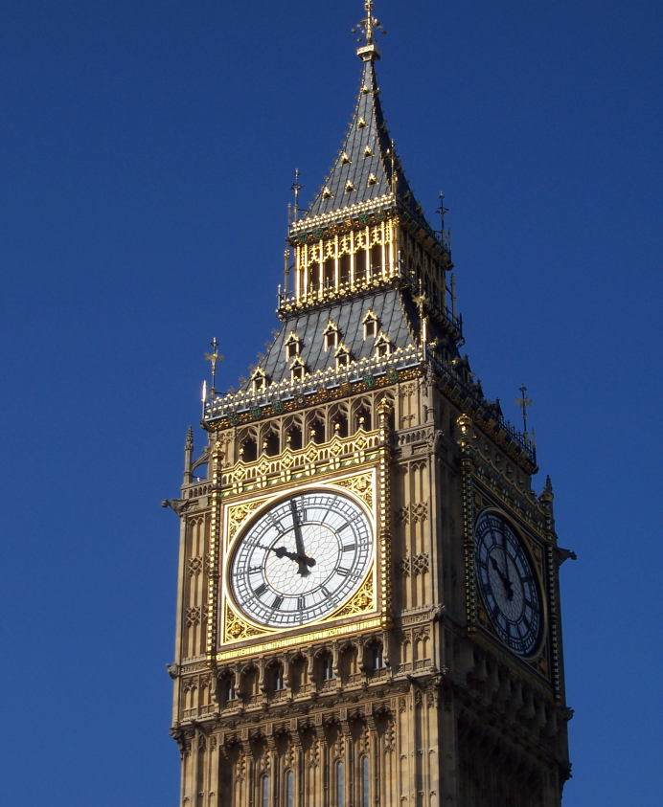
What number is Big Ben?
1
3
2

Slide 19
Big Ben was named after…
a)The commissioner
b)The famous boxer
c)Its size

Slide 20
The Tower of London was founded in …
a)11 century
d)12 century
c)13 century

Slide 21
How many ravens live there?
a)Eleven
b)Twelve
c)Thirteen

Slide 22
How many rooms are there in the Buckingham Palace?
a)775
b)765
c)875

Slide 23
What is there in the palace?
a) Museum
b) Zoo
c) Cinema

Slide 24
Westminster Abbey is a …
a)Palace
b)Church
c)Museum

Slide 25
What can you find in the British Library?
a)Any book
b)Any book published in Britain
c)Any newspaper published in
Britain.

Slide 26
Who won the Trafalgar battle?
a)General Nelson
b)Captain Nelson
c)Admiral Nelson

Slide 27
Well done !
Подготовила и провела учитель английского языка 1 категории
МКОУ Орловской СОШ им. И. Ф. Жужукина
Тещина Л. В.
2015 – 2016 уч. г.

