Slide 1
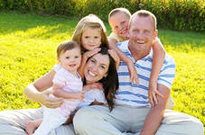
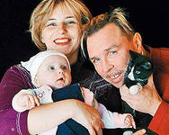
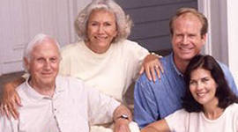
Monday, the 24-th of November.

Slide 2
Phonetic Drill
I` ve got a mother.
I` ve got a father.
I` ve got a sister.
I` ve got a brother.
We live together.
We love each other.

Slide 4
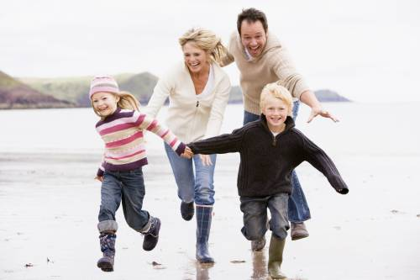
Family Ties
To describe the family we will revise:
The words
My mother’s/father’s name is…
Possessive Case
Her/his name is…
Possessive pronouns

Slide 5
Think and name the members of the family
family [‘fæməli] семья

Slide 6
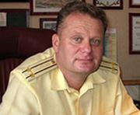
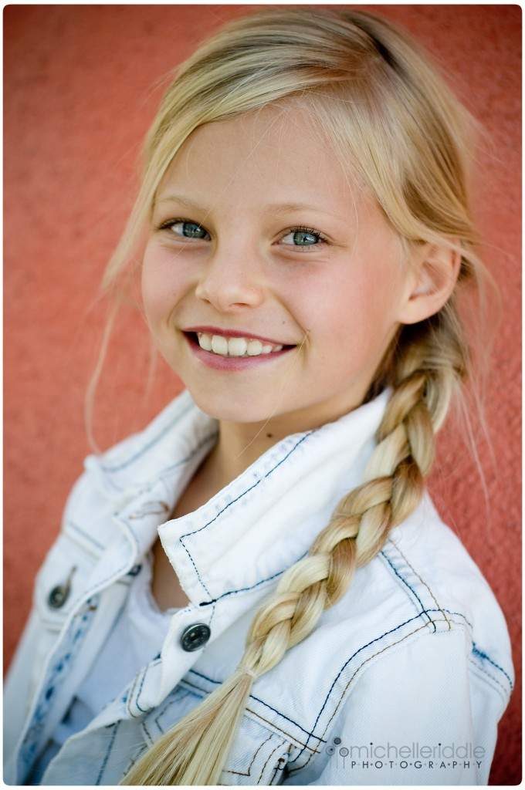
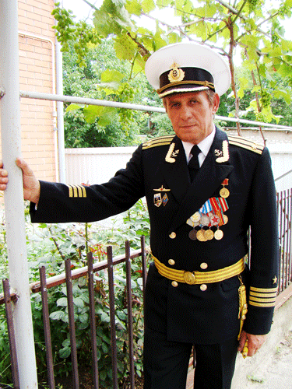
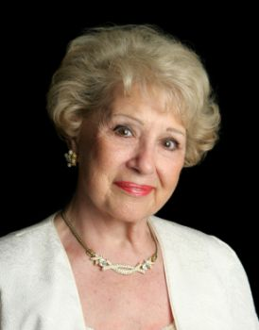
Look at the pictures and name the members of the family
Father
(husband)
Mother
(wife)
Daughter
(sister)
Son
(brother)
parents
children
grandfather
grandmother
granny
grandparents

Slide 7
Find the hidden word:
jokplmotherk
mother
hgrfatherokui
father

Slide 8
Find the hidden word:
jthfsvjosonuj
son
ksrdaughtery
daughter

Slide 9
Find the hidden word:
kbrotheruhfb
brother
hgysistermng
sister

Slide 10
Find the hidden word:
gtyhauntglmf
aunt
hunclenyhkja
uncle

Slide 11
Join the Parts of the Words!
MO TER BRO CLE
FAT THER NT MOTHER
SIS HER AU THER
FA TER UN WI
DAUGH MILY GRAND FE

Slide 12
Possessive Case
Tom’s friend
My father’s sister
My sister’s toys
Друг Тома
Сестра моего папы
Игрушки моей сестры

Slide 13
father
dad [‘dæd]
My dad is my mother’s….
husband

Slide 14
mother
mum [‘mΛm]
My mum is my father’s….
wife

Slide 15
daughter
She is my parents’…….
daughter

Slide 16
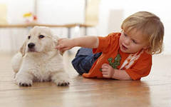
brother
He is my parents’…….
son

Slide 17
grandfather
He is my mother’s …
father

Slide 18
grandmother
She is my father’s …
mother

Slide 19
Read the text
navigator
служит на корабле
serves on the ship
госпиталь
штурман
hospital

Slide 20
Read the text
This is Dmitri Ivanov
He’s married, and this is his family. Their house is in Kronshtadt.
He ‘s an officer, a navigator. He serves on the ship “Smolnyj”. The ship is very big.
Svetlana is Dmitri’s wife. She is a doctor. She works in a hospital. The hospital is near their house.
“Our children are Irina and Ivan. Irina is a student. Ivan is a cadet. He studies at the Cadet Naval School. We’re happy in Kronshtadt”.

Slide 21
Grammar
She’s married.
She’s an officer.
‘s = is

Slide 22
Answer the questions:
Is Dmitri married?
Where is their house?
What is Dmitri’s job?
Is his ship big or small?
What is Svetlana’s job?
Where is her hospital?
Is Irina a doctor?
Is Ivan a student?

Slide 23
Look at the family tree. Complete the sentences
Dmitri = Svetlana
Irina Ivan
wife
Svetlana is Dmitri’s ________
Dmitri is Svetlana’s ________________
Ivan is their __________
Irina is their ______________
Ivan is Irina’s _____________________
Dmitri and Svetlana Are Irina and Ivan’s ______________

Slide 24
Ask and answer the questions.
He’s Dmitri’s son
Who is Ivan?
He’s Irina’s brother

Slide 26
Listening

Slide 27
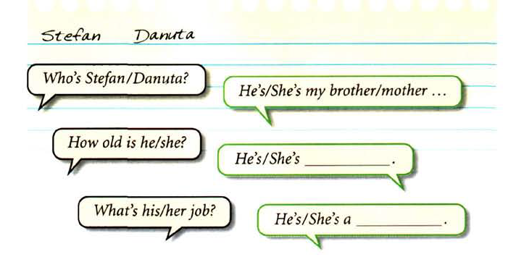
Speaking
Work in pairs.
Write the names of your family. Ask and answer questions as in the example

Slide 28
Tell about your friend’s family:
Hello!
My name ……..
I have got a friend.
His name is……
He has got………
His mother’s name is ……
She is ………
She’s a ……….

Slide 29
Now I know …
Now I can…
Do you know the words now?
I…
Can you talk about your family?
What was interesting at the lesson?
What was difficult?

