Slide 1
Holidays of the UK
Нагибина Екатерина Робертовна (учитель английского языка, МБОУ СОШ №32)

Slide 3
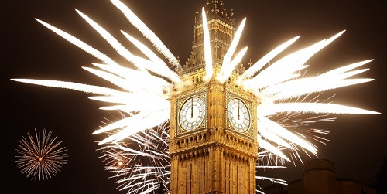
January
Празднование Нового года в Лондоне.
The main holiday of this month is New Year’s Day celebrated on the First of January. To be exact the party begins on the 31st December and lasts to the next morning or even day. Members of the families give each other the presents and everyone makes a wish for the next year.

Slide 4
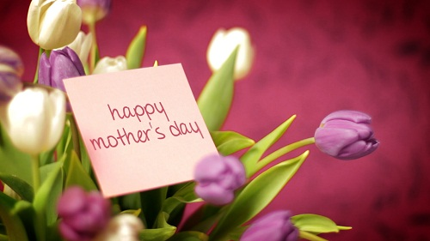
March
Подарок ко Дню Матери в Британии.
30th of March is celebrated throughout the UK as a Mother’s Day. It is a day to thank mothers for everything they do during the year. British give their mothers gifts or cards, cook a meal for them or treat them to a day out.

Slide 5
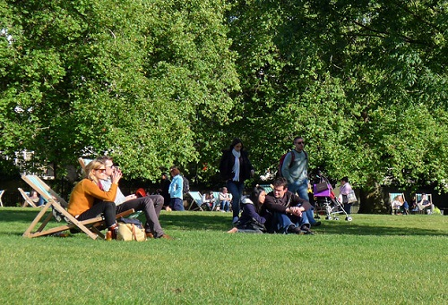
5th and 26th of May are Bank holidays in Great Britain. Two Mondays of this month are the day off work and school for British. They spend it outdoors enjoying the spring weather (if they are lucky, of course).
June

Slide 6
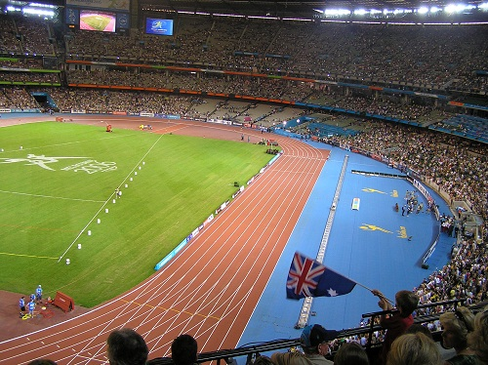
23rd of July is a day when the Commonwealth Games begin (in 2014). It is the large sport event, which take place every four years.

Slide 7
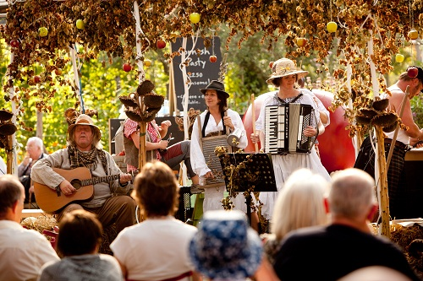
Around 23-25th of September (the date depends on the Moon calendar) British celebrate Harvest Festival. This is the day of celebration of the food grown on the land.

Slide 8
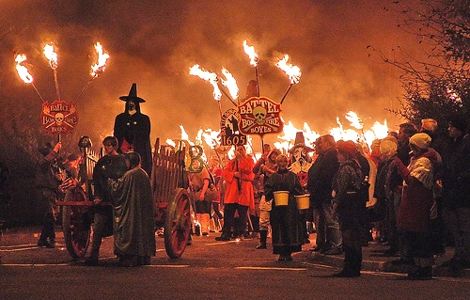
5th of November is the Bonfire Night. This day marks the anniversary of Guy Fawkes who failed Gunpowder Plot. This day is commemorated with displays of fireworks.

Slide 9
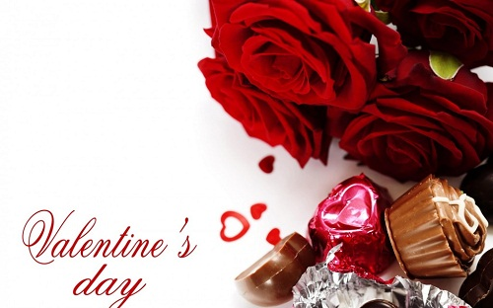
The main holiday of this month is St. Valentine’s Day, celebrated on 14th of February. It is a day of love, celebration of romance. Most of the UK people try to go out for dinner with their sweethearts and give them some presents – flowers, chocolate or Valentine’s card.

Slide 10

On the 1st of April Britain celebrates April Fools’ Day. For the only one day of the year it is encouraged to play tricks and practical jokes. Even mass media often feature fake stories. If you want to reveal the joke, you just say ‘April fool!’!

Slide 11
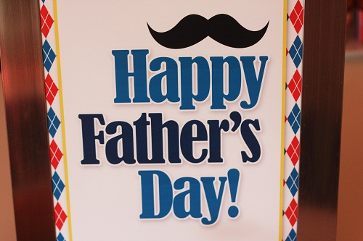
The 15th of June is the Father’s Day. It is a day to show appreciation to grandfathers, fathers and stepfathers. People in Great Britain give their fathers gifts or cards, go out for drinks or have a meal together.

Slide 12
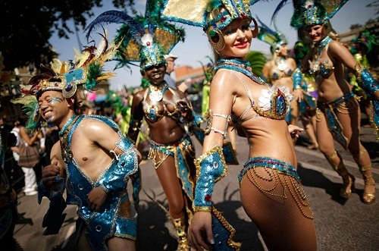
On 25th of August British celebrate Notting Hill Carnival. It is held in London and considered as Europe’s biggest street festival.

Slide 13
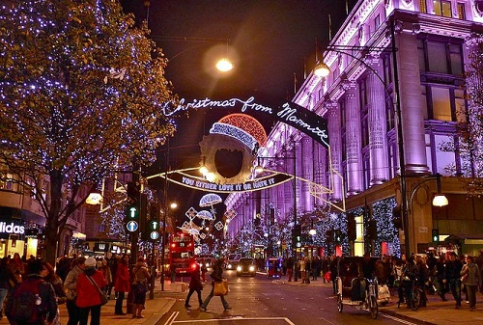
On 25th of December British people celebrate Christmas, even if they are not really religious. Christmas became family holiday with Christmas tree decorating, traditional Christmas dinner and presents.

Slide 14
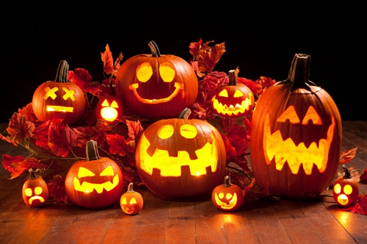
The 31st of October is one of the favorite children’s holidays – Halloween. Most of grownups like it too. Children carve pumpkins and go trick-or-treating, older people go to the parties. The most important thing is to dress up properly – as gruesomely as you can.

