Slide 1
Игра -
викторина
для 5 классов
по английскому языку
Составила: учитель английского языка
МБОУ СОШ №16
Морозова Дарья Сергеевна

Slide 2
Let`s count | 10 | 20 | 30 | 40 | 50 | 60
The famous characters | 10 | 20 | 30 | 40 | 50 | 60
Grammar practice | 10 | 20 | 30 | 40 | 50 | 60
Answer the questions | 10 | 20 | 30 | 40 | 50 | 60

Slide 3
Ten plus eleven is…
21

Slide 4
Eight plus eight
is…
16

Slide 5
Seven plus thirteen
is…
20

Slide 6
Fourteen plus eight
is…
22

Slide 7
Twenty minus twelve is…
8

Slide 8
Twenty-two minus ten is…
12

Slide 9
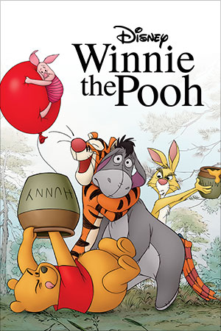
This character is a funny bear. He is fat but very nice. He likes honey and doesn`t like bees. He enjoys to make up rhymes. He likes to visit his friends Rabbit and Piglet.

Slide 10
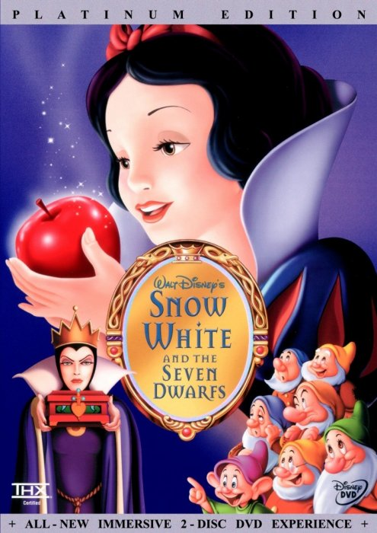
This is very kind girl. She is very beautiful, much more beautiful than her stepmother. That`s why her stepmother sent her to the forest. But girl found seven friends there. They were Seven dwarfs. They all lived very happily together.

Slide 11
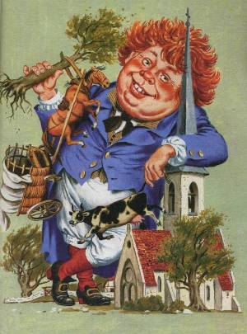
This man is a character of English folk rhymes. He is very fat. He is always hungry. He can eat everything: bread and butter, cheese and meat, churches and people. He says that his stomach is never full.
Robin the Bobbin

Slide 12
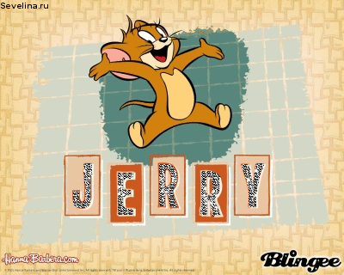
This funny mouse is a character of the American cartoon. This mouse was created by Walt Disney. The mouse is very clever, but he always has a lot of problems with a cat. He has to make many tricks to run away from this cat.

Slide 13
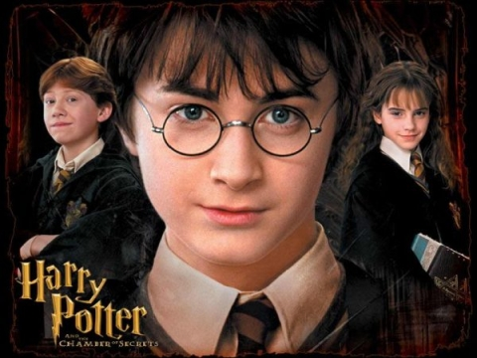
This is a boy. He has no parents. His parents were magicians and the angry man killed them. This boy is very talented and clever. He studies at the magic school. He can do a lot of magic tricks. He has got a lot of friends. They help him to fight against angry men.

Slide 14
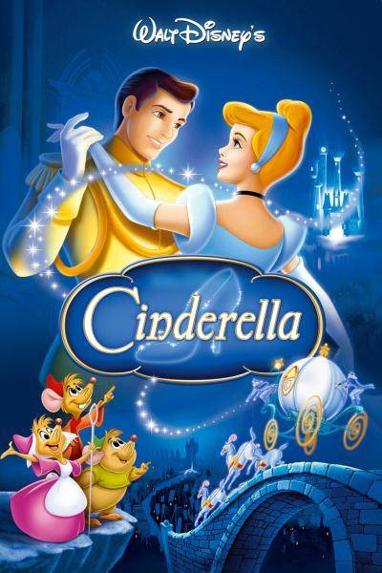
She is a very kind and nice girl. She has got a father but she hasn`t got a mother. Her stepmother and her stepsisters are very angry and greedy. This girl has got a godmother, a fairy. The fairy gives her a beautiful dress and crystal shoes to go to the ball. But the girl loses one shoe.

Slide 15
How many letters are there in the English alphabet?
26 letters

Slide 16
How many seasons are there in a year?
4 seasons

Slide 17
What day comes after Friday?
Saturday

Slide 18
Who is my mother`s mother?
My grandmother

Slide 19
When do the English celebrate Christmas?
In December

Slide 20
What is Coca-Cola?
A drink

Slide 21
She does homework every day.
Он убирает дом каждый день.
Она делает домашнее задание каждый день.
Она убирает дом каждый день.

Slide 22
Why do you play computer game?
Почему ты играешь на компьютере?
Когда ты играешь на компьютере?
Кто играет на компьютере?

Slide 23
These are the boys` hats.
Эти шляпы мальчиков.
Та шляпа мальчика.
Эти шляпы мальчика.

Slide 24
There isn`t ____ bread in the cupboard.
Some
A lot of
Any

Slide 25
You are reading the newspaper at the moment.
Ты читаешь газету
в данный момент.

Slide 26
Он купил пальто вчера.
He bought a coat
yesterday.

Slide 27


Slide 28
Используемая литература
1. Лебедева Г.Н. Внеклассные мероприятия по английскому языку в начальной школе. Праздники, конкурсы, тематические мероприятия, инсценировки, игры и занимательные задания. С нотным приложением. – М.: Глобус, 2014. – 282 с.
2. Дзюина Е.В. Театрализованные уроки и внеклассные мероприятия на английском языке: 5-7 классы. – М., 2012.

