Slide 1
Тещина Лилия Васильевна МКОУ Орловская СОШ им. И. Ф. Жужукина с.Орловка, Воронежская область учитель английского языка

Slide 2
Sport

Slide 3
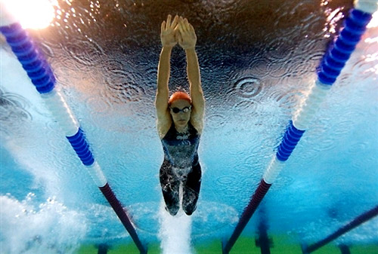

Slide 4
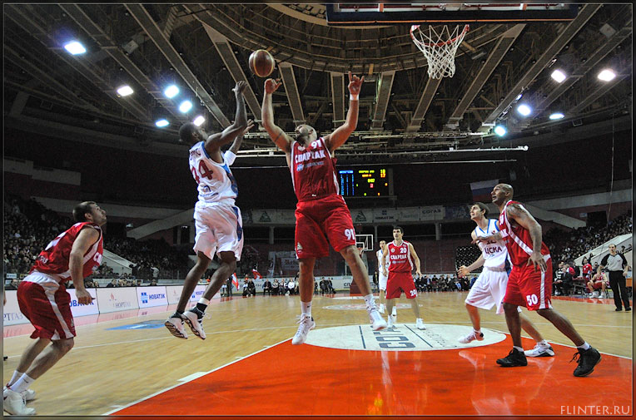

Slide 5
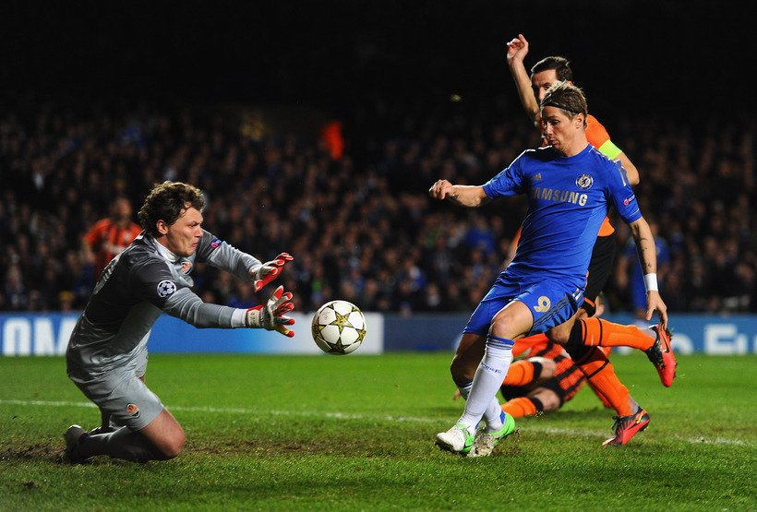

Slide 6
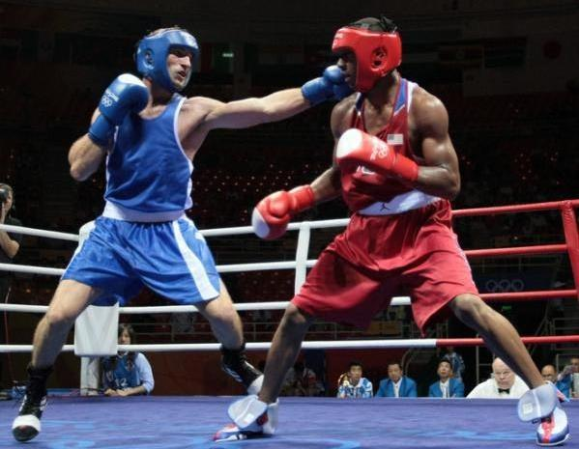

Slide 7
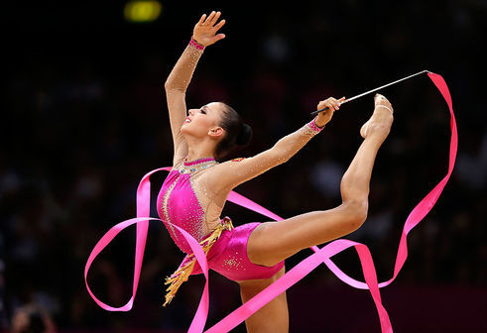

Slide 8
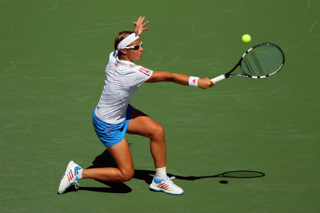

Slide 9
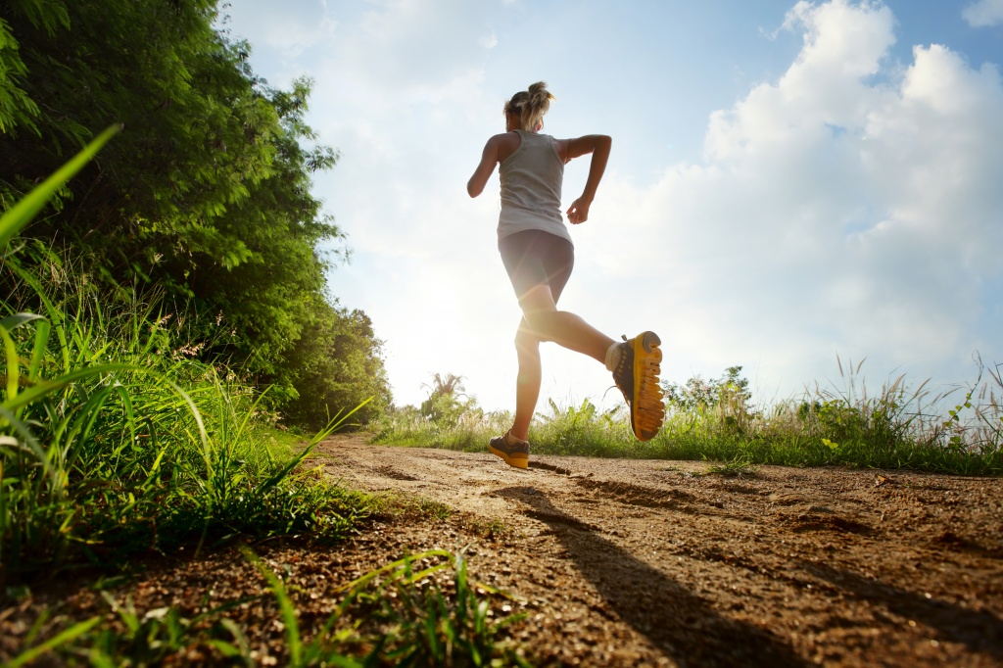

Slide 10
Cycling
1) -Welcome to the… (championship)
-Let’s watch … (… is against …)
2) -A lot of people … (watch it\cheer) their favourite sportsman.
3) -… (come) to the finishing line.
-And number … (cross) the line the first.
-This is new champion …
4) -(I can’t see). A lot of photographers (take)

Slide 11
Football\basketball
1) -They (play) the second game.
2) - The score is ….
3) - It’s the last minute
4) - Look, the number … (take a ball) and (score a goal\throw a ball into basket)
5) - … is new champion.

Slide 12
Box
1) -They (play) the last round.
2) - The score is … .
3) - Look, … (give) a strong shock and … (fall).
4) - It’s knockdown
5) - … is new champion.

