Slide 1
Тещина Лилия Васильевна МКОУ Орловская СОШ им. И. Ф. Жужукина с. Орловка, Воронежской области учитель английского языка
Презентация к уроку по учебному предмету «Иностранный язык (английский язык) в 7 классе на тему «Врача …» (УМК Spotlight под редакцией Ю.И. Ваулина, Д. Дули и др.)

Slide 2
THE AIM OF THE LESSON
Learn to write a letter of advice.
So we should:
1. learn disease and give advice;
2. learn to identify problems;
3. study the structure of writing a letter of advice.

Slide 3

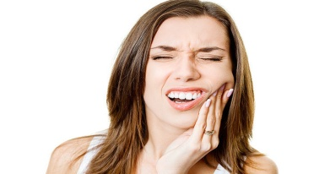
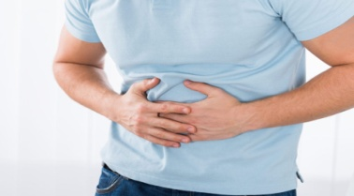
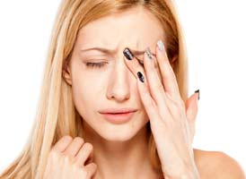
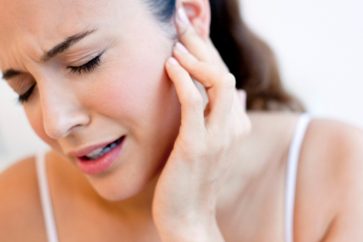
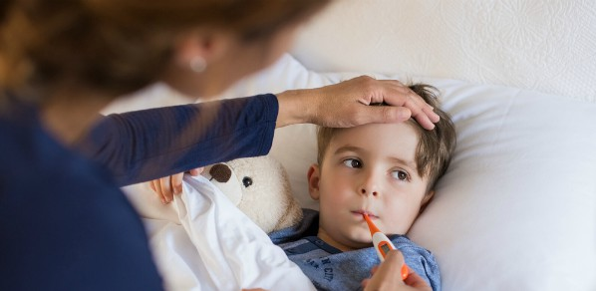
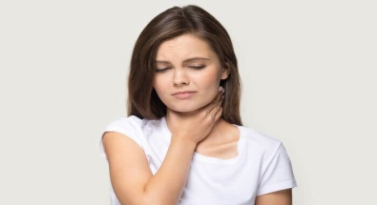

DISEASE
have a headache
have a stomachache
have an earache
have a sore throat
have a toothache
have sore eyes
have a high fever
feel exhausted

Slide 4

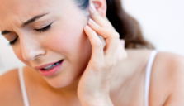




ADVICE (If you …, you should … . )
have a headache
take a painkiller
have a stomachache
eat a light meal
have an earache
put drops in it
have a sore throat
have a hot cup of tea
have a toothache
take a painkiller
have sore eyes
wash with cold water
have a high fever
put a cold pack on your forehead
feel exhausted
lei down and get some rest

Slide 5
ACT THE DIALOGUE
1.Let’s go to/play …
2.I’m sorry I can’t. I don’t feel well.
1. What’s the matter?
2. I’ve got … .
1. I’m sorry to hear that. You should … .
2. Thank you.
1.I hope you get better soon.

Slide 6
WHAT IS EACH PERSON'S PROBLEM?
I group
‘Worn out’ is exhausted and he/she needs to feel better before the tennis tournament.
II group
‘Computer Freak’ has got lots of headaches and his/her eyes are sore all the time.

Slide 7
STRUCTURE OF THE LETTER OF ADVICE
Introduction:
- heading (address/date);
greeting (Dear … , );
opening remark (Here are a few things you can try in order to feel better ).
Main body
(It’s important to …; Why don’t you …; You should …).
Conclusion:
closing remark (I hope my advice helps );
Yours faithfully/sincerely; name/surname.

Slide 8
REMARKS FOR A LETTER OF ADVICE
I group
(opening remarks)
II group
(closing remarks)
I’m sorry you feel that way. I think I can help you.
Let me know what happens.
I hope everything turns out for the best.
Here’s what you can do.

Slide 9
ADVICE TO 'COMPUTER FREAK'
work less on his computer;
get a filter for his computer;
get more sleep;
check his eyes.

Slide 10
SAY
I haven’t known … .
Now I know … .
I can … .

