Slide 1
Manners, manners
Kaufman K. Kaufman M.
“Happy English.ru”
7 class
Подготовлен и проведен учителем английского языка 1 квалификационной категории МБОУ сош 13 г.Волжский Волгоградской области Кушиной Э.С.

Slide 2
Good manners and rules of behaviour at home, work, transport or other places are very important in modern society

Slide 3
Homework :
-P 132 Ex A(Перевод диалога)
-Составить плакат для школьной столовой на английском языке, используя Should/shouldn’t

Slide 4
[u]
The cook took a good look at the pudding and put sugar in it

Slide 5
Repeat the words and find them in our song:
a napkin on your lap to pass smth to smb straight never, ever elbows close to your sides They are all that matters. to bite to chew stew rude

Slide 6
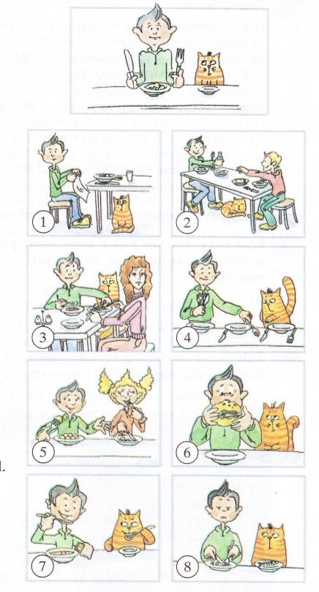

Slide 7
Revision of the previous lesson: “ Modal verb should”. Complete the chart:
1.You … eat with your fork and spoon.
2.You … talk while you are eating.
3.You … eat your cake with a spoon.
4.You … eat chips with your fingers.
5.You … keep your napkin on the table near your plate.
6.The knife … on the right of your plate.
7.If something on the table is too far away, you … stand up and take it.
Should | Shouldn’t

Slide 8
Check your answers:
Should | Shoudn’t
1.You should eat with your fork and spoon. | 2.You shoudn’t talk while you are eating.
3.You should eat your cake with a spoon. | 7.If something on the table is too far away, you shouldn't stand up and take it.
4.You should eat chips with your fingers.
5.You should keep your napkin on the table near your plate.
6.The knife should go on the right of your plate.

Slide 9


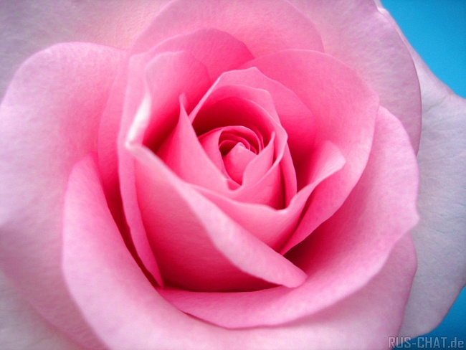


Slide 10
Look at the pictures and match them with its meanings:

Slide 11
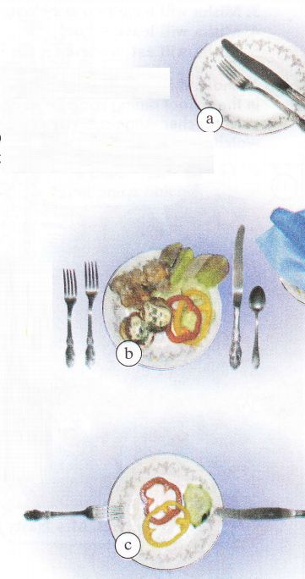
2. 2. The table is set.
1. I’ve finished
3.I am going to eat more.

Slide 12

The fork goes on the left, The knife goes on the right, And never, ever try to eat Without your fork and knife.
Spoons are for soup, Forks - for cakes and stew. But never, ever try to bite More food than you can chew.
Manners,
Manners…
Refrain: Manners, (manners) They are all that matters. Sit as straight as you could, Elbows close to your sides. Manners, (manners) They are all that matters. Never play with your food,
And you will be all right.
If something is too far, You pass it to your mates. But never, ever try to take From other people's plates.
To talk at table is polite, And not to talk is rude. And never, ever try to talk When your mouth is full of food.
Refrain
At table every time You have to watch yourself, And never, ever start Without a napkin on your lap.

Slide 13
Good bye, children! The lesson is over.

