Slide 1
Leopard
Выполнила: преподаватель английского языка ЯковлеваН .Г. Школа №72

Slide 2
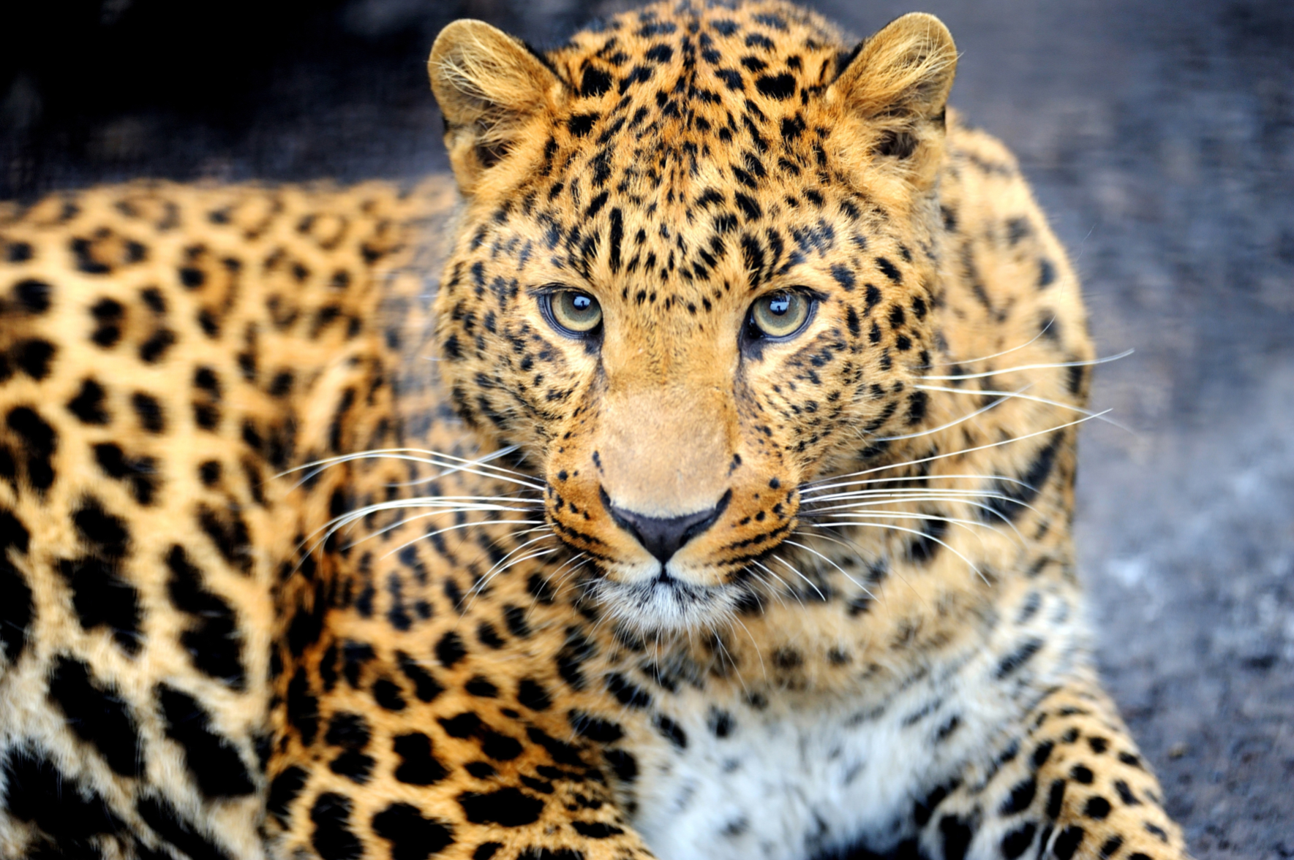
Leopard
Leopard — species of carnivorous mammals felines, one of four members of the genus Panther related to the subfamily of big cats. In the 20th century was included in the Red book .

Slide 3
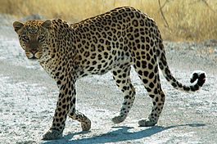
Leopard big cat, however, the largest much less the tiger and the lion. The body is elongated, muscular, light and slim, very flexible, with a long tail. Legs relatively short, but strong.

Slide 4
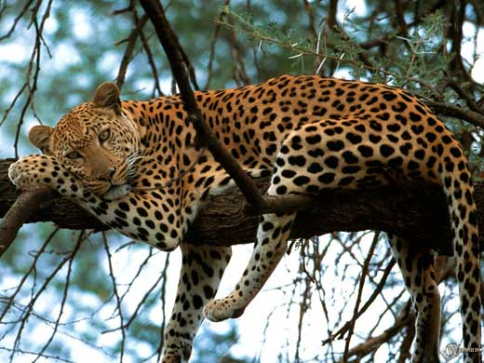
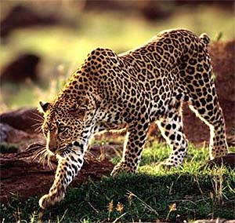
The size and weight of leopards depend on the geographical region of habitat. The specimens that inhabit the forests, usually smaller and lighter and living in the open areas — on the contrary, larger.

Slide 5
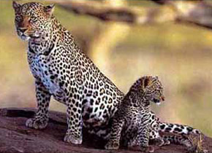
The General coloration of the fur is bright, the background is yellow or reddish-yellow with small black spots. These spots are of two types — solid or ring shapes — the so-called "sockets". In the center is the last bright field, more or less corresponding color main background color of fur.

