Slide 1
Earth Hour
What is it?
МБОУ КСОШ № 13
Г. Новый Уренгой
Хиль О. А.

Slide 2
Earth Hour is a global environmental initiative in partnership with WWF(World Wildlife Fund). Individuals, businesses, governments and communities are invited to turn out their lights for one hour on Saturday March 23, 2013 at 8:30 PM to show their support for environmentally sustainable action.

Slide 3
Earth Hour started in 2007 in Sydney, Australia, when 2.2 million individuals and more than 2,000 businesses turned their lights off for one hour to take a stand against climate change.

Slide 4
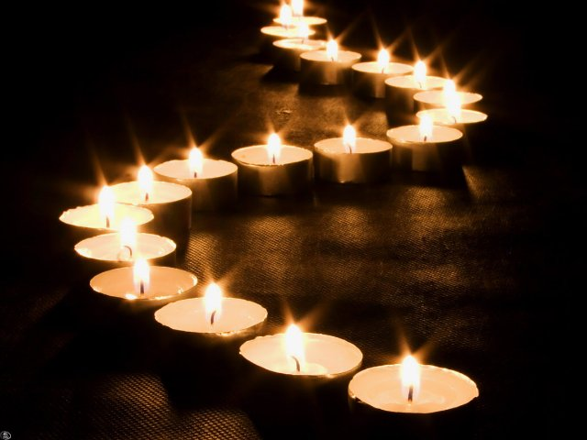
The aim is to highlight the charity’s call on governments, organisations and individuals to pledge their commitment to tackling climate change.

Slide 5
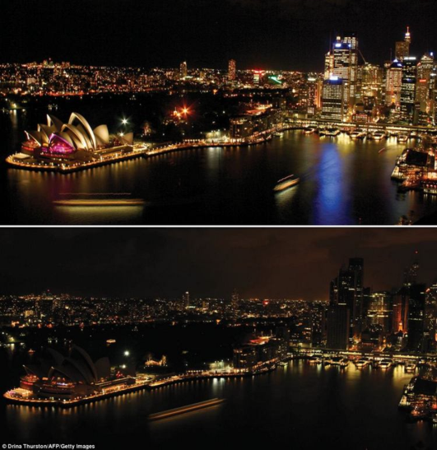
Sydney was the 1-st city.
The lights around Sydney's Harbor and the iconic Opera House are recognized across the world.

Slide 6
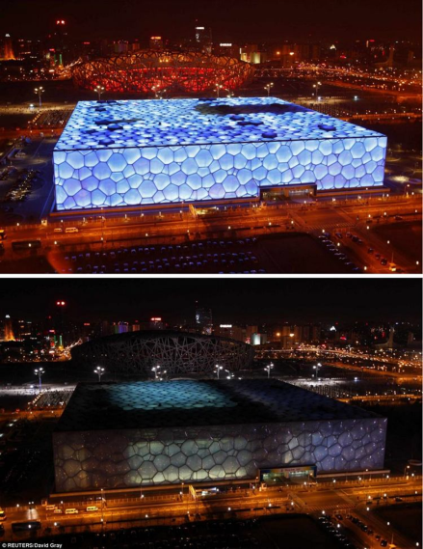
China also took part and this picture shows the National Aquatics Centre. In 2012 year, 85 Chinese cities pledged to turn their lights off - more than double from previous year.

Slide 7
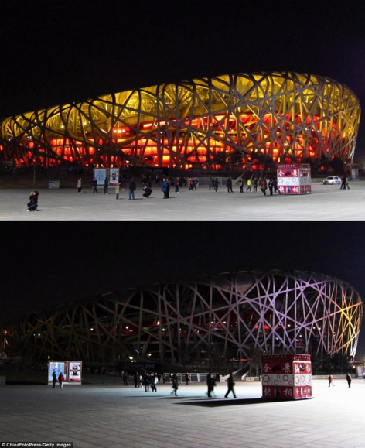
The 'Birds Nest' stadium in Beijing, China.

Slide 8
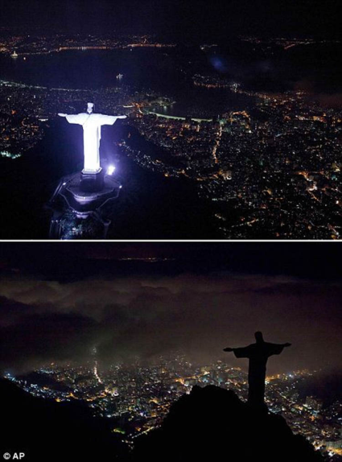
Christ the Redeemer statue in
Rio de Janeiro is switched off.

Slide 9
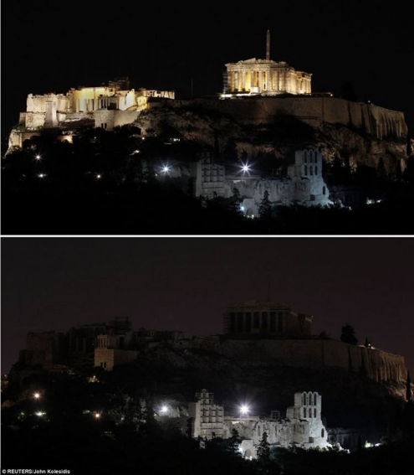
The Acropolis and the Herodion in Athens also switched off to show support for Earth Hour.

Slide 10
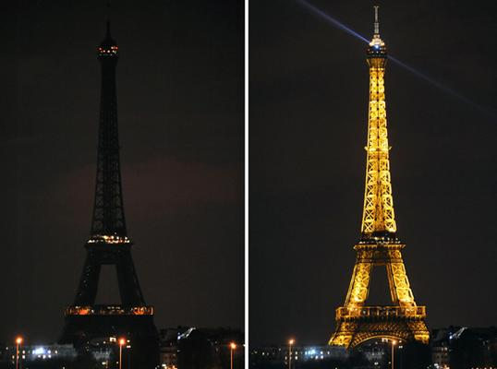
Stunning before-and-after pictures of the moment the Eiffel Tower.

Slide 11
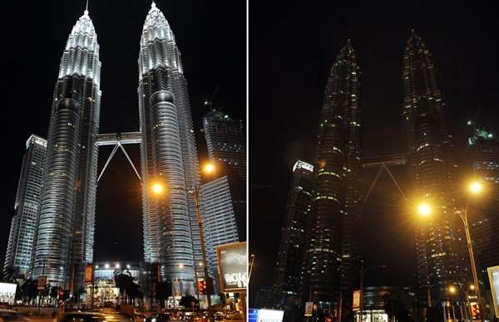
WWF’s Earth Hour is about creating a message so powerful that governments and businesses cannot fail to take notice’.

Slide 12
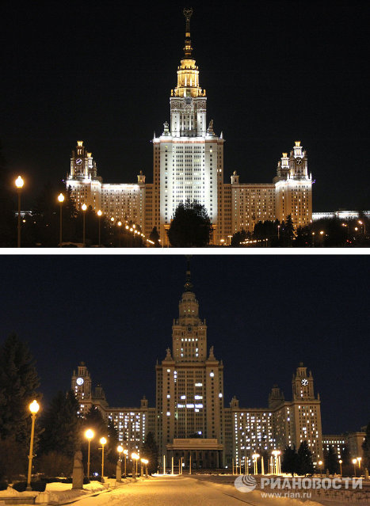
Russia also takes part in in WWF’s Earth Hour.

Slide 13
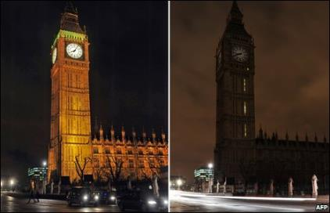
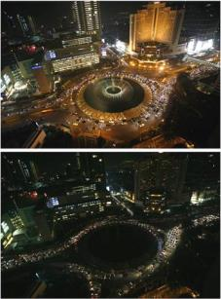
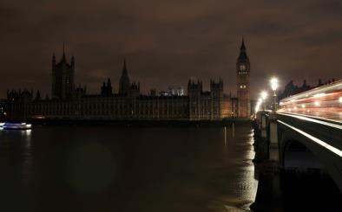
People all over the world switch off their lights for one hour.

Slide 14
WWF’s mission is to stop the degradation of the earth’s natural environment and to build a future in which humans live in harmony with nature, by conserving the world’s biological diversity, ensuring that the use of renewable natural resources is sustainable, and promoting the reduction of pollution and wasteful consumption.

Slide 15
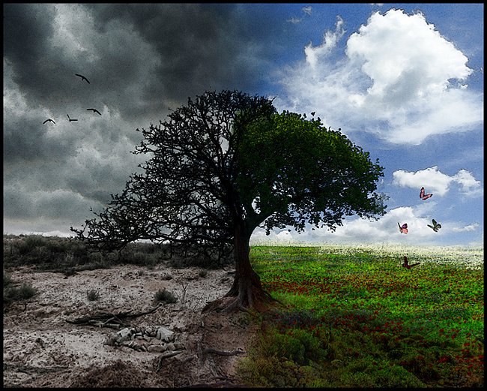
Now, answer just one simple question: “What can you do for your planet?”
Will you give a chance for our Earth or…?

Slide 16
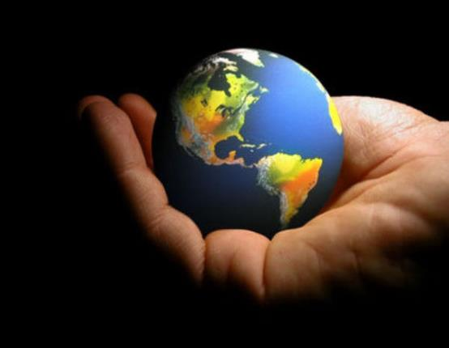
Our future is in our hands!

