Slide 1
ВЕСЕЛОЕ СОРЕВНОВАНИЕ
ЦЕЛИ:
-ОБОБЩЕНИЕ ИЗУЧЕННОГО МАТЕРИАЛА ПО ТЕМЕ «ЛИЦА ЛОНДОНА»
-АКТУАЛИЗАЦИЯ ФОНЕТИЧЕСКИХ И ГРАММАТИЧЕСКИХ НАВЫКОВ
-СОВЕРШЕНСТВОВАНИЕ НАВЫКОВ МОНОЛОГИЧЕСКОЙ И ДИАЛОГИЧЕСКОЙ РЕЧИ

Slide 3
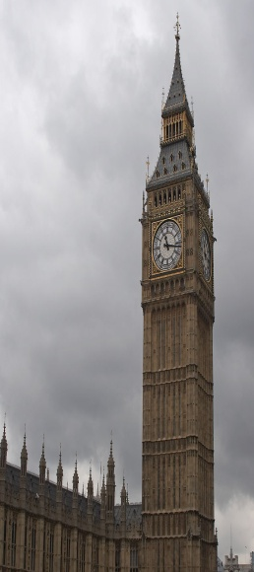
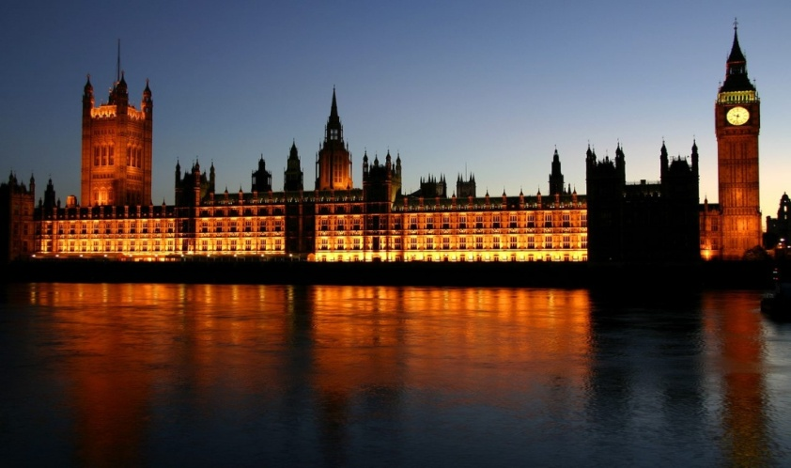
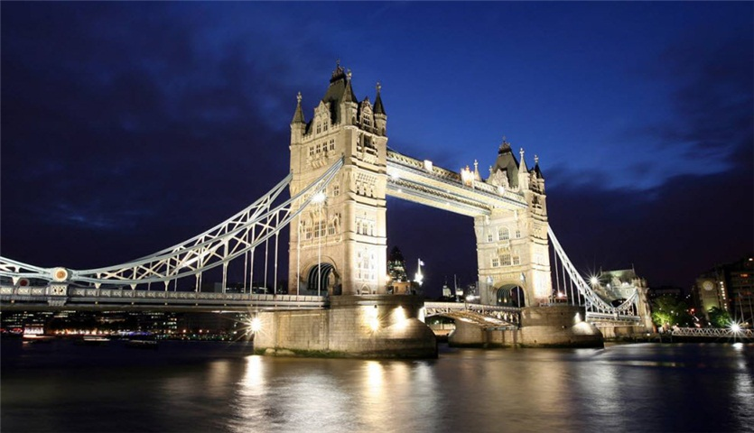
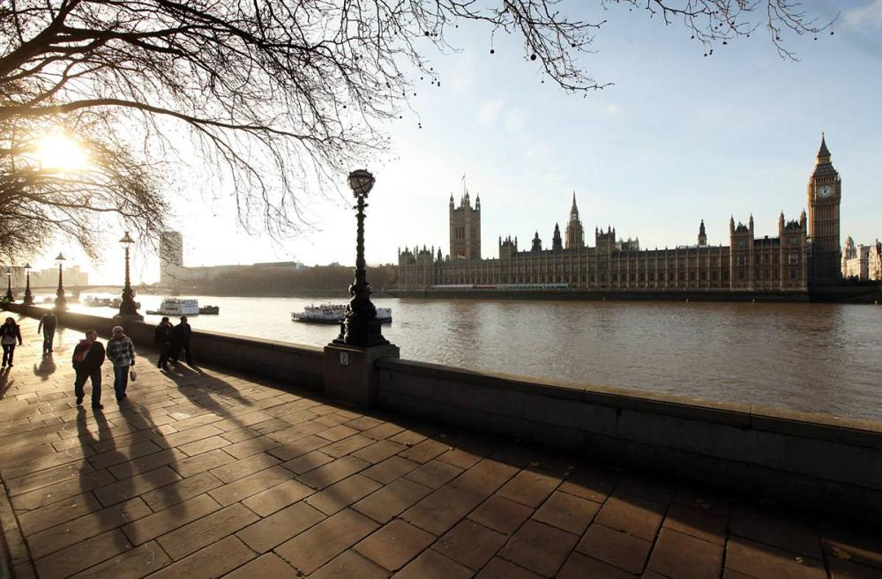
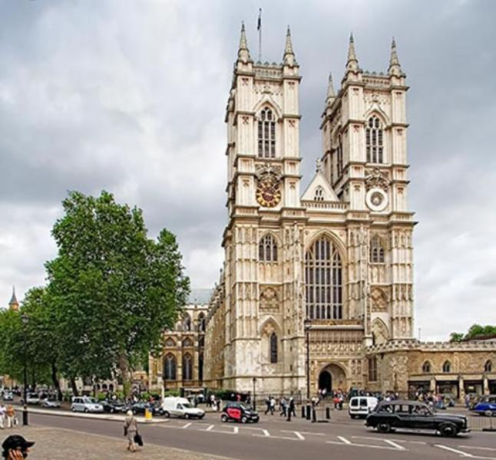
THE FACES OF LONDON

Slide 4
TODAY WE SHALL HAVE A COMPETITION ON THE TOPIC «FACES OF LONDON». LET’S DIVIDE INTO TWO TEAMS AND THINK OF THE NAMES FOR THE TEAMS.

Slide 5
КОНКУРС 1 ВИЗИТНАЯ КАРТОЧКА ANSWER THE QUESTIONS:
WHAT IS YOUR NAME?
WHERE DO YOU LIVE?
HOW OLD ARE YOU?
WHERE ARE YOU FROM?
HAVE YOU GOT A FAMILY?
HOW MANY SISTERS HAVE YOU GOT?
WHAT IS YOUR HOBBY?
DO YOU GO TO SCHOOL?
DO YOU SPEAK FRENCH?

Slide 6
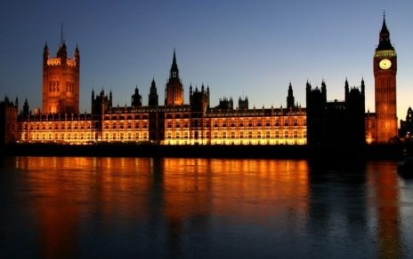

КОНКУРС 2 НАЗОВИ ДОСТОПРИМЕЧАТЕЛЬНОСТИ ЛОНДОНА
BBGENI-
WBEBSETYMAINTSRE -
TPHAER HLOIUASMEESNOTF-
BPUAKLIANCGEMAH-
TLHOE NTDONWERFO-
TTHHEASEM-

Slide 7
CONTEST 2
BIG BEN
WESTMINSTER ABBEY
THE HOUSES OF PARLIAMENT
BUCKINGHAM PALACE
THE TOWER OF LONDON THE THAMES

Slide 8
КОНКУРС 3
NOW WE SHALL ROLE PLAY THE DIALOGUES ABOUT THE CAPITAL OF GREAT BRITAIN TODAY. YOU WILL WORK IN GROUPS DURING 5 MINUTES AND THEN WE SHALL START.
ЧЛЕНЫ КАЖДОЙ ИЗ КОМАНД В ТЕЧЕНИЕ 5 МИНУТ СОСТАВЛЯЮТ ДИАЛОГ ПО ТЕМЕ «СТОЛИЦА ВЕЛИКОБРИТАНИИ»,А ЗАТЕМ РАЗЫГРЫВАЮТ ЕГО.

Slide 9
КОНКУРС 4
IT S TIME TO REMEMBER OUR POEMS AND TO DO SOME EXERCISES.
РАССКАЖИ СТИХОТВОРЕНИЕ ДЛЯ ФИЗКУЛЬТМИНУТКИ И ПОКАЖИ СООТВЕТСТВУЮЩИЕ ДВИЖЕНИЯ.

Slide 10
CONTEST 4 PHYSICAL EXERCISES FOR YOU:
Hands up! Hands down!
Hands on hips! Sit down!
Hands up! To the sides!
Bend left! Bend right!
One, two, three! Hop!
One, two, three! Stop!
Stand still!
Stand up and show me orange!
Hands up and show me blue!
Clap! Clap! Show me yellow!
Sit down. Nice of you!
Stand up and show me blue!
Hop! Hop! Show me red!
Sit down. Nice of you!
Stand up and show me grey!
Sit down and point to the green.
Clap! Clap! Show me pink.
Stop! Very nice of you.

Slide 11
КОНКУРС 5-ДЛЯ КАПИТАНОВ
NOW OUR CAPITAINS HAVE THE SPECIAL TASK. THERE ARE THE CARDS ON YOUR DESKS. LOOK AT THEM. YOU CAN SEE THE TASK FOR YOU THERE.
КАПИТАНЫ КОМАНД ПОЛУЧАЮТ КАРТОЧКИ С ЗАДАНИЕМ.

Slide 12
CONTINUE THE LOGICAL CHAIN.
ДЛЯ КАПИТАНА 1 КОМАНДЫ :
ДЛЯ КАПИТАНА 2 КОМАНДЫ:
PABLO PICASSO | JOHN LENNON | CHARLES DARWIN | MARGARET THATCHER
AN ARTIST | A SINGER | A SCIENTIST | …
BUCKINHAM | KENSINGTON | LONDON | HYDE
PALACE | GARDENS | ZOO | …

Slide 13
CONTEST 5
1 POLITITIAN
2 PARK

Slide 14
КОНКУРС 6
TRANSLATE INTO RUSSIAN THE STORY ABOUT A TRIP TO LONDON:
LAST WEEK WE WENT TO LONDON. LONDON IS
THE CAPITAL OF GREAT BRITAIN. WE VISITED
MANY INTERESTING PLACES:TRAFALGAR SQUARE,
BIG BEN, WESMINSTER ABBEY, THE HOUSES OF
PARLIAMENT, THE BLOODY TOWER, BUCKINGHAM
PALACE, THE TOWER OF LONDON, THE TAMES AND
OXFORD STREET. WE BOUGHT A LOT OF SOUVENIRS IN
OXFORD STREET. I LIKED BUCKINGHAM PALACE BEST
OF ALL. THE QUEEN OF GREAT BRITAIN LIVES IN IT. IT
IS A WONDERFUL BUILDING WITH A MONUMENT IN
FRONT OF IT. THERE ARE MANY PLEASANT PARKS,
GREEN SQUARES, BEAUTIFUL STREETS AND MUSEUMS
IN THE CAPITAL OF GREAT BRITAIN. WE LIKED LONDON
VERY MUCH.

Slide 15

THANK YOU FOR YOUR WORK. YOU WERE ACTIVE AND CLEVER TODAY. DO YOU LIKE OUR COMPETITION?
AND THE WINNER IS…

