Slide 1
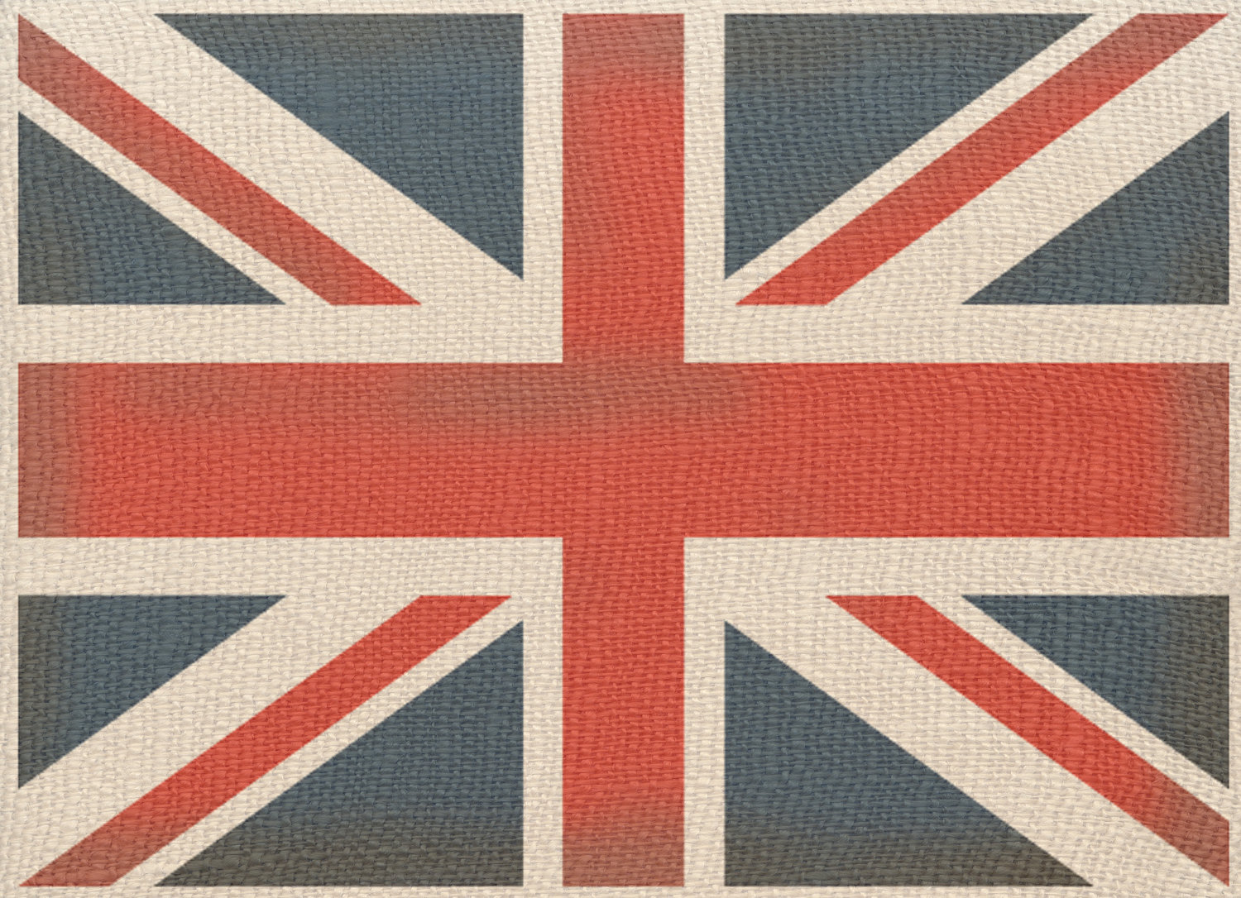
Tea Drinking in England
English traditions
Сергеева Ирина Александровна (преподаватель иностранного языка, СПб ГБУ " Высшая банковская школа")

Slide 2
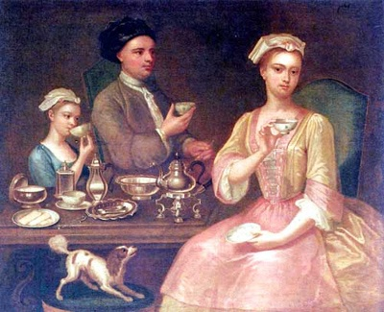
English tea drinking traditions have a long history. Tea was brought to England in the seventeenth century by a Portuguese princess, who married king Charles II of England, and has been popular in the country ever since.

Slide 3
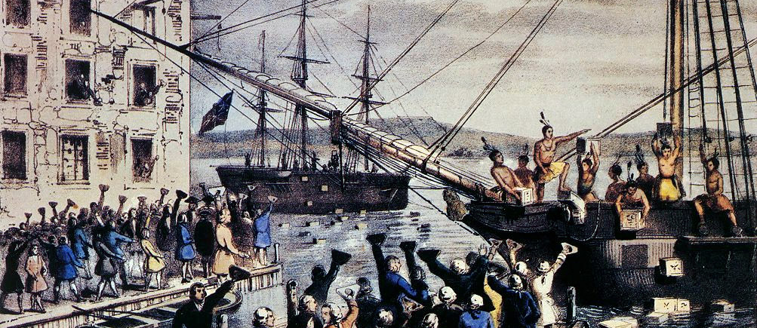
When the first clippers began to bring tea to England from China and India, it was very expensive. The reason was that the members of the church called it a “sinful ^{ii} drink” because it was coming from a non-Christian country. So it was taxed to 119%^{iii} and therefore tea became a drink for the elite. A drink for the rich, the aristocracy, tea was locked up in the households in enamel containers.

Slide 4
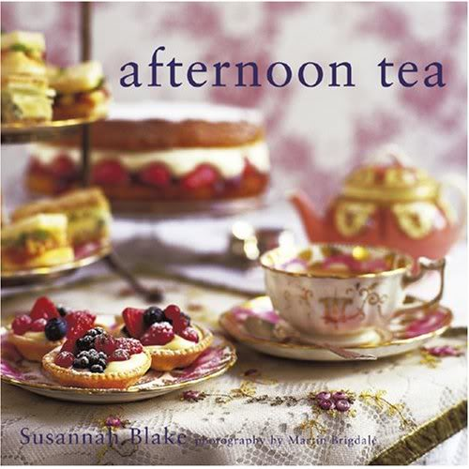
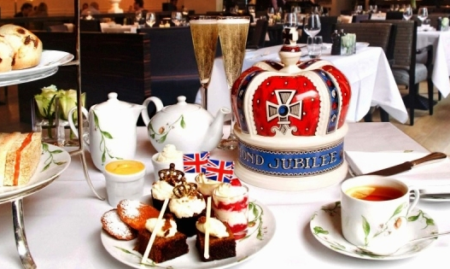
Traditional tea time in English is late afternoon, when world-famous 5 o’clock tea is served. Five o’clock tea is a ceremony, a work of art. It is not only about a perfect combination of the tablecloth, the napkins, the flowers, the vases and the tea set, it means a certain way of behaving and talking too.

Slide 5
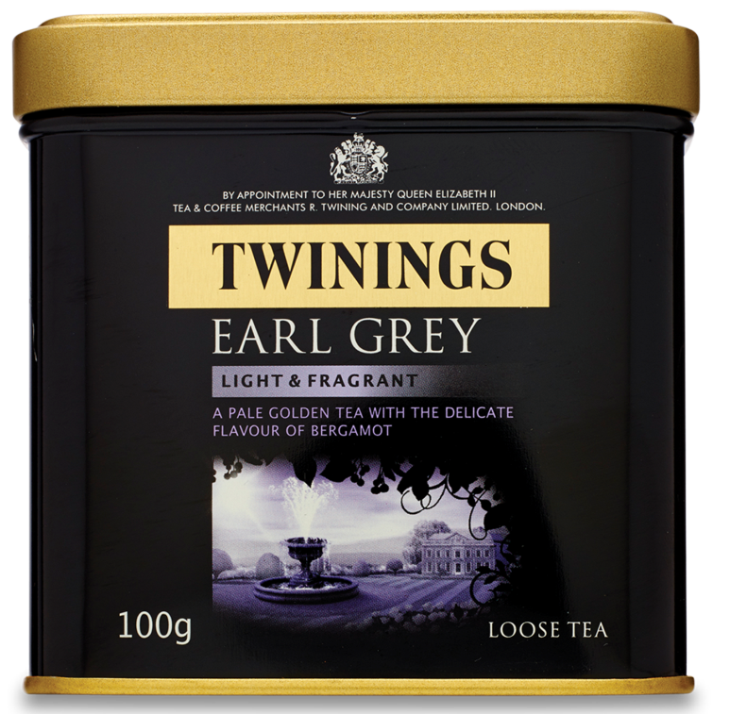
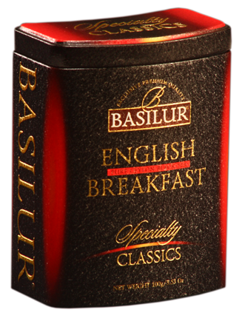
But tea is also drunk in the morning and during the day because the English believe it to be healthy and refreshing. There are a lot of traditional tea-rooms in England, where ideally you should not ask for a cup of tea, but say you want an Earl Grey or an English Breakfast because you should drink your teas according to how you are feeling. For example, English Breakfast is a strong tea, which fills you with energy, and Prince of Wales or Earl Grey are more relaxing. Green teas are very refreshing, very light and good after meals.

Slide 6
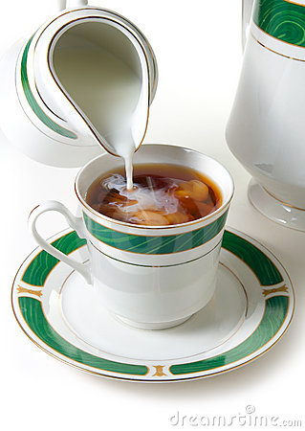
Tea is traditionally served with lemon or milk. Tea used to be drunk black without anything in it, but as people became more in a hurry they added milk to drink it more quickly. It is possible that milk was used to cool the tea down when the hostess did not want to have her guests for too long.

Slide 7
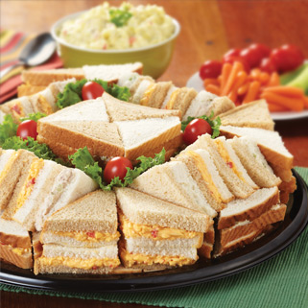
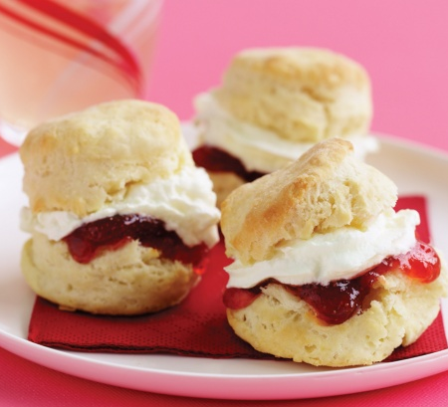
By the classical tea ceremony serves traditional plentiful entertainment: finger sandwiches with crusts cut off: with butter and cucumber ... Traditional British scones, both simple and whole wheat or dried fruit baked immediately shortly before tea time. Eat scones with Devonshire Clotted Cream and homemade jams. Small crumpets served hot with butter and honey. To "high" tea table (high afternoon tea) is always a large selection of fresh pastries, which are traditionally served on special whatnot. Assortment of cakes typically includes: fruit cake , Victoria sponge, chocolate cake, ginger bread , finger biscuits, baskets of fresh fruit and more.

Slide 8
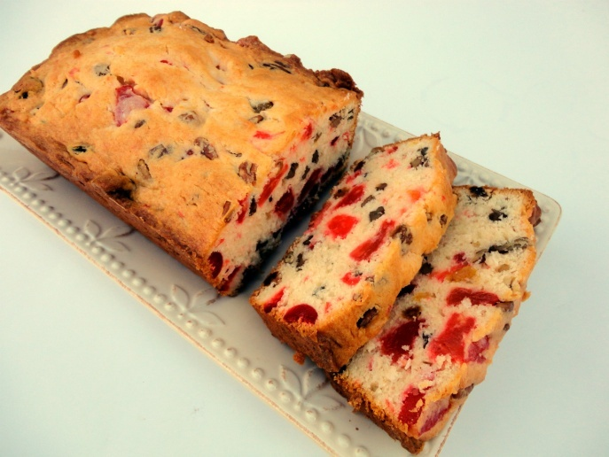
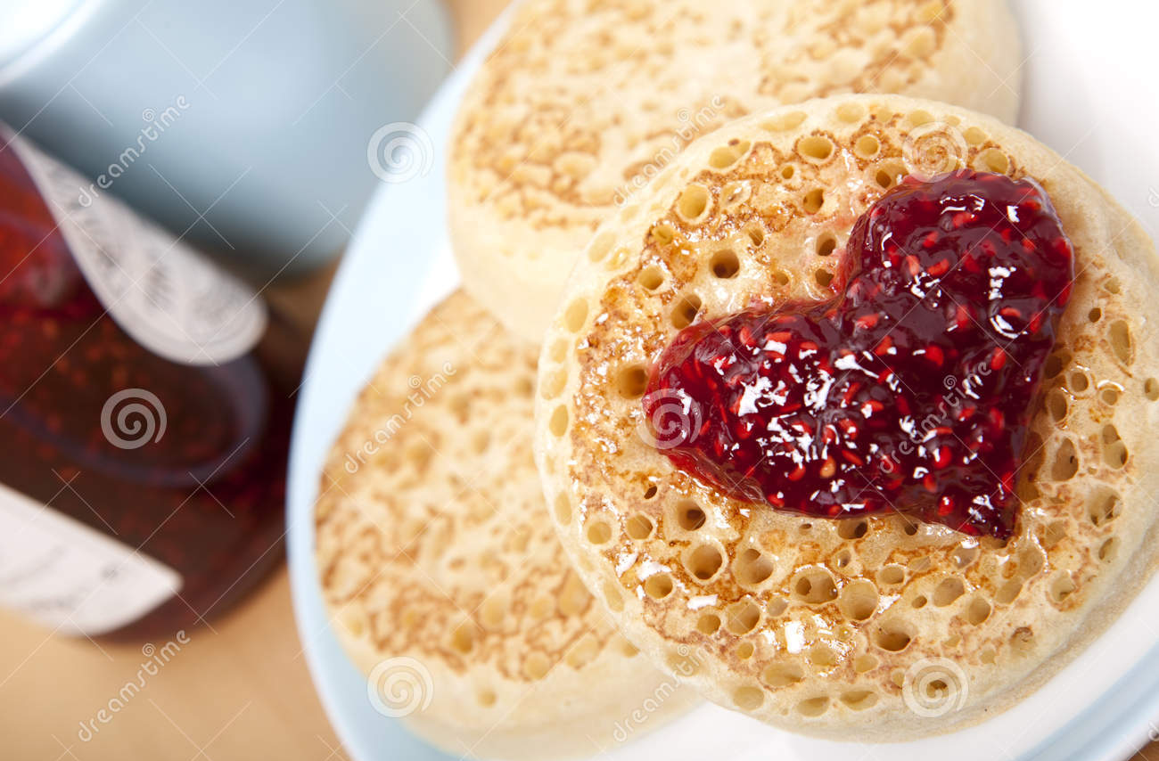
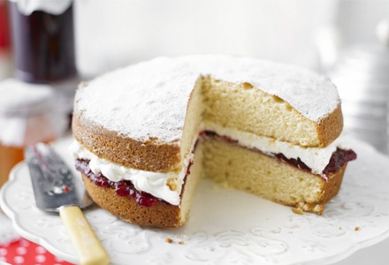
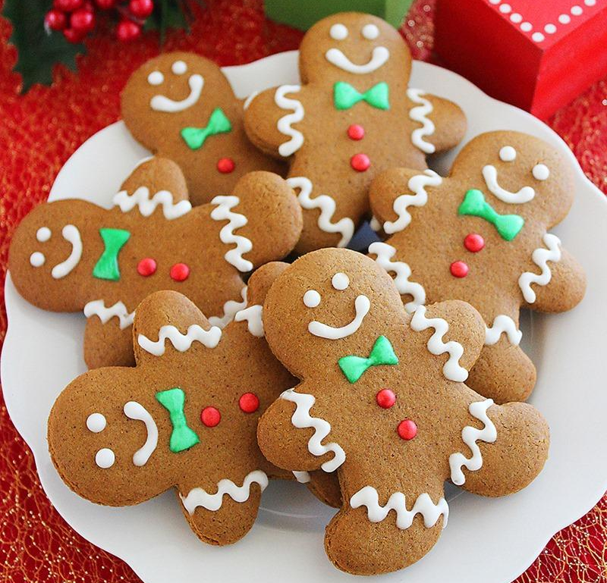
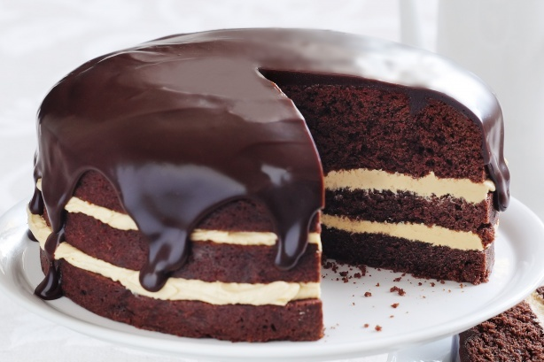
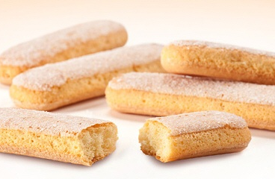

Slide 9
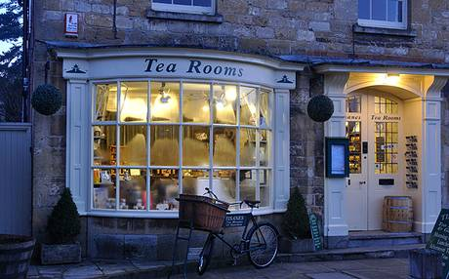
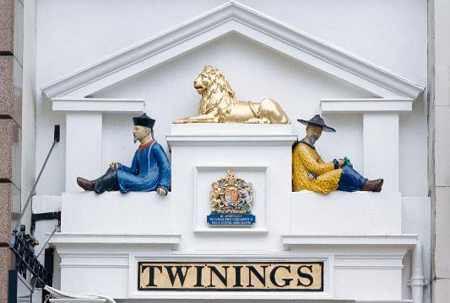
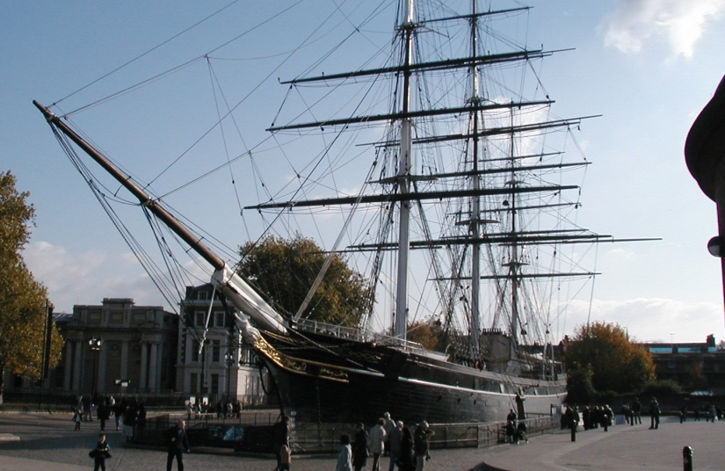
These days much is being done to restore old traditions. Tea rooms and museums that carefully store anything associated with tea are very popular. For a long time the Cutty Sark – the last of the tea clippers – stood at Greenwich and was visited by thousands of tourists interested in the history of tea. Unfortunately, it was destroyed by a fire in 2007. The ship was 138 years old.

Slide 10
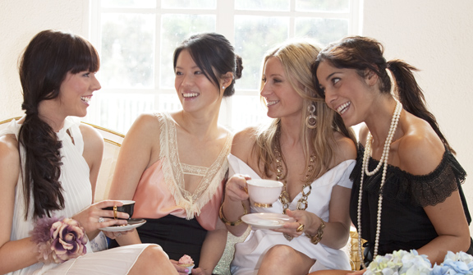
The essence of tea-drinking has not changed. Tea is drunk with milk, usually from china cups. The atmosphere is more important than quality of the food and the tea. Finally, tea should not be drunk in a hurry and should be accompanied by friendly conversation.

Slide 11
Thank you for your attention!

