Slide 1
Dresscode (Western)

Slide 2
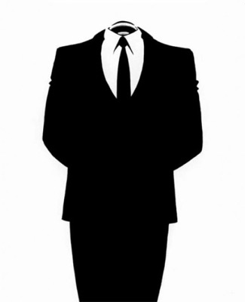
For a long time not a secret that the clothes speak about the person without words. How we are dressed, it is possible to draw certain conclusions on our personal features, style of communication and the relation to work. And if in personal contact some negligence in a choice of clothes is admissible, in business relations clothes style and the general ukhozhennost play a basic role. Proceeding from it, I ripened need for emergence of the dresscode assuming observance of rules of a choice and carrying clothes in certain situations. The special attention is paid to a corporate dresscode as the majority of people carries out the most part of the time at work.

Slide 3
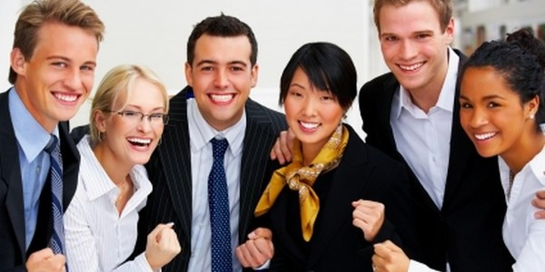
In our country the concept "dresscode" appeared in the early nineties with arrival of the foreign companies on the market. The attitude towards him was very superficial. Existence of a dresscode was regarded as a sign of the progressive serious company. At present the understanding of this phenomenon much more went deep, need of a similar component of corporate culture as instrument of development of business began to be realized by many employers and their employees.

Slide 4
Corporate dresscode - a fundamental link of corporate culture and image of the company. When we are included into any office, first of all we pay attention to appearance of employees. Combination of an official style to elegance - the distinctive feature of staff of the companies in whom each expert respects and appreciates itself, working over the image for achievement of common goals.

Slide 5
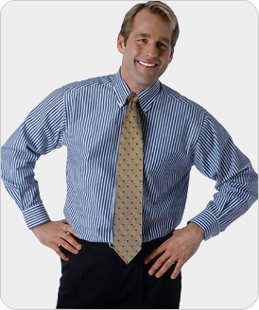
The dresscode, in other words, is the set of rules which observance is obligatory. The main goal of a dresscode - to create a certain notion at the client about quality of work and service level.
Appearance of the personnel — this direct continuation of corporate culture. It is a way to show a good shape of affairs in the company, respect for clients and business partners, and also helps clients not to distract at the solution of serious questions. Also introduction of restrictions disciplines employees, adjusts on a business harmony, defines the status of the person, creates feeling of uniform team at collective, prevents the conflicts which could arise because of too different understanding of that is pertinent and that isn't present.

Slide 6
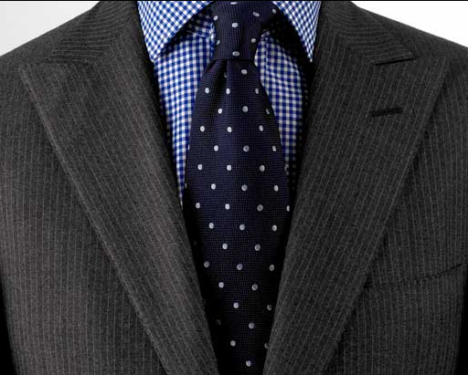
The clothes, undoubtedly, influence how the person feels, and it affects results of his work. The dress code in many respects defines behavior of each person. If the dresscode is a part of corporate image, image is formed at the expense of company philosophy: its missions, values, and also are more whole to which she aspires.
Clients and partners of the company perceive the tightened appearance of the personnel as one of reliability and wellbeing signs. Moreover, the dresscode carries out one more important function – the general clothes style unites employees and promotes formation of solid team.

Slide 7
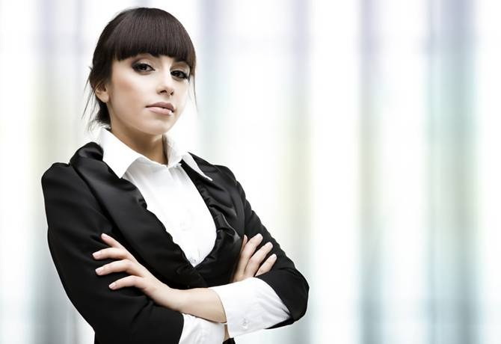
Relevance of introduction and dresscode observance in the companies is caused by several reasons.
First, it is competition growth. To the companies there was everything more difficult and more difficult to be allocated against other players of the market, to draw attention and to be remembered to the client. The corporate dresscode can just become strong competitive advantage of the company. In combination with advertizing advance the uniform or its separate elements are an integral part of a brand.

Slide 8
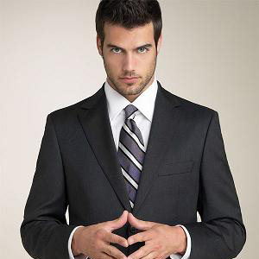
Secondly, development of corporate culture. The dresscode is part of a package of measures on maintenance and development of uniform corporate standards, and it is an important task for the large company. When the organization includes some thousands of employees over all country, the general standards allow to sustain uniform model of the organization, uniform standards of business.
Therefore the dresscode acts as the element of corporate culture uniting all employees, and motivating personnel to adhere to the general principles of the company.

Slide 9
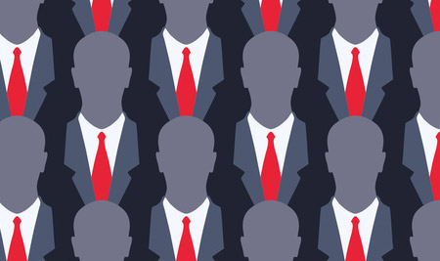
Dresscode — it always the element influencing image of the organization. In its advantage the following arguments testify:
The strict clothes discipline, adjust for work while free style discourages.
Clients and partners perceive the tightened, business appearance of the personnel as a sign of reliability, wellbeing.
The person adhering to norms in clothes, involuntarily will conform more strictly and to other rules.
The general style in clothes, and in even bigger degree the uniform form unites people, promotes formation of a community, team.
To modern office with its laconic interior from the esthetic point of view more there correspond business clothes of employees.
The firm clothes are a peculiar advertizing carrier, it bears information on the company, promotes increase of recognition of its trademark.

Slide 10
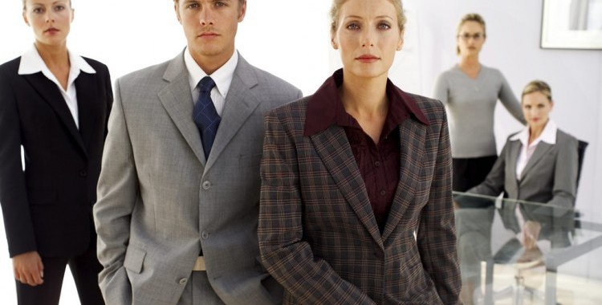
Arguments of opponents of uniformity in clothes are most often reduced to the following:
At work we carry out the most part of life, and a business suit — not the most comfortable clothes. In more free clothes of people feels more conveniently and raskovanny.
Need to wear even during a heat a suit with long sleeves and especially stockings, not only causes discomfort, prevents to work, but also is capable to do harm to health. In the same way, as a ban in a cold season on warm things.
Not always the salary allows employees to look and buy decently expensive business clothes, and to tear off the considerable sums from a family to conform to requirements of the employer, everyone is ready far not.
To many employees, especially women, it isn't pleasant to look "as all" and the whole year to carry same. Especially, if the model is unsuccessful or doesn't approach to figure type.
Seeking to save, the companies often order cheap clothes which quickly lose a look.

Slide 11
Generally, office dresscode influences a psychological state of employees doubly. On the one hand, it repays a certain identity, and with another adjusts on a business harmony, on effective implementation of the professional tasks. The "identical" clothes help employees to identify itself with the company, improve interaction in team. It is very important aspect as the business dresscode is considered by many as the instrument of formation of image of the company in environment.

Slide 12
Thank for your attention!

