Slide 1
Ecology
Сергеева Ирина Александровна (преподаватель иностранного языка, СПб ГБУ "Высшая банковская школа")

Slide 2
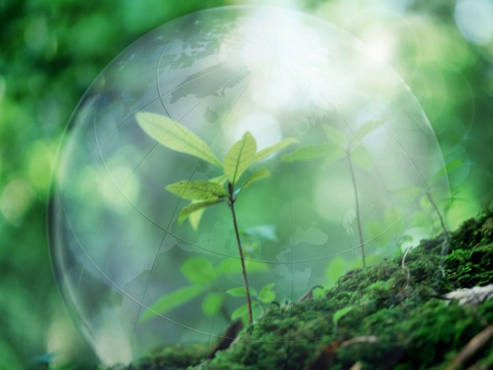
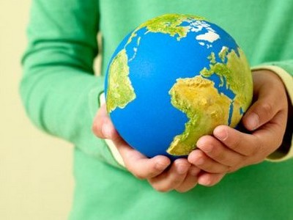
Ecology is the study that helps to preserve the Earth, its plants and animals. It is also supposed to study the environment and the relationship between human activities and nature.

Slide 3
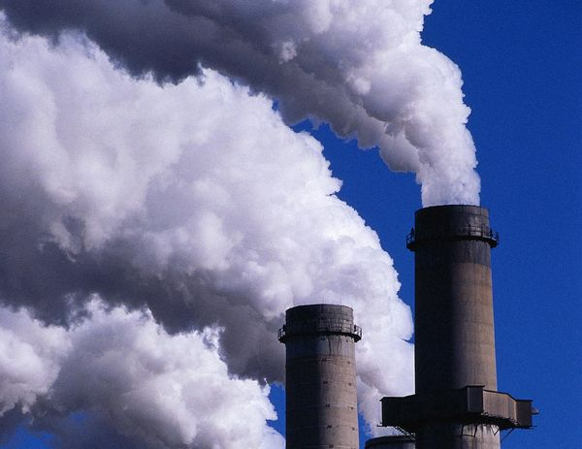
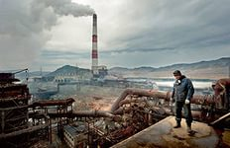
At present times we have to face such ecological problems as acid rain, global warming, loss of rare species, ozone reduction, etc. Many scientists think that it is connected with industrial boom and development of civilization in the world.

Slide 4
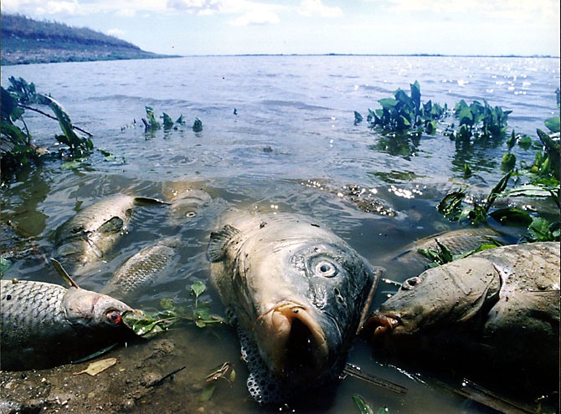
Every year world industry pollutes the atmosphere with tons of dust and other harmful things. As a result many species of animals and plants disappear forever, including fish and birds.

Slide 5
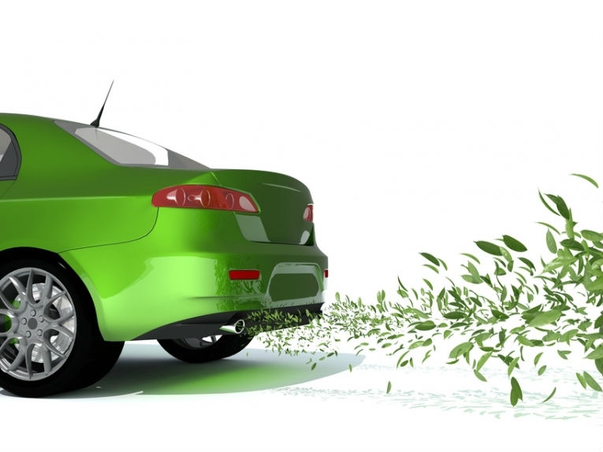
Apart from factories there are lots of vehicles in the streets of every more or less developed city. It includes cars, motorbikes, buses, minivans, trucks and other types of transport which use fuel.

Slide 6
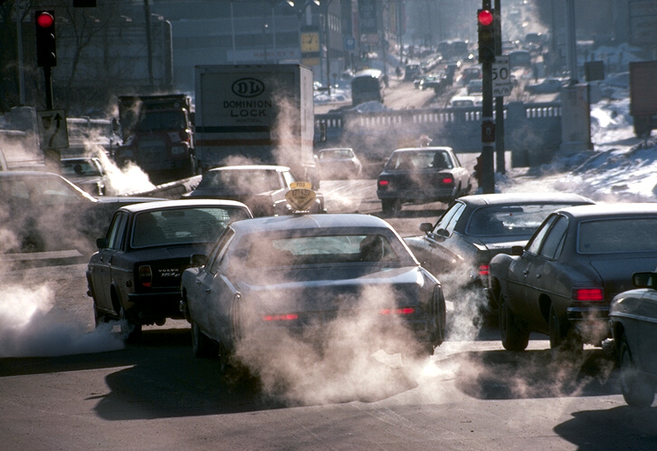
First of all, they exhaust toxic gases into the air. Secondly, they are considered to be the main noise offenders in the city. This problem progresses as the number of cars increases from year to year.

Slide 7
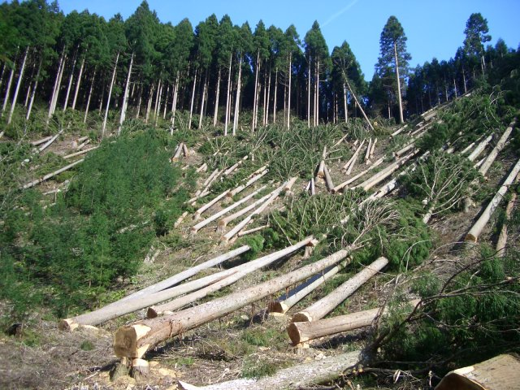
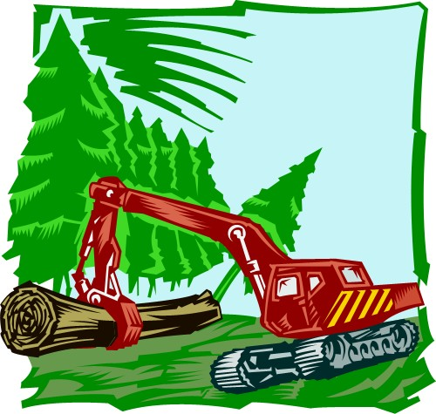
Another problem which is worth mentioning is the tree cutting. Trees are a source of oxygen and clean air. So, by doing this people simply violate the biological balance.

Slide 8
thank you for your attention

