Slide 1
Разработчик проекта: Ледовских Людмила Адамовна-преподаватель английского языка
Государственное образовательное учреждение
среднего профессионального образования
«Яшкинский техникум технологий и механизации»
Добро пожаловать
в королевскую
семью

Slide 2
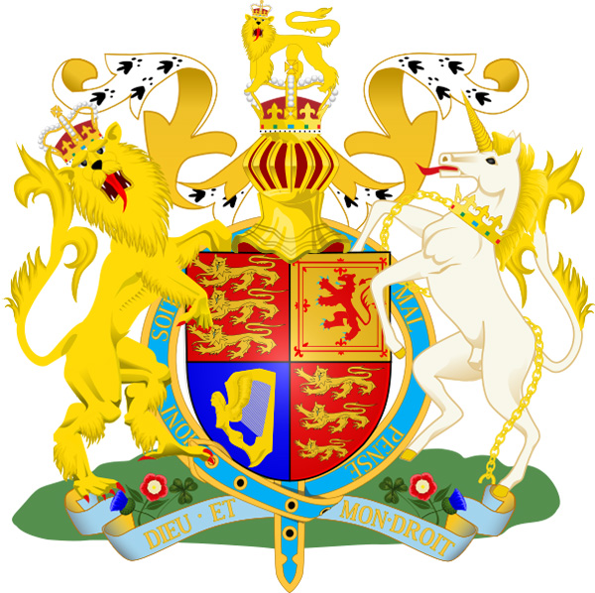
The arm of the United Kingdom
of Great Britain
and Northern Ireland

Slide 3
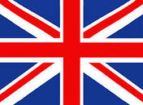
The flag of the United Kingdom
of Great Britain and Northern Ireland
It is named Union Jack It consists
of the flags of Scotland,
Wales, England, Nothern Ireland

Slide 4
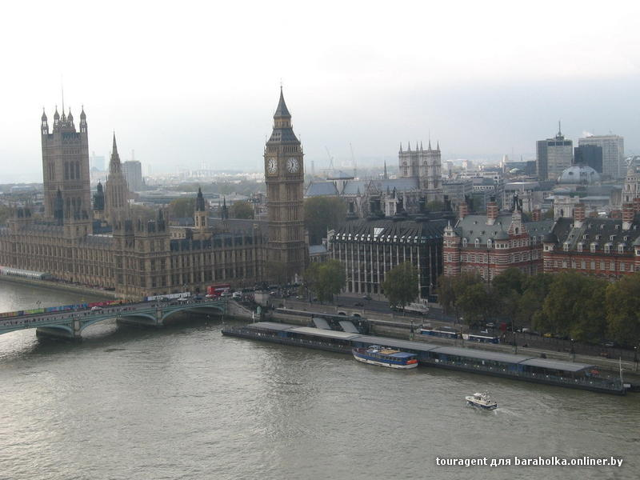
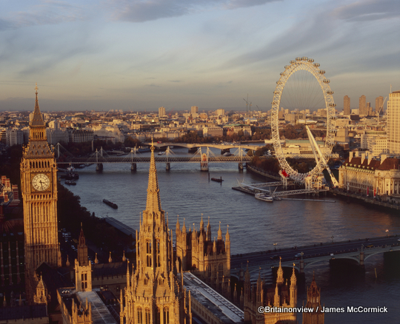
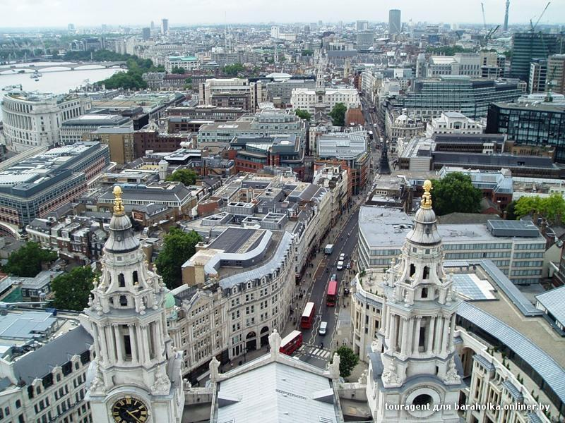
London is the capital of the UK It stands on the river Thames
8 million people live in it
Big Ben is the symbol
of Great Britain

Slide 5
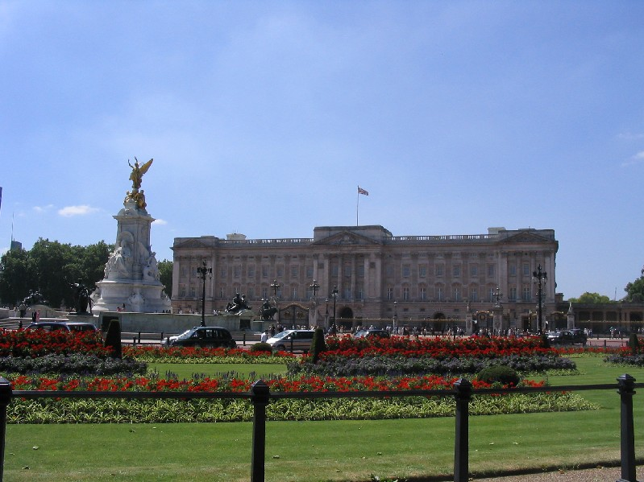
Buckingham Palace built in 1705 is the official royal residence-the place where the queen and her family live

Slide 6
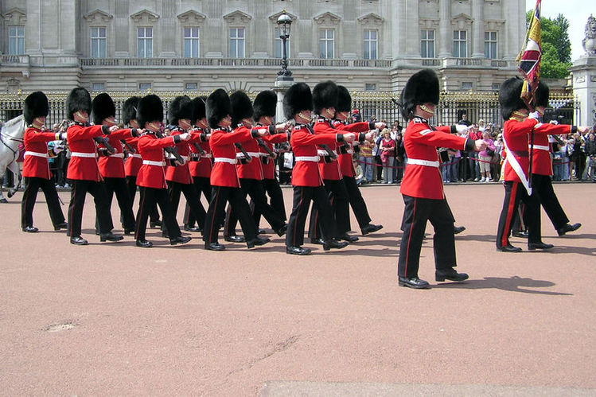
New Queen’s guard replace the Old Queen’s Guard

Slide 7
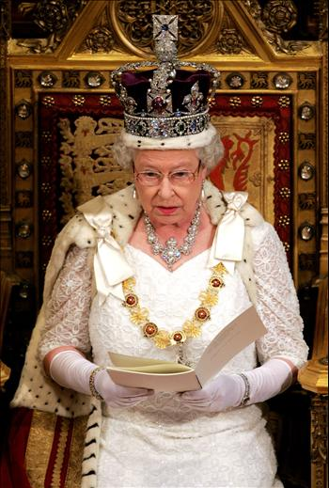
The Queen Elisabeth II
Born in 1926
In 1952 she became the Queen of Great Britain and Northern Ireland
Rules the country over 60 years
The people
respect their Queen

Slide 8
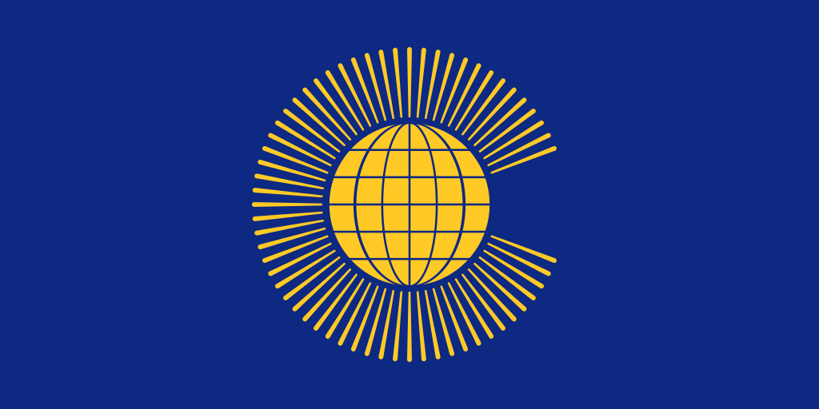
Flag of the British Commonwealth 0f nations
Traditionally the Head of the British Commonwealth is the British monarch.
Elizabeth 2 is the Head of the British Commonwealth

Slide 9
the British Commonwealth 0f nations -53 countries

Slide 10
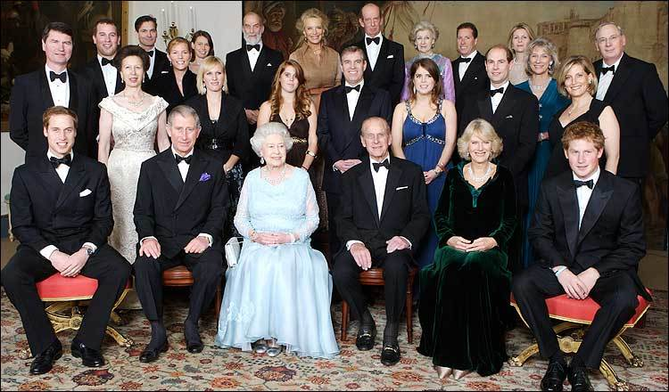
The Royal family: 3 sons, a daughter, grandchildren and relatives

Slide 11
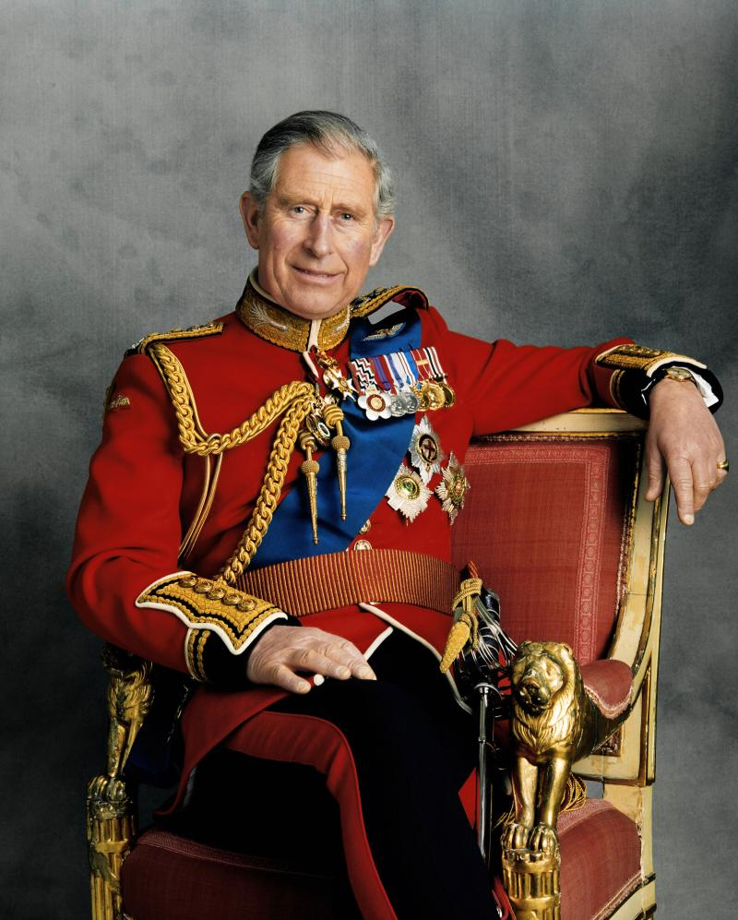
Prince Charles
Queen’s the eldest son born in 1948. Charles’ sons: William
and Harry

Slide 12
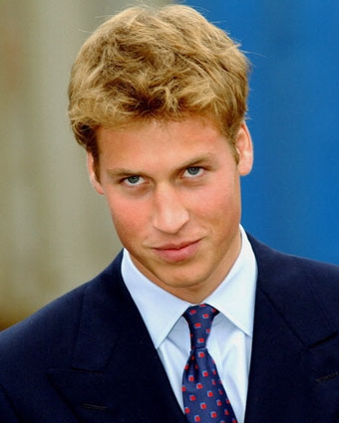
Prince William
The eldest Charles’son
A future king
of the
UK
born in
1982

Slide 13
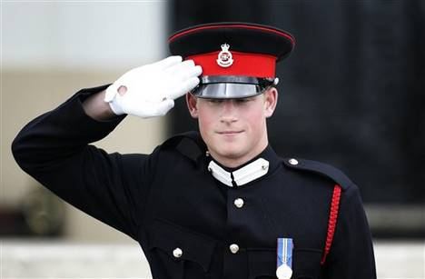
Prince Harry the youngest Charles’ son born in 1984.

Slide 14
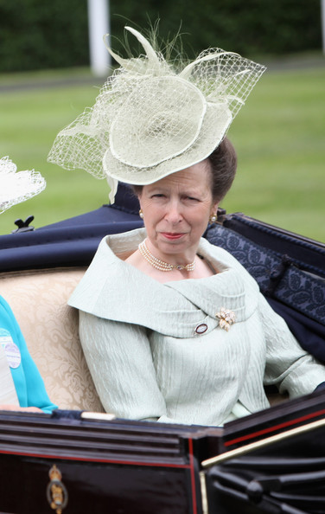
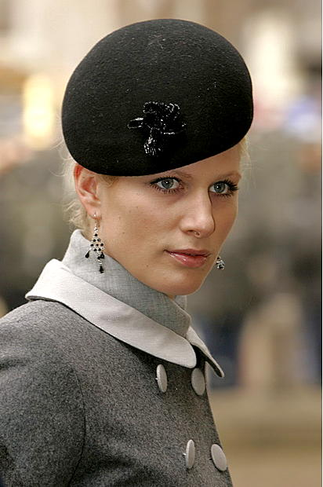
The Queen’s daughter
Princess Anna
Her children:
Peter, Zara.

Slide 15
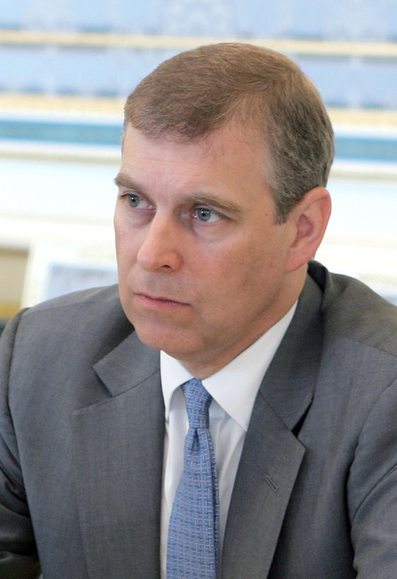
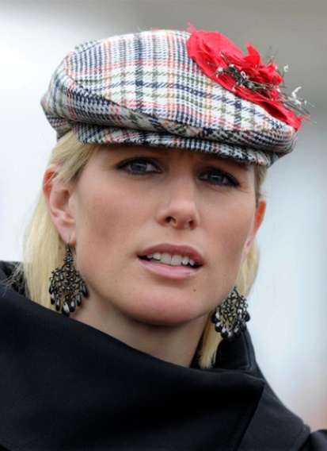
The second Queen’s son Andrew
His daughters:
Princess Beatrice, Princess Eugenie

Slide 16
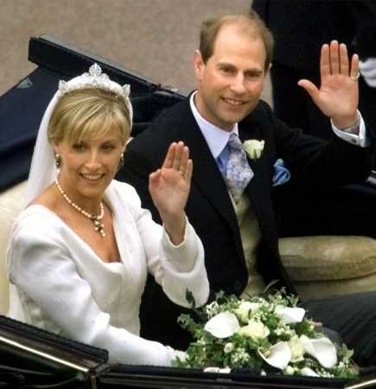
Queen’s the youngest
son Edward
They have
two children:
a daughter
Lousa
and
a small son
James

Slide 17
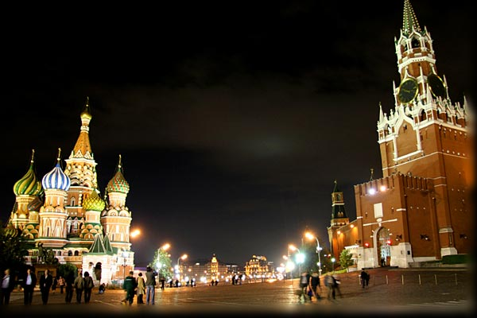
1994 the Queen made a historic visit to Russia

Slide 18
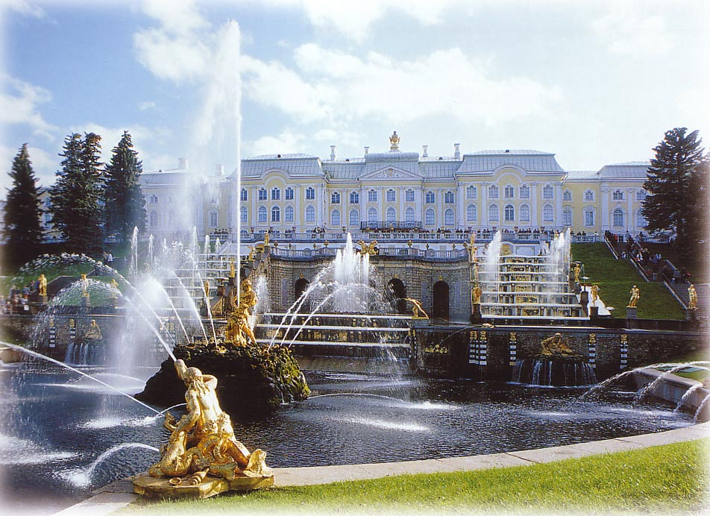
1994 Prince Charles made a business visit to Saint-Petersburgh together with the queen.

Slide 19
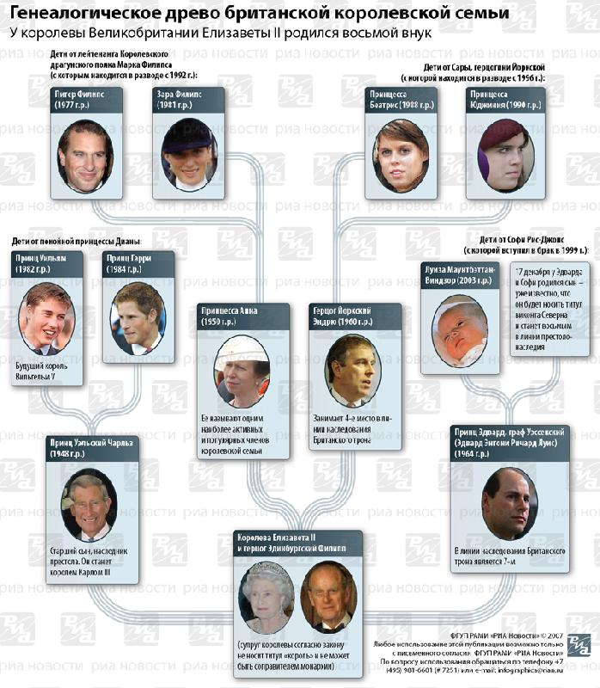
Genealogy of British queen family

Slide 20
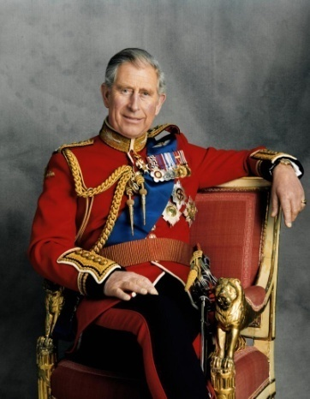
3 Prince George
Ascenders ( наследники) of the throne of Queen Elizabeth II
1.Prince Сharles
2.Prince William
4.Prince Harry

Slide 21
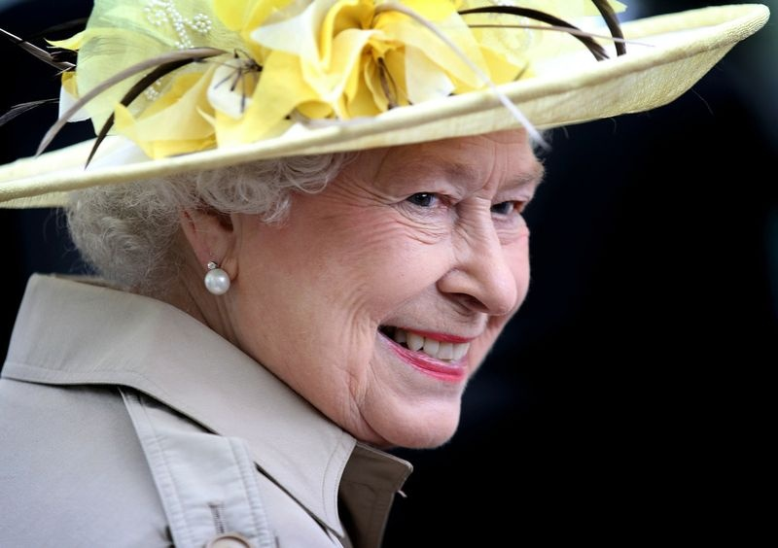
English monarchy
Queen Elizabeth II is the head of the United Kingdom of Great Britain and Northern Ireland.She is descended (произошла) from Saxon monarch’s dinasty of Windsor –Mountbutton) The Queen is a constitutional monarch and plays a ceremonial role. She reigns but she has no real power. She acts on the advice of the Prime-minister and Parliament

Slide 22
Список источников.
hhhhttp://yandex.ru
1. Best of Britain’s Castles produced by AA Publishing c AA Media Limited 2009
2. Landmarks of Britain by Lisa Pritchard published in 2006 by Myriad Books Limited 35 BishopsrhorpeRoad,LondonSE26,PA 3. Безкоровайная Г.Н. Кайнранская Е.А., Соколова Н.И.,Лаврик Г.В. Учебник английского языка для НПО И СПО “ Planet of English”. 2011г.
4.Тимофеев В.Г., Вильнер А.Б., Колесникова И.Л. и др. Учебник английского языка для 10 класса (базовый уровень) / под ред. В.Г. Тимофеева. – М.: Издательский центр «Академия», 2007.
5. Тимофеев В.Г., Вильнер А.Б., Колесникова И.Л. и др. 6.Рабочая тетрадь к учебнику английского языка для 10 класса (базовый уровень) / под ред. В.Г. Тимофеева. – М.: Издательский центр «Академия», 2007.

